Slide 1
Apeejay School of Management, New Delhi
ACBSP: Our Journey

Slide 2
Apeejay’s Journey
Working towards accreditation
Receiving accreditation
Working on areas of improvement
Continuous improvement

Slide 3
Working Towards Accreditation: The Beginning
Collective Agreement
Collective Ownership
Timelines and Budget

Slide 4
Progress Towards Prelim Report
Formation of Core Team – Champion and Co-Champions
Standard Owner – Lead and team members for each standard
Extensive review process with Director and Dean

Slide 5
Progress Towards Prelim Report
Understanding Standards
Regular Interaction with Mentor
Extensive Vision and Mission Development Process
Minutes and documentation
Evidences for everything we do

Slide 6
Vision
To be the most preferred management school known for creation of valuable business leaders

Slide 7
Mission
We nurture globally competent, socially sensitive and ethically sound managerial talent to lead businesses and organisations.
We inculcate creative thinking and problem solving skills through a dynamic curriculum in an interactive learning environment.
We do this with a set of committed faculty, deeply engaged in both creation and dissemination of knowledge strengthened by a rich academic and industry interface.

Slide 8
Responsibility Centres
Responsibility Centers for Standards and Criteria with timelines

Slide 9
Preparing the Self Study Report
Regular Review and Feedback
Collection of Evidence for each Criteria
Cross Referencing

Slide 10
Preparing for Site Visit
Preparation of documents
Schedule of site visit
Site Visit Report
Response to Site Visit Report

Slide 11
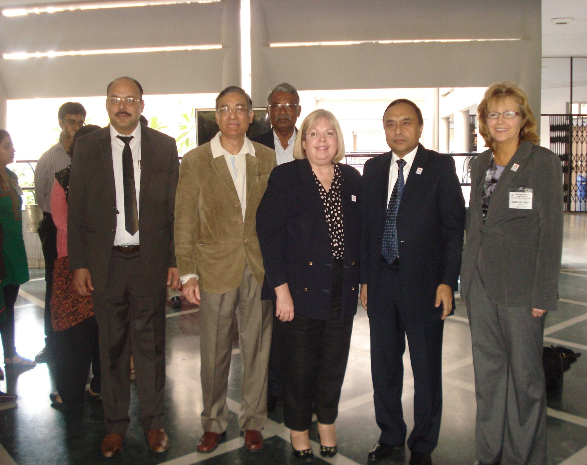

Slide 12
Continuous Improvement
Curriculum development as per Bloom’s Taxonomy
Professional Skills development
Assessment based on Learning Outcomes
Result Analysis and Action Plan
Policy Manual
Stakeholder Feedback and Action Plan

Slide 13
Matching Mission & Program Objectives
From the Mission to the Program to Courses
Courses
Common Professional Component
Professional Skill Development
Core Values
Course(s) Objectives
Bloom’s Taxonomy
The Learning Outcomes

Slide 14
Professional Skill Development
Mission of ASM
Program Objective and Program Outcomes
List of Professional Skills
Clarity of Concepts (CC)
Application Skills (APS)
Analytical Skills (ANS)
Creativity (CRT)
Problem Solving Skills (PSS)
Initiative (INT)
Communication Skills (CMS)
Team Work (TEW)
Profession Skill Development

Slide 15
Program Outcomes | Outcome | Professional Skill Development
Demonstrate an in-depth understanding of the body of knowledge in core and functional areas of business management. | Knowledge Outcome | Clarity of Concept This is measured by how well a student has understood the fundamental content, core concepts, basic principles of the courses taught and is able to recall the same

Slide 16
Program Outcomes | Outcome | Professional Skill Development
Interpret management problems in both domestic as well as global contexts Analyze complex business problems in changing global scenario and take critical decisions, keeping the larger good, as well as, societal interests in mind. Successfully apply creative and analytical thinking with a systems perspective to determine solutions. | Skill Outcome | Application Skills, Analytical Skills, Problem Solving Skills This is measured by the ability of students to apply the knowledge learnt in class in various situations given and critically analyze problems and develop solutions

Slide 17
Program Outcomes | Outcome | Professional Skill Development
Demonstrate continuous learning Orientation Contribute towards well-being of the society Choose ethically appropriate options while making decisions | Attitude and Value Outcome | Ethical Intent, Societal Concerns

Slide 18
Program Outcomes | Outcome | Professional Skill Development
Take initiative and work in teams to achieve organizational goals Interact effectively with various stakeholders of business | Behavioral Outcome | Team work, Initiative, Communication Skills This is measured by Teamwork, Initiative and Communications Skills displayed by students in different activities, assignments, projects completed during continuous assessment

Slide 19
Quality Assurance

Slide 20
The Quality Policy of the institute focuses on:
Continuous improvement in strategic planning and leadership that promotes performance excellence;
Curriculum development in line with industry requirements;
Accomplishment of learning outcomes through pedagogical innovations and continuous improvement in assessment processes;
Human Resource effectiveness through appropriate planning, deployment and performance management of faculty and staff;
Stakeholder satisfaction through regular feedback and proactive interventions

Slide 21
ACTIVITIES OF QA CELL- CURRICULUM DEVELOPMENT
Curriculum Development for achieving International Standards
Collection of revised course outlines as per Bloom’s Taxonomy
Alignment of Curriculum as per Bloom’s Taxonomy
Bloom’s Taxonomy Workshop was conducted among the faculty
Approval of competent authority and finalizing Course Curriculum for implementation

Slide 22
ACTIVITIES OF QA CELL- RESULT ANALYSIS
Development of a performa for continuous student assessment (Professional Skill Development)
Analysis of students’ results
Discussion of student performance with respective area heads for closing the loop
Compilation and discussion of strategies advised by Area Heads for student improvement
Sending to Area Heads and respective faculty for final implementation and execution

Slide 23
ACTIVITIES OF QA CELL- FEEDBACK MECHANISM
Identification of stakeholders and designing/ revision of all feedback forms
Validation of Feedback Forms and finalization
Analysis of data collected from different feedback forms
Implementation of feedback mechanism
Closing the Loop- Taking corrective measures after feedback data analysis

Slide 24
Our Stakeholders
Current Students
Alumni
Prospective students
Faculty
Staff
Recruiters/ Corporate
Parents

Slide 25
S. NO. | STAKE HOLDERS | GATHERED AT THE TIME OF | FREQUENCY | SUBMISSION TO QA TEAM
1. | Alumni | Alumni Meet | Twice in a year | Within a week of Alumni Meet
2. | Corporate | Summer Internship | Every Year | Last week of July every year
3. | Students | Industrial Visit | After every visit | Within two days of the visit
4. | Students | Guest Lecture | After every Guest Lecture | Within two days of the Lecture
5. | Participants (Academia and Corporate) | FDP/ MDP/ Workshop | During the FDP | Within two days of the workshop

Slide 26
S. NO. | STAKE HOLDERS | GATHERED AT THE TIME OF | FREQUENCY | SUBMISSION TO QA TEAM
6. | Students | Mid- term exams (about teaching pedagogy of respective faculty members) | After every mid- trimester exam | Within a week
7. | Parents | Beginning of 2nd Trimester | Every year | Within a week
8. | Prospective Students | Beginning of 1st trimester | Every year (June/ July) | Within a week
9. | Recruiters | Company Visit at the campus or off campus | After every company visit | Within two days
10. | Faculty & Staff | Every Year About Infrastructure | Every year (Mid- December) | Within a week
11. | Students | Every Year About Infrastructure | Every year (Mid- December) | Within a week

Slide 27
A Journey of Continuous Improvement
Focus on systematic record keeping
Data based decision making
Cloud based data aggregation
Alignment of policies and processes
Facilitated other accreditations
Focus on continuous quality improvement

Slide 28
Thank You

