Slide 1
Accreditation with a Difference
SEAA Conference
Delhi, India
November 7, 2017

Slide 2
History of ACBSP
Founded in 1988 for teaching and learning focused institutions.
In 2007 re-oriented standards and criteria to the Malcolm Baldrige National Quality Award
CHEA Scope: ACBSP accredits business, accounting, and business-related programs at the associate, baccalaureate, master, and doctorate degree levels worldwide.
Offers separate accounting program accreditation (associate and back/grad)
Explicit focus in on maintaining scalable, accessible, and cost-effective accreditation pathways

Slide 3
Mission, Vision, and Values
Mission –
ACBSP promotes continuous improvement and recognizes excellence in the accreditation of business education programs around the world.
Vision
Every quality business program worldwide is accredited.

Slide 4
Largest Business Program Accreditor
1,175 | Member Campuses
985 | Baccalaureate/Graduate Degree
188 | Associate Degree
255 | Outside the United States
60 | Different Countries
6 | Continents
13,000+ | Individuals
939 | Institutions with Accredited Business Programs
154 | Candidates for Accreditation
82 | Not Yet Seeking Accreditation
Largest globally in terms of students served

Slide 5
Branding your school and ACBSP
Branding to Promote Candidacy
or Accredited Status

Slide 6
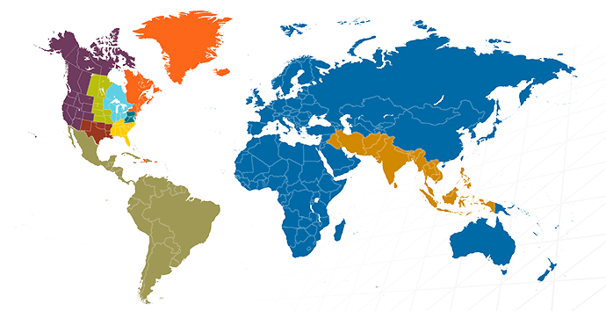
ACBSP International Regional Structure
Region
8
4
1
7
5
6
3
Region
10
Region
9
Offices globally:
HQ – Kansas City, USA
European HQ – Brussels
Latin America – Lima, Peru

Slide 7
ACBSP Embraces International Accreditation Principles
Member of CHEA and CHEA International Quality Group (CIQG)
Includes 7 CIQG International Quality Principles
Through CIQG in alignment with:
2005 UNESCO-OECD Guidelines for Quality Provision in Cross-Border Higher Education
2007 INQAAHE Guidelines of Good Practice for Quality Assurance
2008 Chiba Principles: Higher Education Quality Assurance for the Asia Pacific Region

Slide 8
The Baldrige Framework for Performance Excellence
Baldrige program originated in 1988
Current serves 6 (soon 7) sectors
Manufacturing
Service
Small business
Education
Health Care
Nonprofit / Government
(Communities of Excellence)
Over 30 years the Framework has evolved to a comprehensive stakeholder-based model
The Baldrige program is part of GEM (Global Excellence Model) Council with programs such as China Quality Award, EFQM, Japan Quality Award, SPRING Singapore
Baldrige is actively used by Tata Business Excellence and Max India

Slide 9
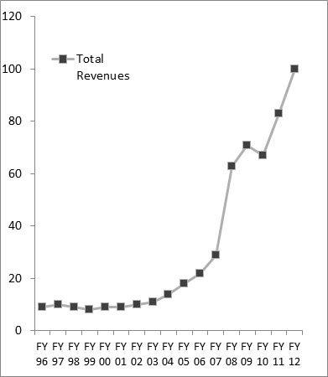
Tata’s Journey with Baldrige—A study in quality growth
Growth with the Baldrige-based Tata Business Excellence Model
"Making an Elephant Dance": How the Baldrige Criteria Helped Transform a Global Conglomerate
(https://www.nist.gov/news-events/news/2014/09/making-elephant-dance-how-baldrige-criteria-helped-transform-global)

Slide 10
ACBSP Standards
Standard 1: Leadership
Standard 2: Strategic Planning
Standard 3: Student and Stakeholder Focus
Standard 4: Measurement and Analysis of Student Learning and Performance
Standard 5: Faculty and Staff Focus
Standard 6: Educational and Business Process Focus

Slide 11
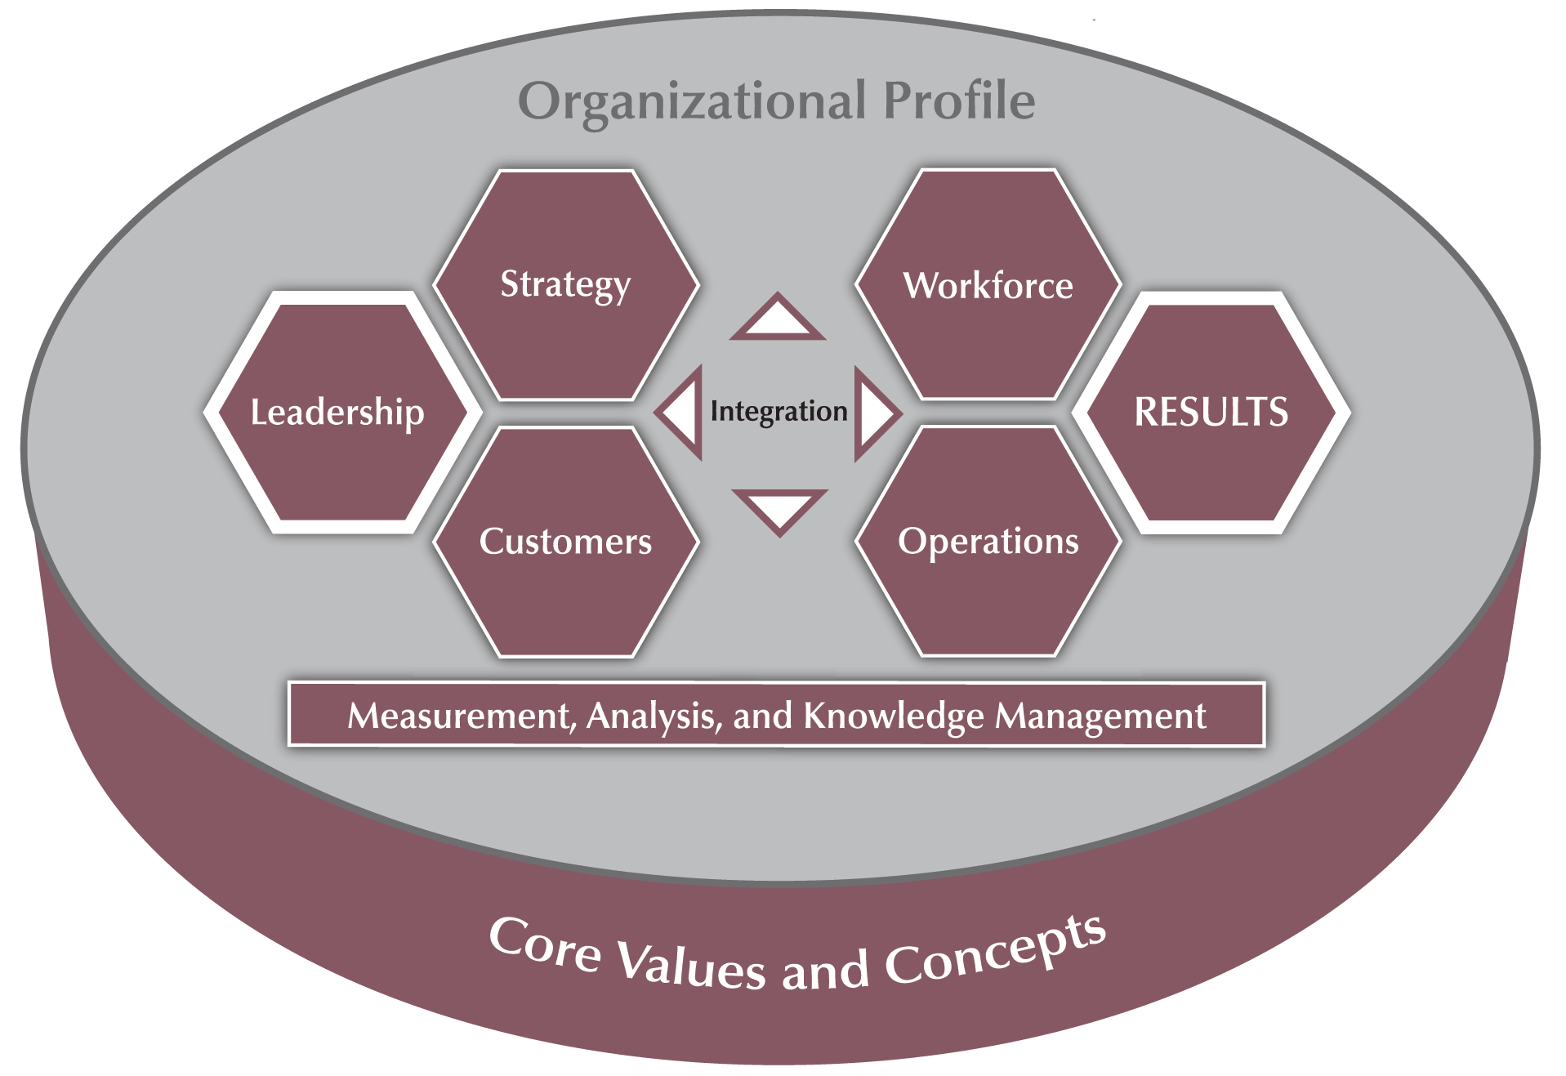
Embracing the Baldrige Framework for Performance Excellence
ACBSP Standards mirror Categories 1 to 6 of the Baldrige Framework for Education
Balanced focus on process and results
Evaluation system and feedback based on Baldrige model—
For processes—ADLI (Approach, Deployment, Learning, Integration)
For results—LeTCI (Levels, Trends, Comparisons, Integration)

Slide 12
ACBSP Accreditation Process
Interest
Member
Candidate
Accredited
Teaching excellence focused program
Institutional accreditation in place
Mentorship process
Self-Study, site visit, Commission decision
Typical timeframe: One to four years
12

Slide 13
Examples of Flexibility of Baldrige Approach
Leadership
Use of curriculum clusters for programs
No hierarchical dean structure
Strategic planning
Traditional goals and objectives
Use of strategic business units
Student advising
Faculty-based model
Professional advisor model
Curriculum development
Backwards Design
Quality Matters
ISO 9001:2008 Quality Management System
Faculty
Small (15) to very large (5,000+) faculty
Adjunct / tenure / non-tenured supported

Slide 14
Ah-Ha’s for Candidates
A process improvement system is required
Accountability and transparency of assessment results (CHEA required)
The business school has autonomy
A need for robust student segmentation
Assessment of learning must have trends and external benchmarks
Mission appropriate faculty research and scholarly activities (Boyer model)
Must demonstrate improvements based on data

Slide 15
Going Beyond Accreditation

Slide 16
Why Going Beyond Accreditation (GBA)?
A recognition that accreditation is a journey not an award or status
Facilitating partnerships in performance excellence
Baldrige program
EFQM
Quality Matters
Staying current with changes in trends in education
Evolution of degrees
Certificates
Competency-based education

Slide 17
Accreditation of Certificates
Certificates are a key growing part of how business education is delivered.
Pilot program for accreditation of certificates (for accredited programs)
Launch Summer 2018
Full roll out in 2019
Criteria will be specific to curriculum elements
In discussions with Quality Matters for curriculum excellence models

Slide 18
Excellence Tiers Recognition

Slide 19
Global Excellence Influences
Excellence🍁Canada
EFQM
EFQM
Baldrige
China QA
EFQM
Baldrige
EFQM
What is quality management is no longer a mystery
19

Slide 20
in understanding business program excellence
Rankings (WSJ, FT, Fortune, Forbes, Economist, BW, India BT, etc.)
Elite programs
What is Excellence?
The gap
Quality Business
Programs
Specialized
Accreditation
Threshold
Quality
Regional Accreditation /
National Authorization

Slide 21
Where differences cause the gap?
 | Input Quality | Process Quality | Outcomes Quality | Scoring
Rankings | Selected | Selected | Selected | Selected elements
National Baldrige / EFQM Global Excellence |  |  |  | Comprehensive / Role Model Reference
Alliance Baldrige / EFQM Committed, Recognized |  |  | () | Comprehensive / Minimum Level Focused
Specialized Accreditation |  |  |  | No
Regional Accreditation / National Authorization |  | ✪ | ✪ | No
 Comprehensive  Holistic  Partial
Lacks systems view
Process & outcomes not fully assessed

Slide 22
ACBSP Accreditation Process
Interest
Member
Candidate
Accredited
Teaching excellence focused program
Institutional accreditation in place
Mentorship process
Self-Study, site visit, Commission decision
Standards and Criteria align closely with Baldrige Criteria ca 2009-10 with results incorporated in Cat. 1 to 6
22

Slide 23
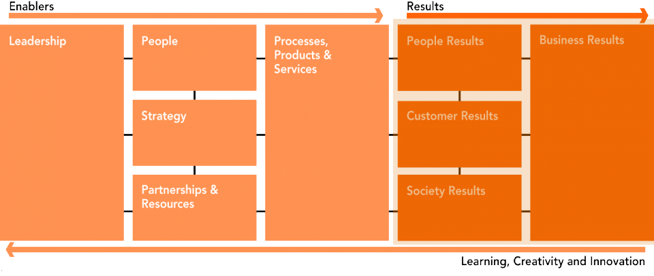
Using ACBSP to embrace Key Quality Frameworks

Slide 24
Additional Excellence Levels
Diamond
Alliance (Top tier)
EFQM R4Ex
Going Beyond Accreditation
Additional Award Tiers
Platinum
Alliance (Top tier -1)
EFQM C2Ex
Accreditation Plus
Excellence Document
Accredited
Candidate
Member
Interest

Slide 25
Accreditation Plus Level
Requirements
Provide an entry point into focused process excellence
Ensure that the key strategic components of a Baldrige Organizational Profile/ EFQM Key Information are in place
Student, Customer, and Stakeholder segments & requirements
Mission, Vision, and Values
Strategic Advantages
Strategic Challenges
Core Competencies
Competitive Environment
Strategic Context
Performance Improvement System
Set the stage for more involved process and results documentation
Delivery Mode
Application preparation: Coaching / mentoring model (Possibly supported by ManageHub Live)
Quality Framework: Baldrige Organizational Profile / EFQM Key Information
Judging: Completeness check by judging panel

Slide 26
Platinum Level
Requirements
Documentation of processes and results at the Basic and Overall Level (Baldrige Excellence Builder / EFQM Committed to Excellence)
Ensure processes and outcomes are documented, assessed, and scored
Baldrige – Baldrige Builder in Scorebook Navigator
EFQM - RADAR
Set the stage for later full document
No site visits
Delivery Mode
Application preparation: Coaching / mentoring model (Possibly supported by ManageHub Live)
Quality Framework: Use of adapted Baldrige Framework criteria or EFQM criteria (modeled after industry-specific models)
Scoring / Judging: Baldrige top tier minus one or EFQM Committed to Excellence (1,000 point model)

Slide 27
Diamond Level
Requirements
Documentation of processes and results at the Basic, Overall, and Multiple Levels (Baldrige Framework / EFQM Recognised for Excellence)
Ensure processes and outcomes are documented, assessed, and scored
Baldrige – Baldrige Framework in Scorebook Navigator
EFQM - RADAR
Site visit of high-scoring applicants
Delivery Mode
Application preparation: Coaching / mentoring model (Possibly supported by ManageHub Live)
Quality Framework: Use of full Baldrige Framework criteria or EFQM criteria
Scoring / Judging: Follows Baldrige state top tier or EFQM Recognised for Excellence (1,000 point model)

Slide 28
Benefits of GBA
Continue the journey towards performance excellence
Enhance the benefits of accreditation based on global principals for quality higher education such as CHEA
Align with world-class frameworks use by role model organizations—Baldrige, EFQM, Japan Quality Award, China Quality Award, etc.
Avoid the costs of additional programmatic accreditations
AND…Real world organizational experiential learning on how to manage change to performance excellence!

Slide 29
Questions / Comments

