Slide 1



Accreditation & after, the power of benchmarking with the best
ACBSP and Baldrige
Going Beyond Accreditation
Slides Produced by Dr. Doug Gilbert

Slide 2

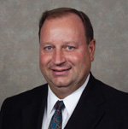
Presenter Contact Information:
Dr. Steve Parscale
ACBSP Chief Accreditation Officer
11520 W. 119th St.
Overland Park, KS 66213
Phone: 913-339-9356
Mobile: 913-526-5285
sparscale@acbsp.org

Slide 3

Characteristics of ACBSP Accreditation
Baldrige National Quality Program
ACBSP Accreditation standards are modeled on
Education Criteria for Performance Excellence
leading edge of validated management practices -forefront management practices that have been
proven to work in high-performing organizations

Slide 4

Benchmark Organizations
University of Wisconsin
Boeing Aerospace
Monfort College of Business
Honeywell
Charter School of San Diego

Slide 5
Benchmark Organizations
Westinghouse
Motorola
Xerox Corporation
Federal Express Corporation
IBM Rochester

Slide 6
Benchmark Organizations
The Ritz-Carlton
AT&T
Texas Instruments
Cadillac

Slide 7
Accreditation & after, the power of benchmarking with the best
Program Quality
Why?
Elite programs
Baldridge
Rankings
(WSJ, FT, Fortune, Forbes, Economist, BW, India BT, etc.)
Excellence
Gap
Filling a gap
ACBSP Accreditation Next
Quality Business
Programs
Specialized
Accreditation
Threshold
Quality
Regional Accreditation /
National Authorization

Slide 8
The power of benchmarking with the best
Input Quality
Process Quality
Quality Outcomes
Scoring
“Baldrige”
Role
Model



Specialized Accreditation



No
Regional Accr. National Auth.

✪
✪
No
Rankings
✪
✪
Rank

Slide 9
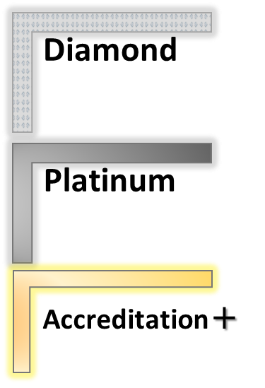

The power of benchmarking with the best
Tomorrow Baldridge
Today ACBSP Accredited

Slide 10
Introducing acbsp
Introducing ACBSP
ACBSP was established in 1988. Until then, only AACSB and EFMD were accrediting bodies for business schools.
Founding schools felt need for an alternative:
Focus on their mission of teaching excellence
Less prescriptive & more outcome based
Sensitive to mission driven schools
Recognize faculty comes from world of work
Offer accreditation to associate and diploma degree
schools (2-year or 3-year)
More affordability – Less expensive in dues and fees

Slide 11
acbsp Mission & Vision
ACBSP Mission and Vision
Mission
“ACBSP promotes continuous improvement and recognizes excellence in the accreditation of business education programs around the world.”
Vision
“Every quality business program worldwide is accredited.”

Slide 12

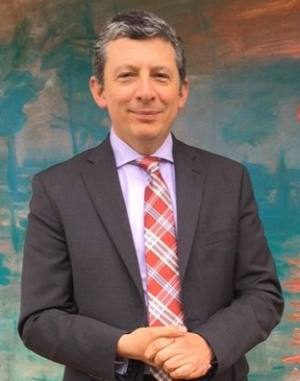
ACBSP Board of Directors
Alejandro Cheyne, Chair
Universidad del Rosario
(Colombia)
Kim Wong, Chair-Elect
Central New Mexico Community College

Slide 13
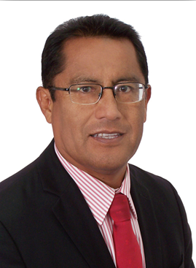
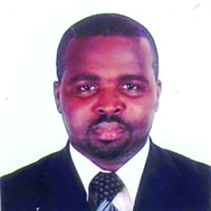
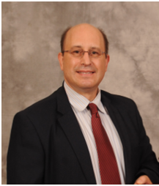
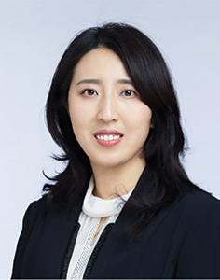
GLOBAL DIRECTORS
Dr. Wilfredo Giraldo
Director of Latin
American Operations
Dr. Abraham Lincoln
Owusu Kwame
Director of African Operations
Dr. Emil Gjorgov
Director of European Operations
Patty Peng
Director of Chinese Operations
ACBSP has three global offices including:
Lima, Peru; Brussels, Belgium; and Beijing, China

Slide 14

Membership
1,162 | Member Campuses
657 | Member Institutions
978 | Baccalaureate/Graduate Degree
184 | Associate Degree
254 | Outside the United States
60 | Different Countries
6 | Continents
13,000+ | Individuals
955 | Institutions with Accredited Business Programs
138 | Candidates for Accreditation
69 | Not Currently Seeking Accreditation

Slide 15

Theme was Transforming Students Through Recruitment, Retention, and Re-Entry
More than 750 in attendance
51 colleges and universities honored with initial and reaffirmation of their business programs

Slide 16
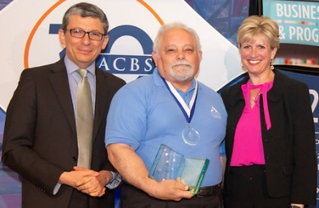
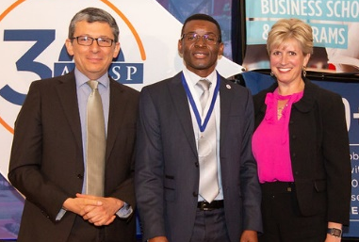
Teaching Excellence Award
The International Teaching Excellence Award nomination and application process is completely online and easier than ever:
Access the Teaching Excellence page on acbsp.org
Nominate a colleague using the form at the bottom of the page
Or… Complete a self-nomination application by clicking the link that takes you to the submission site (in English & Spanish).
Complete the application and answer the criterion responses and submit!
Deadline to submit is December 15th. Self nominations are accepted and encouraged! More information available at the ACBSP table.
LEFT: 2018 Region 6 Bacc/Grad Degree International Teaching Excellence Award Winner, David Dyson; RIGHT: 2018 Region 6 Associate Degree International Teaching Excellence Award Winner, Germain Pichop, with Immediate Past-Chair, Mary Vaughan, and 2018-19 Chair, Alejandro Cheyne.

Slide 17
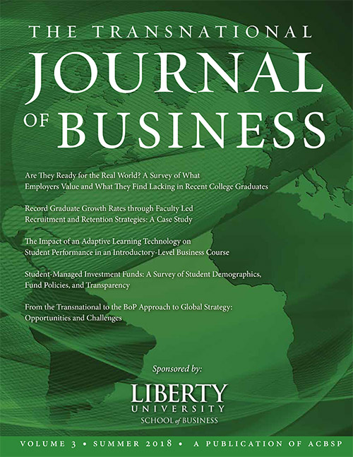
Transnational Journal of Business – Volume 3
The ACBSP Scholar-Practitioner Publications Committee is proud to announce the release of the third issue of The Transnational Journal of Business. The five articles selected underwent an extensive peer-reviewed process before being accepted for publication.
TJB Volume 3, published in June 2018, is available as a free downloadable PDF at acbsp.org/journal.
A printed version is also available for $20 per copy.

Slide 18

2018 Deans symposium
Join us in Washington, D.C. on November 9-11, 2018 for the 3rd Annual ACBSP Deans Symposium!
Our topics include:
• Strategies for being an Effective Dean
• Maximizing Resources and Fiscal/Economic Challenges
• Managing Technology in the Business Unit
• Innovation in Education/Entrepreneurship
Visit acbsp.org/mpage/ds for more information.

Slide 19

Save the Date: ACBSP Conference 2019
Join us in Houston, Texas on June 21-24, 2019 for the ACBSP Annual Conference!
The theme for the conference is
“The Art of Developing Entrepreneurial Leaders”.
Visit acbsp.org/page/events for more information.

Slide 20


Slide 21
Going Beyond Accreditation
ACBSP has a unique opportunity over the next two years to improve the member benefits and services, and enhance ACBSP’s brand. We are focusing on three initiatives:
Certificate Accreditation
Unified Accreditation Standards – Seven standards beginning January 2019
Accreditation Next
Notes:
Hand out the updated “Accreditation Timetable” one-sheet with the unified 7 standards on the back, and the “Accreditation Next” booklet - which is available for U.S. audiences (Baldrige) and European audiences (EFQM).

Slide 22

ACBSP Accreditation Process
Online Reporting Portal

Slide 23
Presenter Contact Information:
Dr. Steve Parscale
ACBSP Chief Accreditation Officer
11520 W. 119th St.
Overland Park, KS 66213
Phone: 913-339-9356
Mobile: 913-526-5285
sparscale@acbsp.org

Slide 24


Introducing ACBSP
You and the ACBSP team
  Have a positive impact on making the world a better place
  Directly contributing to the continuous improvement of society’s cultural, social and economic advancements
  One student at a time, one country at a time

Slide 25

Introducing ACBSP
ACBSP accreditation processes
  Help institutions of higher education deliver ever-improving value
  Enhance the quality of education, positively impacting institutional sustainability, improving overall institutional capabilities and effectiveness, and enhancing institutional learning

Slide 26

ACBSP Guiding Principles
Focuses on student-centered learning and engagement
Celebrates teaching excellence
Promotes access and inclusiveness that recognizes the diversity of institutional missions worldwide

Slide 27
ACBSP Guiding Principles
Advocates continuous improvement
Encourages involvement and professional development of individual members
Requires outcomes that are results oriented

Slide 28
ACBSP Guiding Principles
Fosters scholarly activities and best practices in research, application, integration, teaching, and service
Commits to meeting the needs of stakeholders
Forges mutually beneficial partnerships

Slide 29
ACBSP Guiding Principles
Embraces visionary leadership
Strategically plans for the future

Slide 30

Accreditation Process
Two accreditation cycles per year
  December 15th
    Self-Study due
    Site visit in February or March
    Board meeting in April
  July 15th
    Self-Study is due
    Site visit in September or October
    Board meeting in November

Slide 31
Accreditation Process
Year One - Membership
Join as member with payment of $2,000 dues and submittal of Member Enrollment Form
Qualifications for membership
  Regional accreditation
  Outside of the U.S., Authority to grant higher education degrees

Slide 32
Accreditation Process
Candidate for Accreditation
Application fee of $2,500 (or one-half) submitted with letter of application for candidacy
Designated as a Candidate for Accreditation
Annual membership dues are $2,600 after entering candidacy
Entered into the ACBSP online accreditation reporting portal

Slide 33


Accreditation Process
Candidate for Accreditation
Assignment of Mentor
Completion of Preliminary Questionnaire
Gap analysis

Slide 34
Accreditation Process
Year Two – Self Study Year
Write Self-Study
  The programs are ready to proceed based on preliminary questionnaire gap improvements
  Mentor recommendation
  Chief Accreditation Officer recommendation
Submit Self-study through the ACBSP online accreditation reporting portal

Slide 35
Accreditation Process
The Self-Study
Self-study is a tool to help business programs critically look at:
  what they are doing,
  how they are doing it, and
  how they can do it better
Non-prescriptive
Supports a path to a sustainable future

Slide 36

Accreditation Process
The Self-Study
Focused on
  Continuous improvement
  Results - Output
Provides structure
  Discipline
  Peer support
  Recognition
Practice what we teach

Slide 37
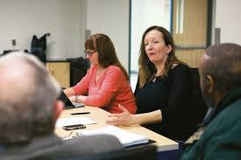
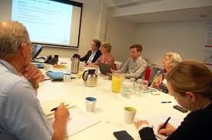
Accreditation Process
Year Three – Site Visit
Site visit scheduled when self-study has been reviewed and there is high likelihood of a successful site visit
Typically three persons
Three day visit

Slide 38
Accreditation Process
Year Three – Site Visit
Finding of evaluators is reviewed by staff and then sent to the business school for comments
Board of Commissioners reviews all materials and makes accreditation decisions
Accreditation effective upon decision of board of commissioners
Can promote accreditation after all expenses are covered

Slide 39

Accreditation Process
Estimated Costs of Accreditation
(Does not include annual membership dues of $2,600)
Accreditation Fee: $2,500
Mentor, Visits, Consultations: $2,000
Site Visit Deposit ($4,000)
Site Visit Honoraria: $1,950
Site Visit Travel Expenses: $2,450
Estimated Total for three years $8,900

Slide 40
Accreditation Process
Reaffirmation of Accreditation
Accreditation period is ten years
Conditional accreditation for four years
Work with assigned commissioner to implement actions required to meet the standards
Membership dues for accredited schools is $2,600 per year
Only costs for reaffirmation are site visit expenses

Slide 41

Most Important thing about ACBSP Accreditation:
Accreditation is an ongoing journey, not a race.
The evaluators and board of commissioners
Are not looking for “gotchas” and ways to penalize the business programs
they are looking for strengths and offering opportunities for improvement as related to the standard or specific criterion.

Slide 42

ACBSP Online Reporting Portal
Self-Studies

Slide 43
Online Reporting Portal:
All business programs submitting a self-study
Must use the online portal to
Complete the introduction
Submit final report using the criterion in the portal
Use the self-study tables found in the evidence file
Why the change?
One location for all files by all users
Increases efficiency for everyone
Secure storage and backup of all files

Slide 44
ACBSP Process – Access to Portal:
Schools in candidacy - Preliminary visit questionnaire completed online
Accredited institutions added to portal based on due date of reports for
  Reaffirmation self-study
  Reports on Notes or Conditions
  Quality assurance report
Add earlier upon request

Slide 45
After self-study reports are submitted:
site visit teams conduct review & prepare report using portal.
schools review & respond to site visit feedback on online portal.
commissioners complete review online
Self-study, feedback report, & institution response, accreditation letters are stored online.

Slide 46
Portal website:
Log in using this link, not through the ACBSP website:
https://acbsp.campuslabs.com

Slide 47
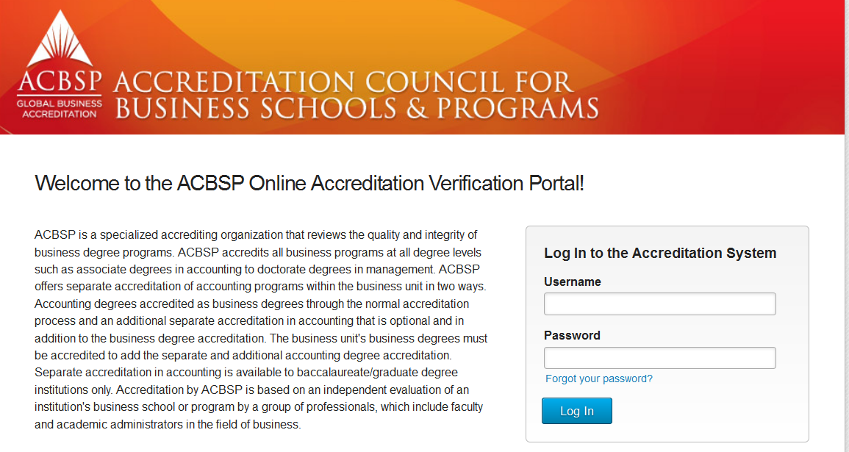
To log in to the system:
Enter school email address
Enter temporary password

Slide 48
Training Example available
If you would like to explore the online reporting portal, you can log in using the 2016 Training Sample – Bedrock School of Business at any time:
Username = welcomedemo@mailinator.com
Password = trymeout!

Slide 49
To log in to the system using the training example:
welcomedemo@mailinator.com
trymeout!

Slide 50
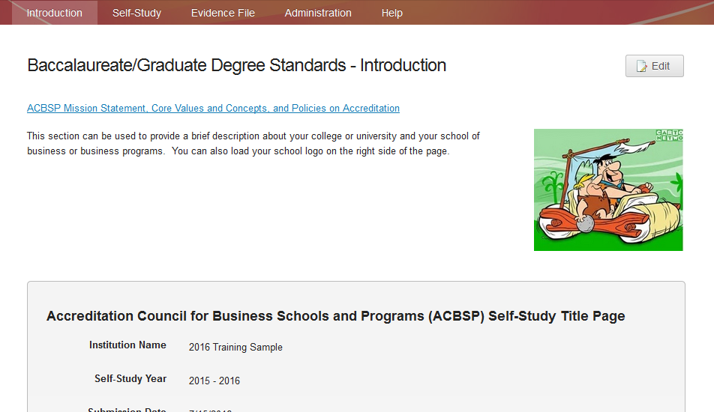
Introduction – Champion can edit:
The Champion can edit this page and must complete the Introduction to lock the report.

Slide 51
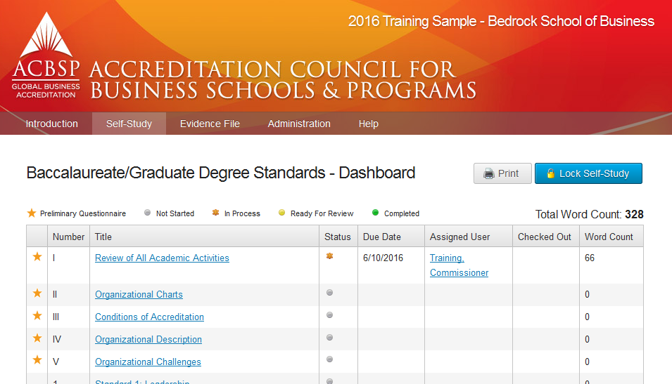
The administration tab allows the Champion to create users and assign roles for their campus.

Slide 52
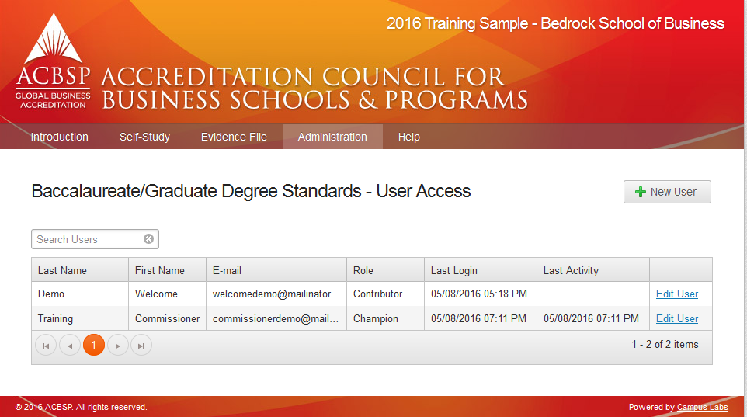
Adding new users – Step One:
Click on New User.

Slide 53
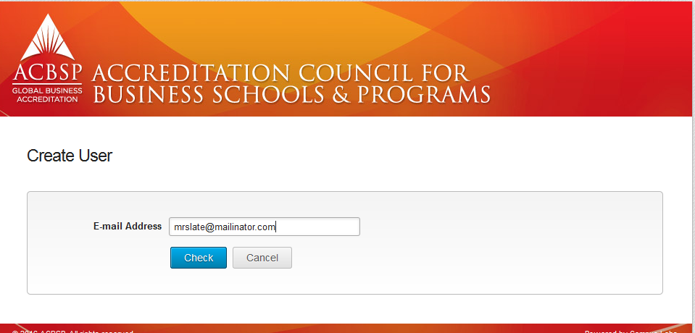
Adding new users – Step Two:
Enter email address and click on check.

Slide 54
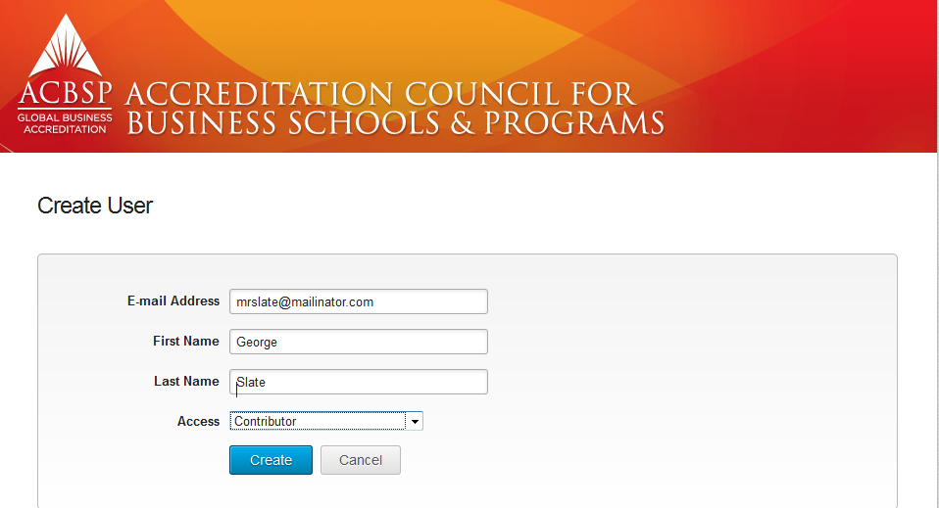
Adding new users – Step Three:
Enter first and last name and level of access. Click on create.
Welcome email with temporary password is sent from support@acbsp.campuslabs.com

Slide 55
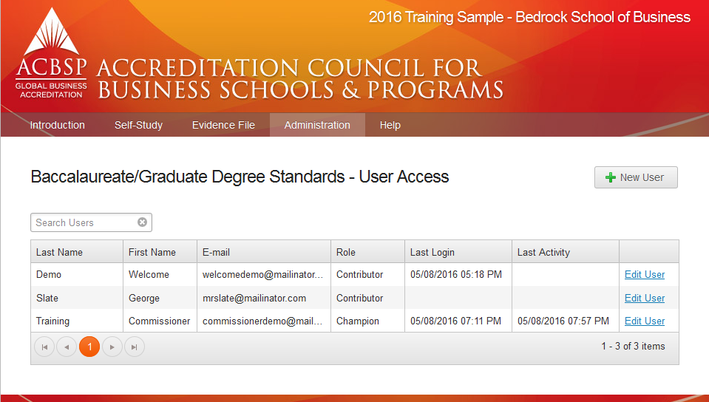
New users appear on list with level of access, last logon & activity.

Slide 56
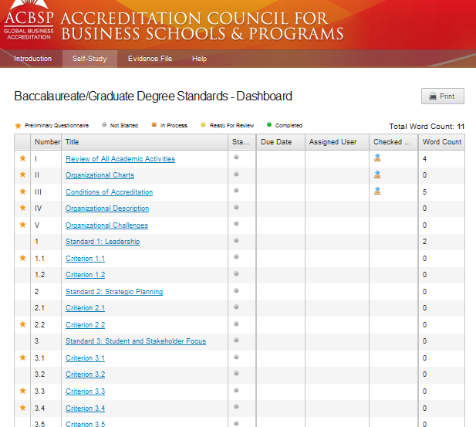
Self-study dashboard
This column indicates the items required for schools completing the preliminary visit questionnaire.
After the mentor and ACBSP have given approval, all of the criterion will be completed.

Slide 57
Champions can assign due dates and individuals to various standards and criteria.
If an item is checked out, it appears in the column. If text is entered in an item, the number of words appears in the Word Count column.

Slide 58
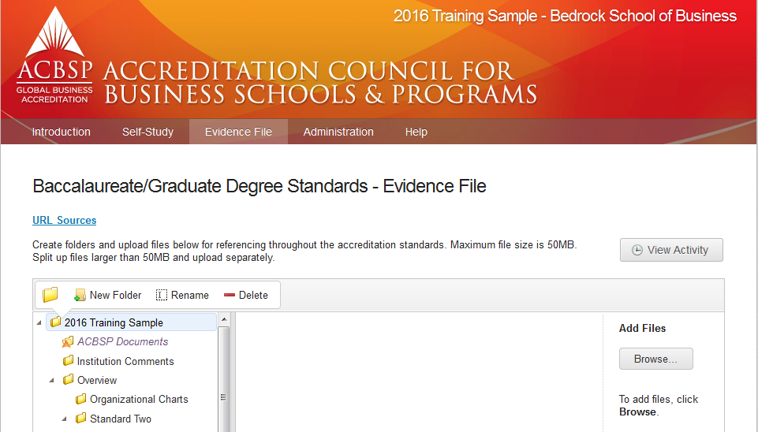
Evidence File:
Provide Supporting documentation and URL’s in the Evidence File Section

Slide 59
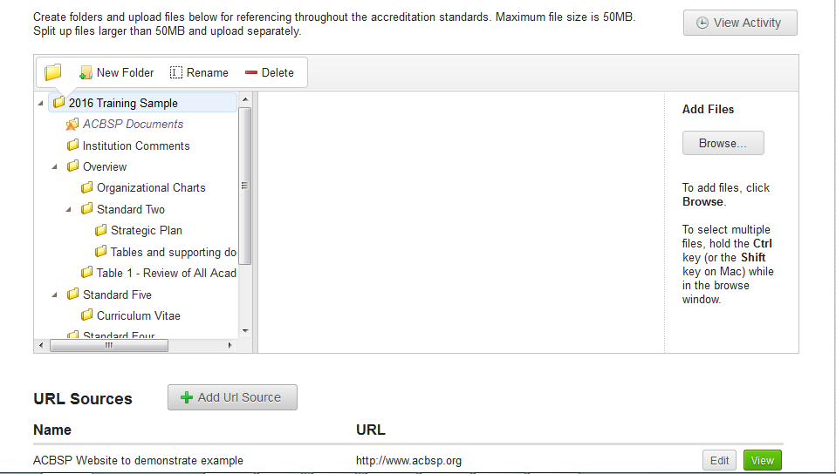
Evidence File:
To load a file, click on “Browse” and select the file you want to load.
To add a website, click on “Add URL Source” and paste the URL into the URL box and then provide a reference for the URL.

Slide 60
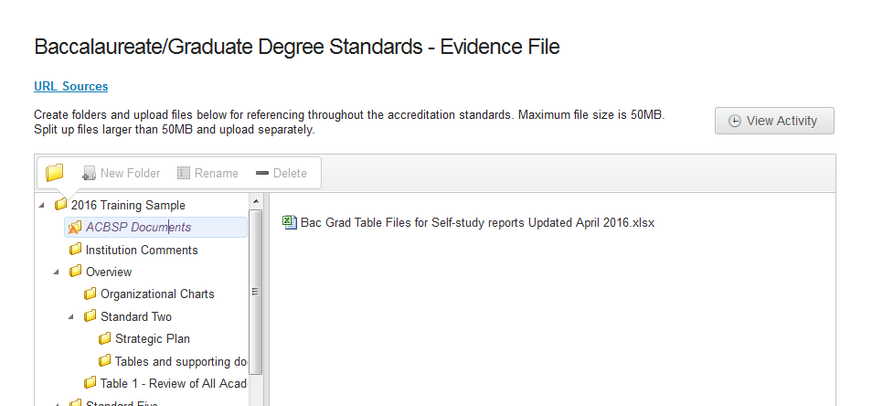
Evidence File – Table Templates:
To view the table templates, click on “ACBSP Documents” , then click on “Bac Grad Table Files for Self-study reports Updated April 2016.xlsx”.

Slide 61
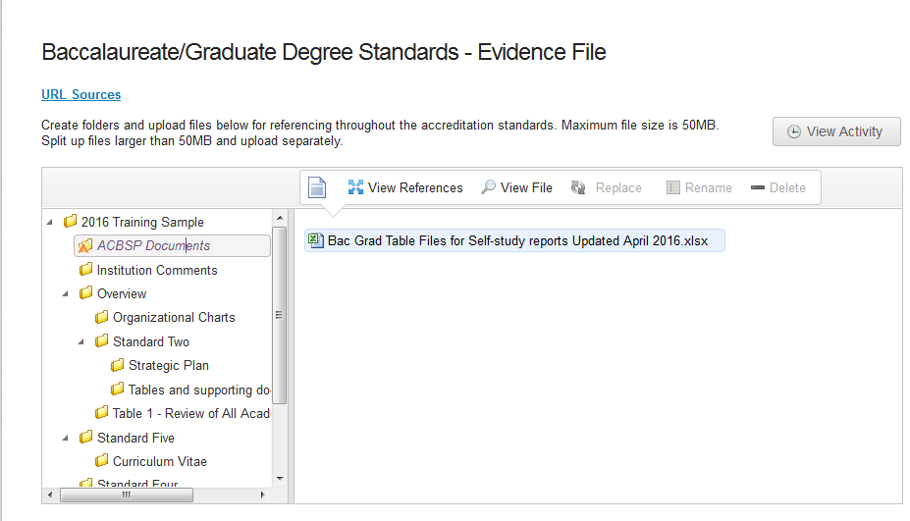
Evidence File – Table Templates:
To view the table templates, click on “Bac Grad Table Files for Self-study reports Updated April 2016.xlsx” and then click on View File.

Slide 62
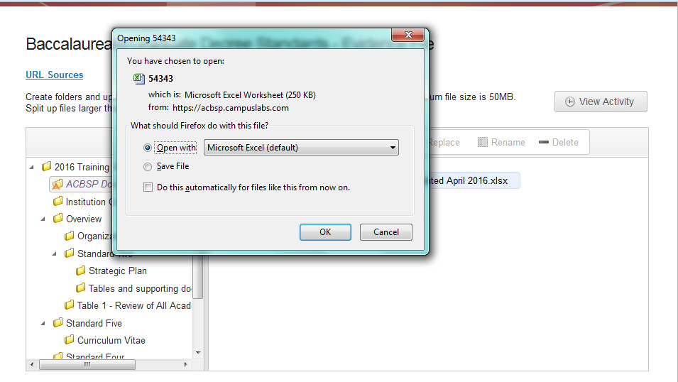
Table Templates – select open with Excel or save file.

Slide 63
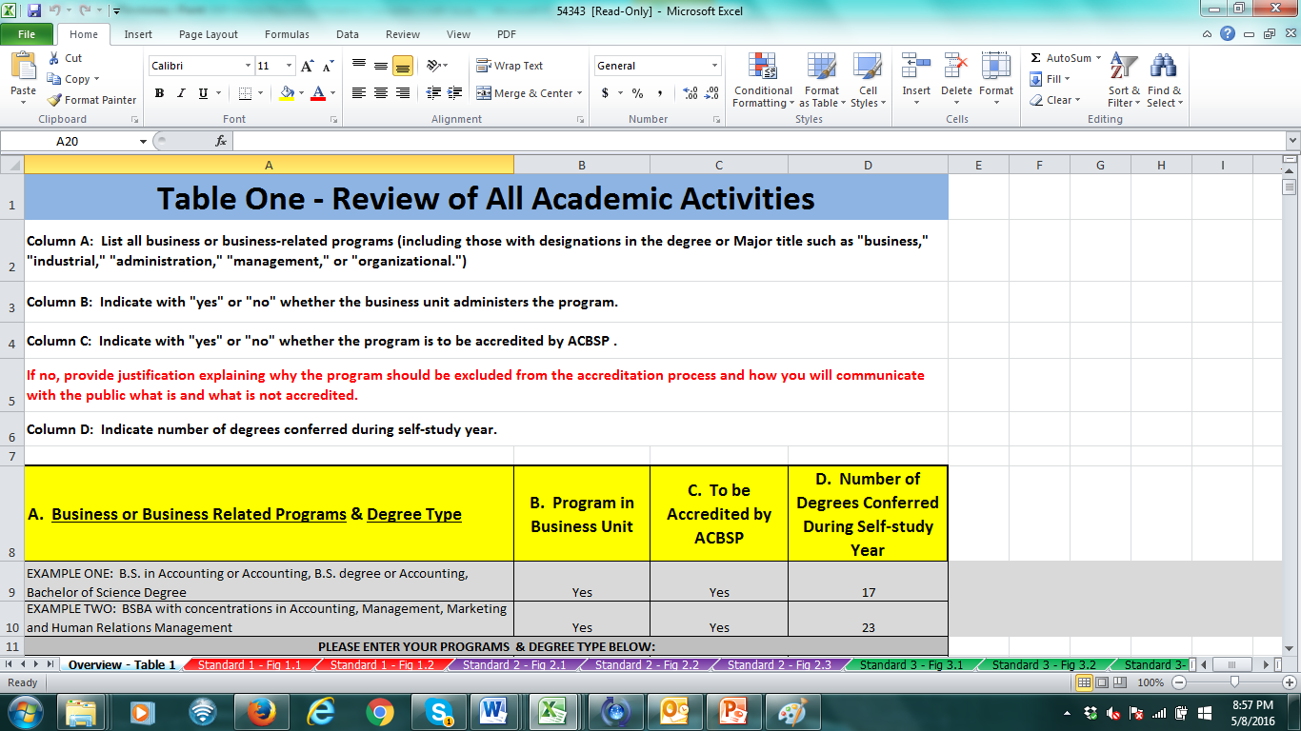
This file contains all the tables and figures for the self-study.

Slide 64
Steps for table templates:
1) Download the table.
2) Save the tables to hard drive or other location.
3) Populate tables and save to your hard drive.
4) Load the file or files back into the evidence file.

Slide 65
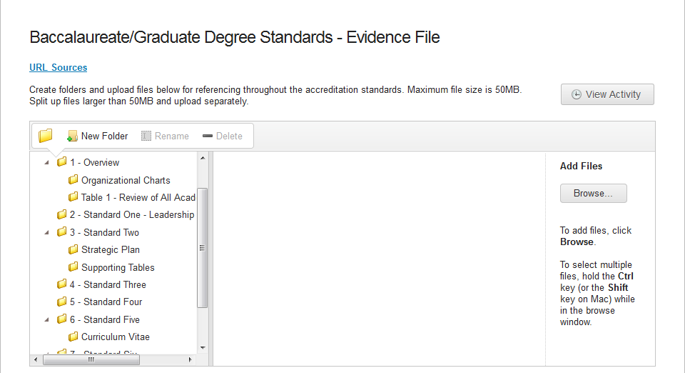
Suggested structure for evidence file for self-studies:
Create a folder for Overview and each standard. To create a subfolder, click on the standard folder and select “New Folder” . Each time you create a folder, you have the opportunity to name it.
You also have the opportunity to delete or rename the folder if needed.

Slide 66
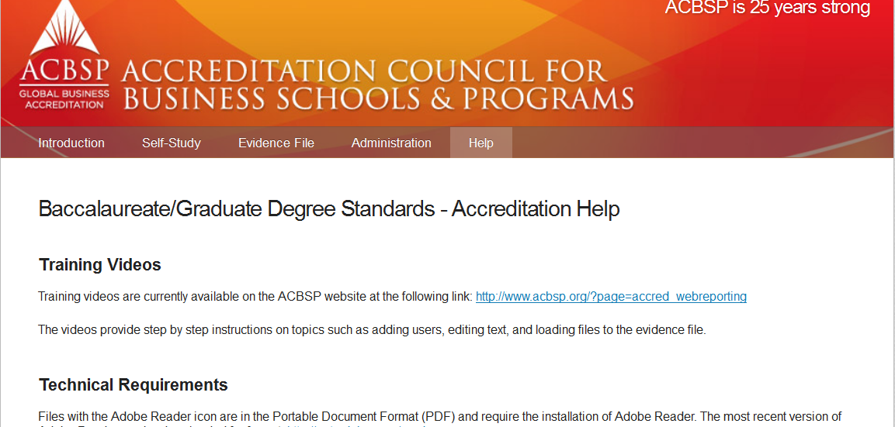
A customized HELP tab will house user documentation and video tutorials.

Slide 67
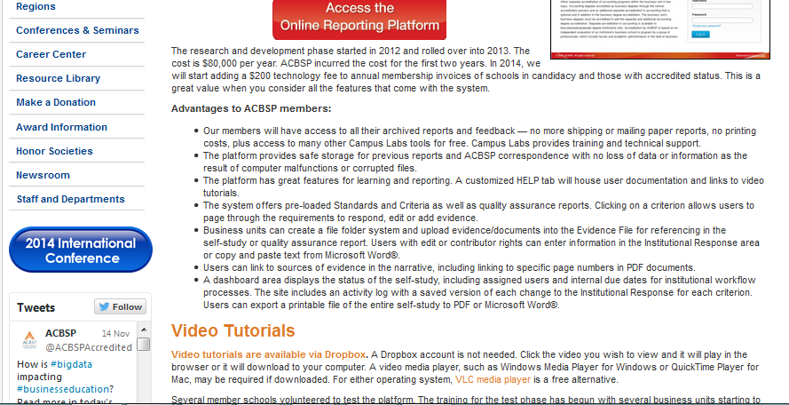
Link to video tutorials & PowerPoint presentations on website:

Slide 68
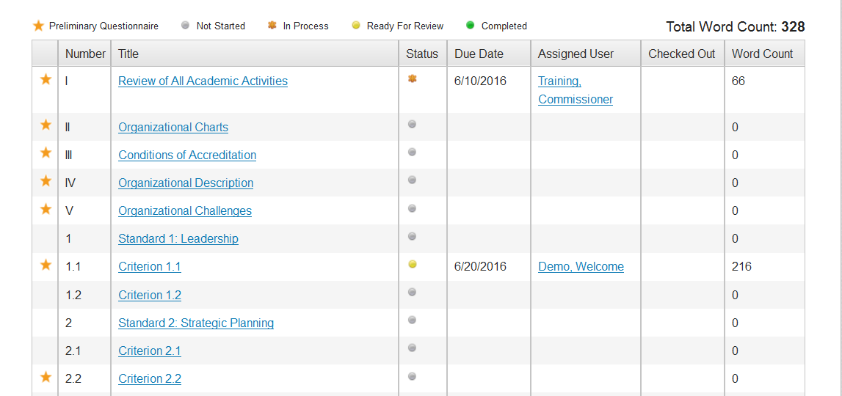
Editing text for dashboard items:
Click on the Standard or Criterion – we will use Criterion 1.1 for this demonstration.

Slide 69
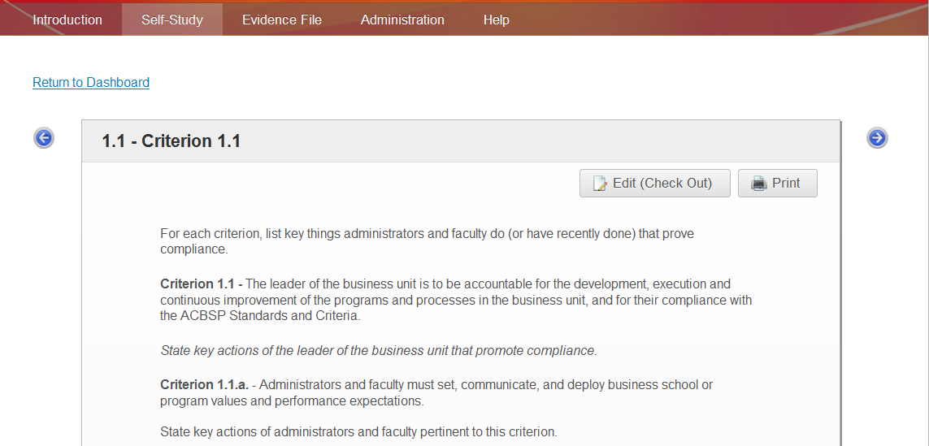
Then click on Edit/checkout:

Slide 70
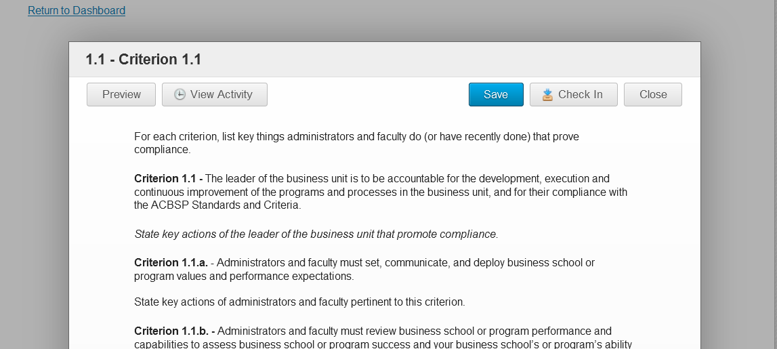
You can now use the text boxes below the instructions to respond:
While the item is checked out, that user is the only one with edit privileges. Be sure to save and check in when finished.

Slide 71
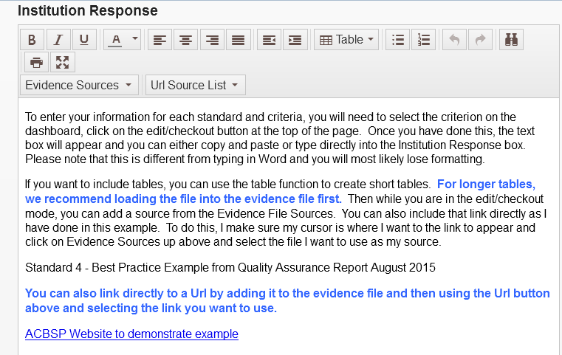
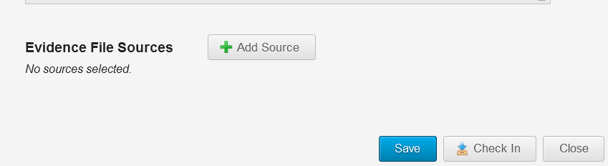
You can enter status, add source files and text in the edit mode.
To add sources, click on add source and then select the file . In the text box, you can directly reference the file or URL by clicking on the appropriate box

Slide 72
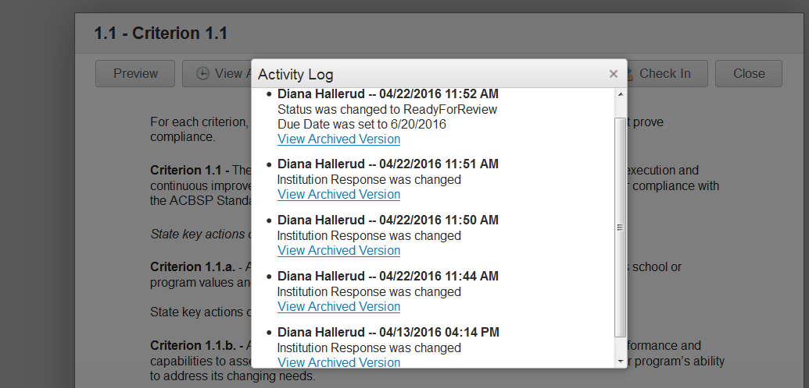
To view previous activity & text, click on view activity button:

Slide 73
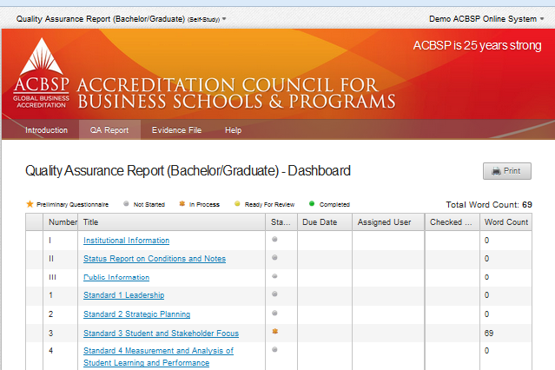
Users can export a printable file of the entire report to a printer, PDF or Word document.
Click on the print button from the dashboard or specific item. A new tab will appear for you to select which option you prefer.

Slide 74
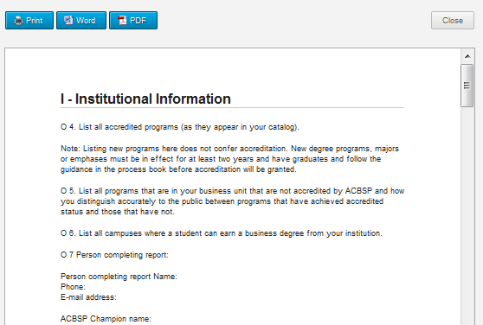
You can print or save the file to your desktop, folder, etc.

Slide 75
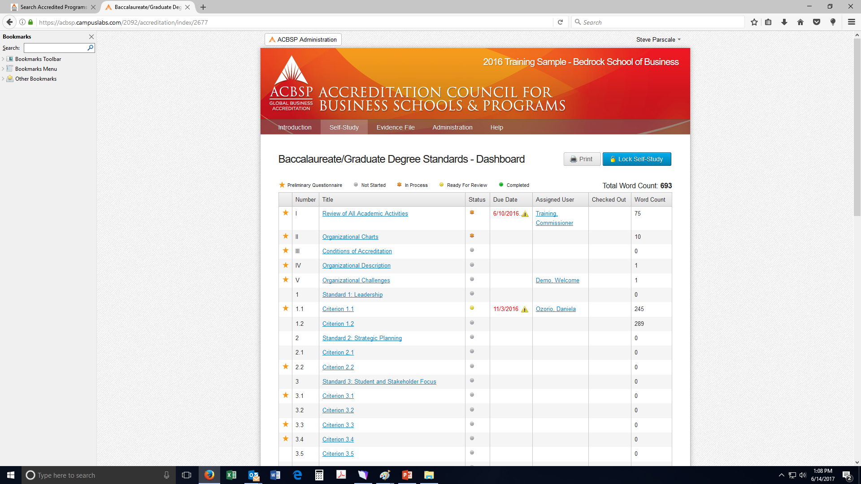
When you select “Lock Self-Study” the portal notifies ACBSP that you have completed the report and it is ready for review.

Slide 76
Tips – How to address and impress:
Evaluators and Commissioners are looking for:
1) systematic process
2) results with trend data
3) examples of how you have used results to make improvements.
4) relevant supporting documents in evidence file.

Slide 77
Practice makes perfect!
Prior to entering information for your business programs, you can use the link below and practice using the demo school at:
https://acbsp.campuslabs.com
School name is: 2016 Training Sample–Bedrock School of Business
Username: welcomedemo@mailinator.com
password: trymeout!
If you need to set up access for a self-study report or have difficulty accessing the system, please contact one of the accreditation staff.

Slide 78
Questions?
Please do not hesitate to contact ACBSP accreditation staff with any questions you may have.
Diana Hallerud: dianahallerud@acbsp.org
Steve Parscale: sparscale@acbsp.org
Cari Hunziker: chunziker@acbsp.org
Thank you!

Slide 79


  Thank you for your participation!

