Slide 1



Presented by:

Slide 2

Objective of the Program, to Help You
    Encourage regular reading of business news
    Set Expectations: Better Read / More Engaged / Informed Students
    Any Course at Every Level Resource
    Dynamic, comprehensive, and inexpensive weekly business textbook
  Bloomberg Businessweek
    Founded in 1929 by McGraw-Hill
    Most read business weekly in the world
    Purchased by Bloomberg in 2009
    Bloomberg: Largest media company & newsroom in the world that is totally devoted to business news
    Print / Digital / Apps

Slide 3
Resourcecenter.businessweek.com
Faculty & Student Resources
    Weekly Instructor’s Guides (13 Disciplines)
      Written by peers
      Article Summaries
      Quiz & Discussion Questions
    Reading Buckets “Greatest Hits Articles”
      Discipline
      Region
      Sector
    Edge Guides
      7 Business Competencies
      Current Reading
      Mini-case studies
    Integration Ideas
    Professional Development Tools
    https://resourcecenter.businessweek.com/

Slide 4
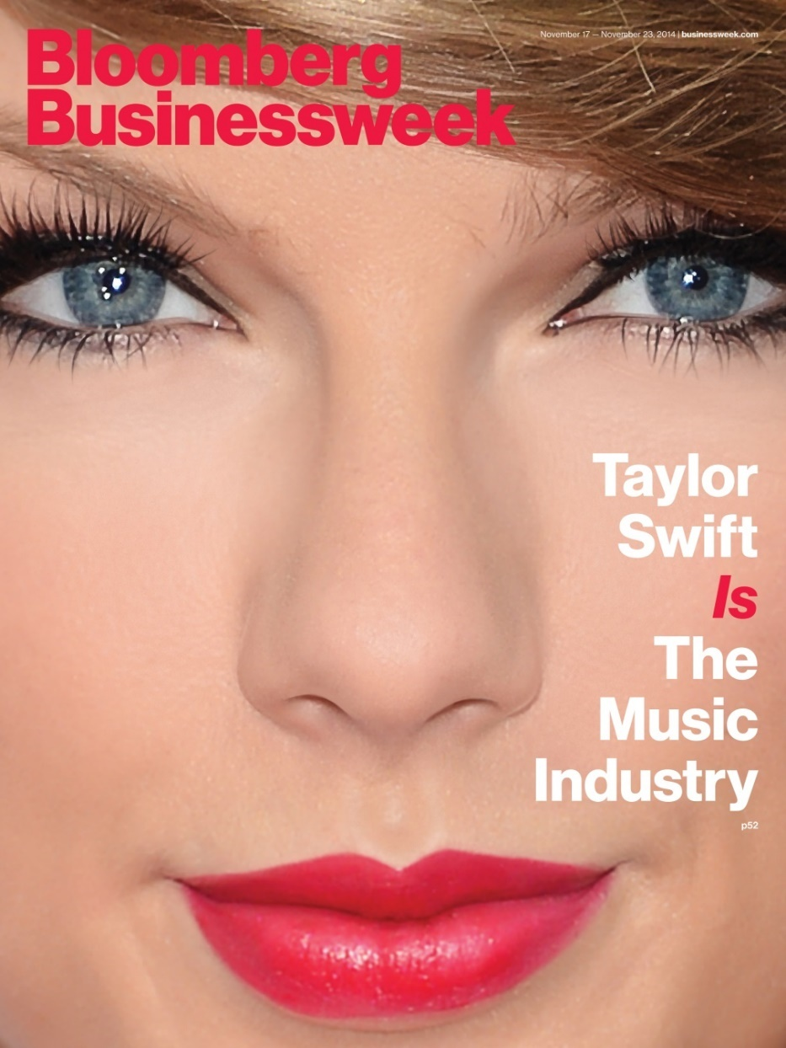


Do Your Students Know Who Both of these Women Are?

Slide 5
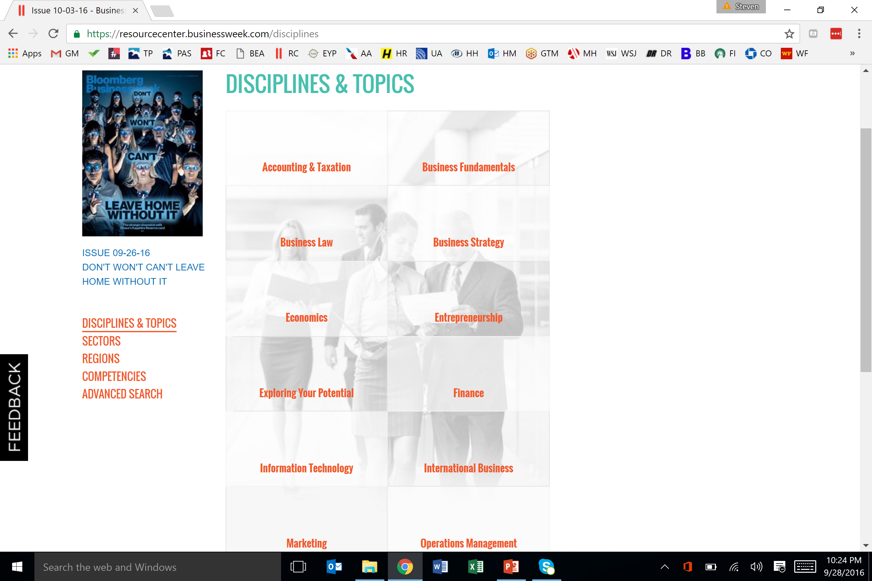

Slide 6
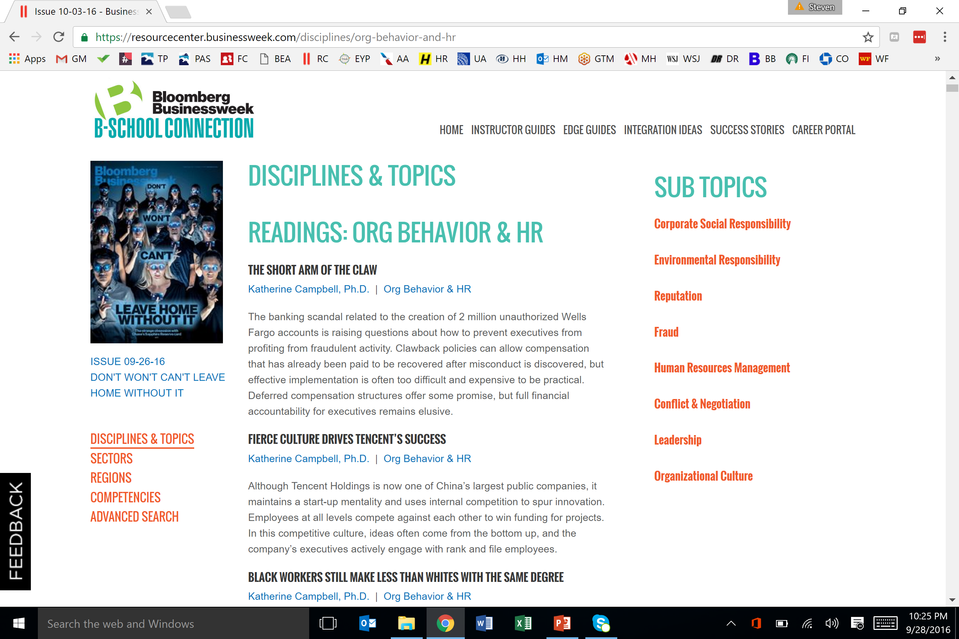

Slide 7
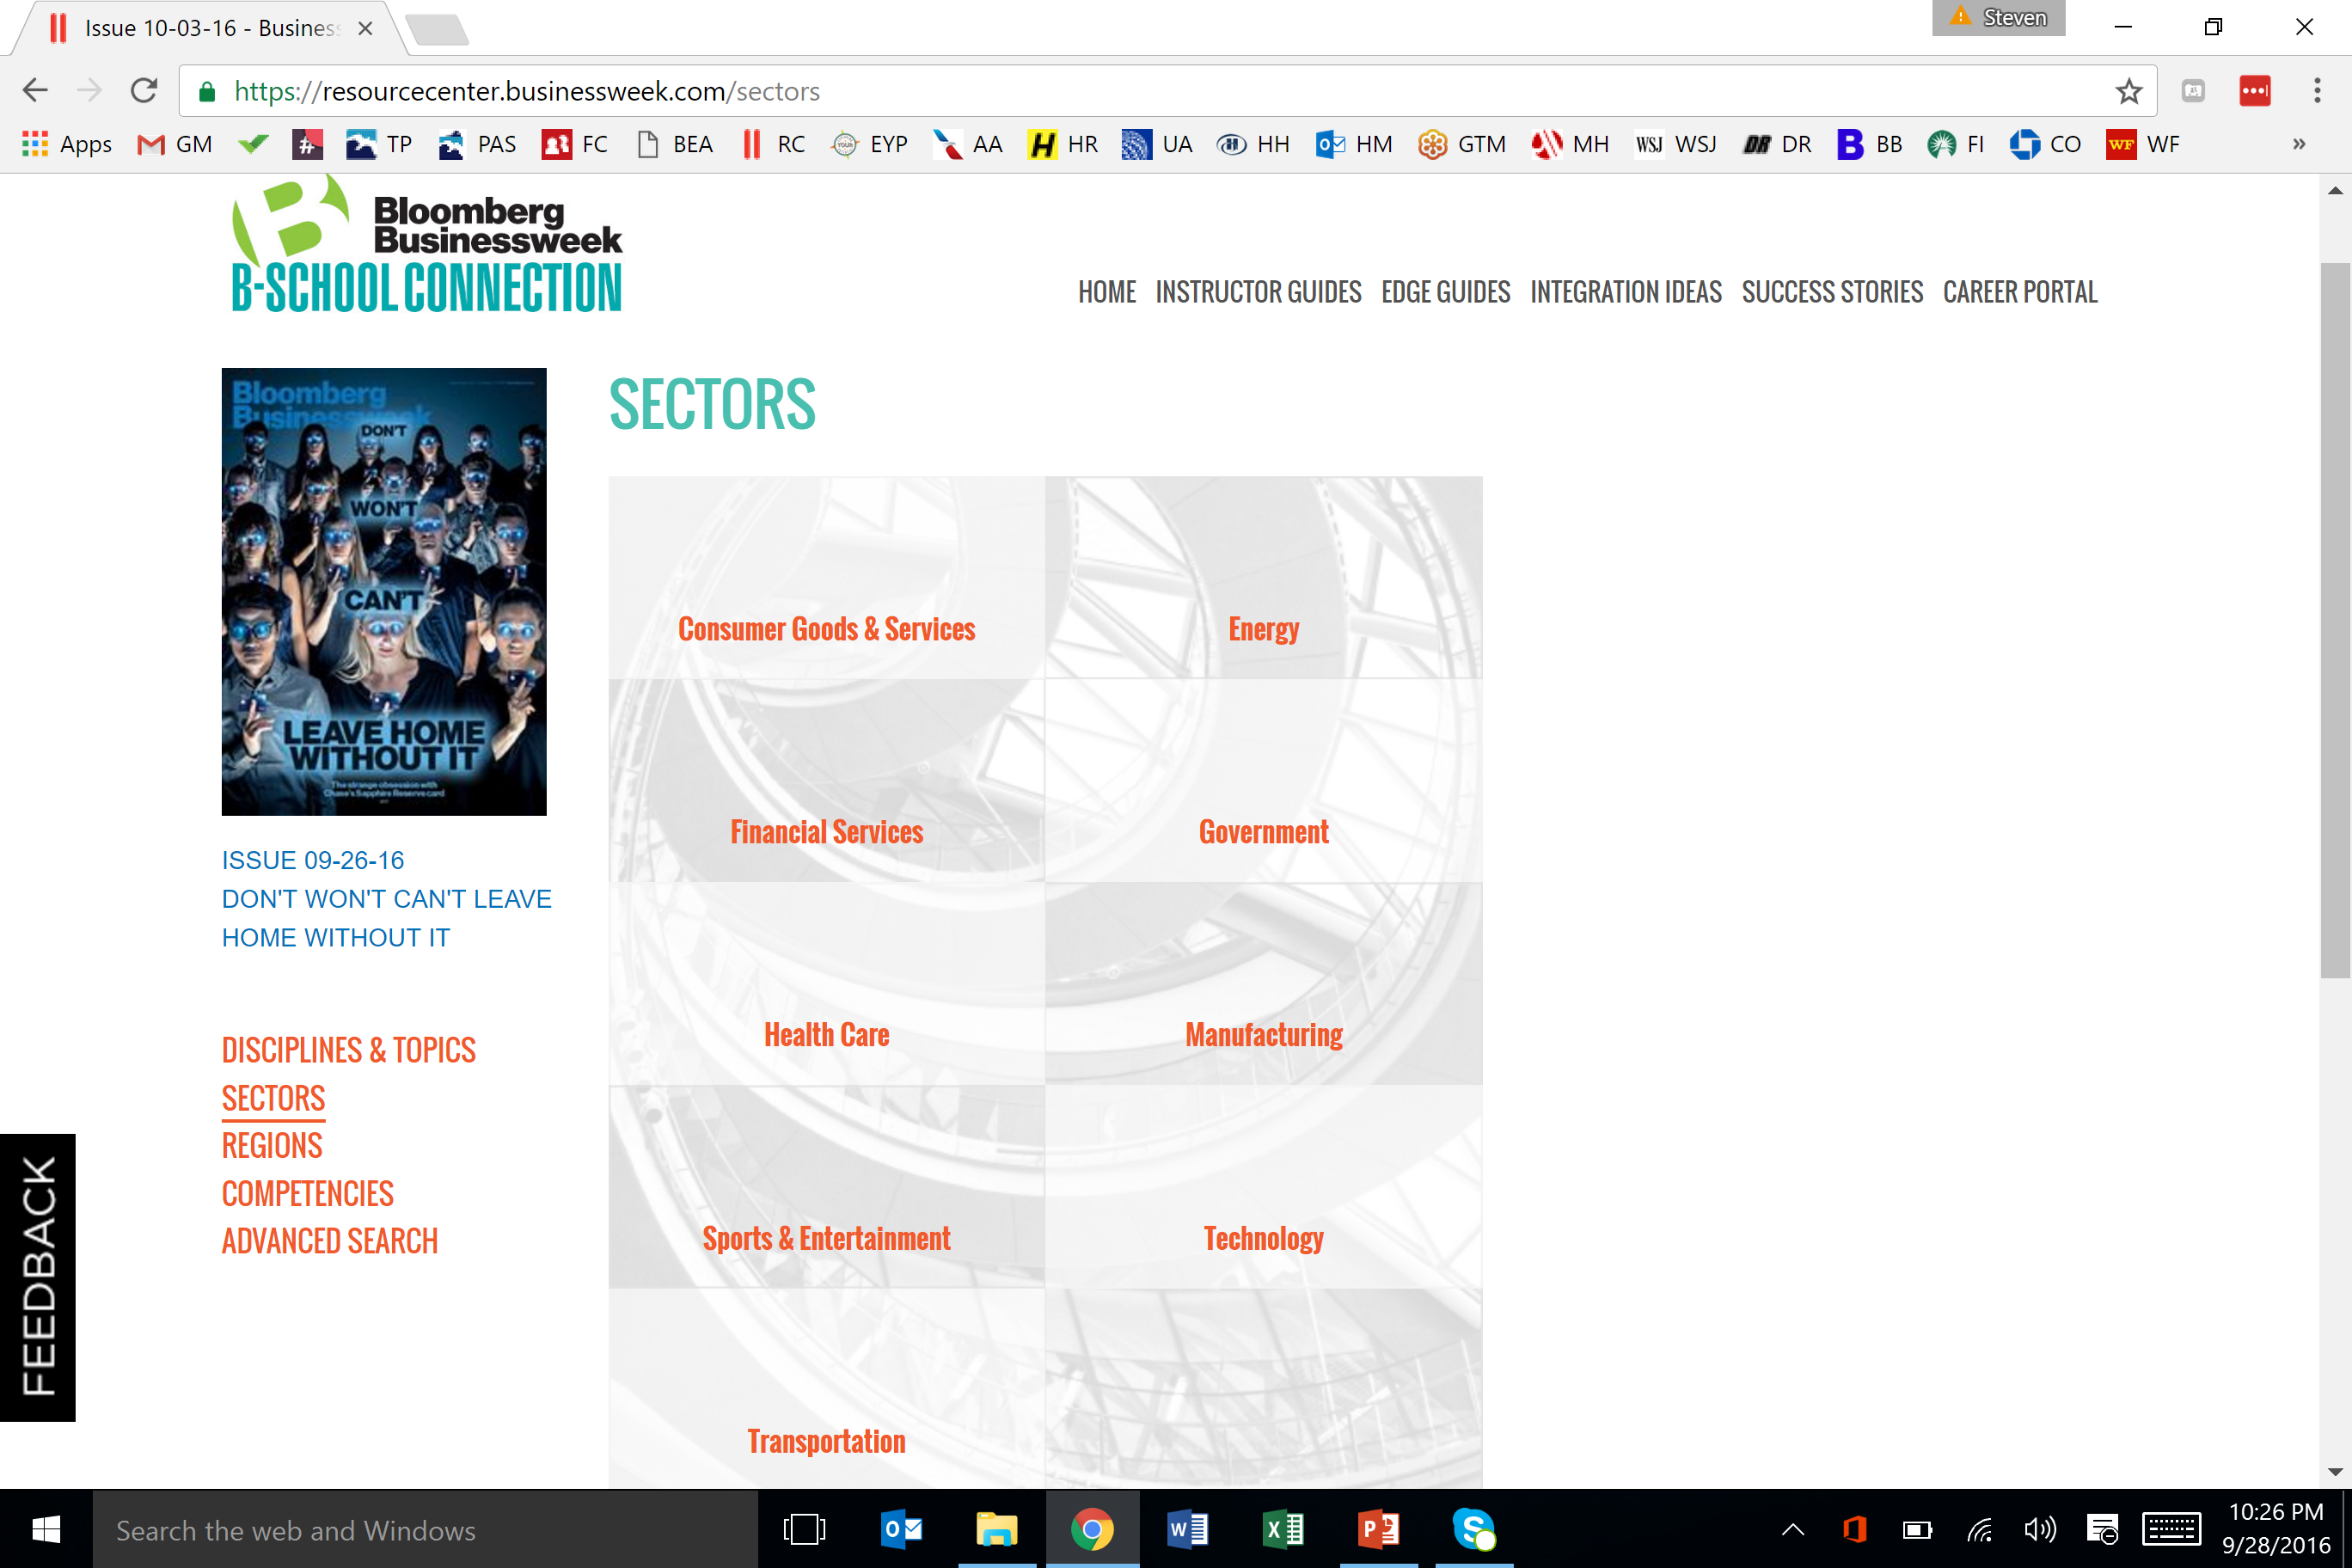

Slide 8
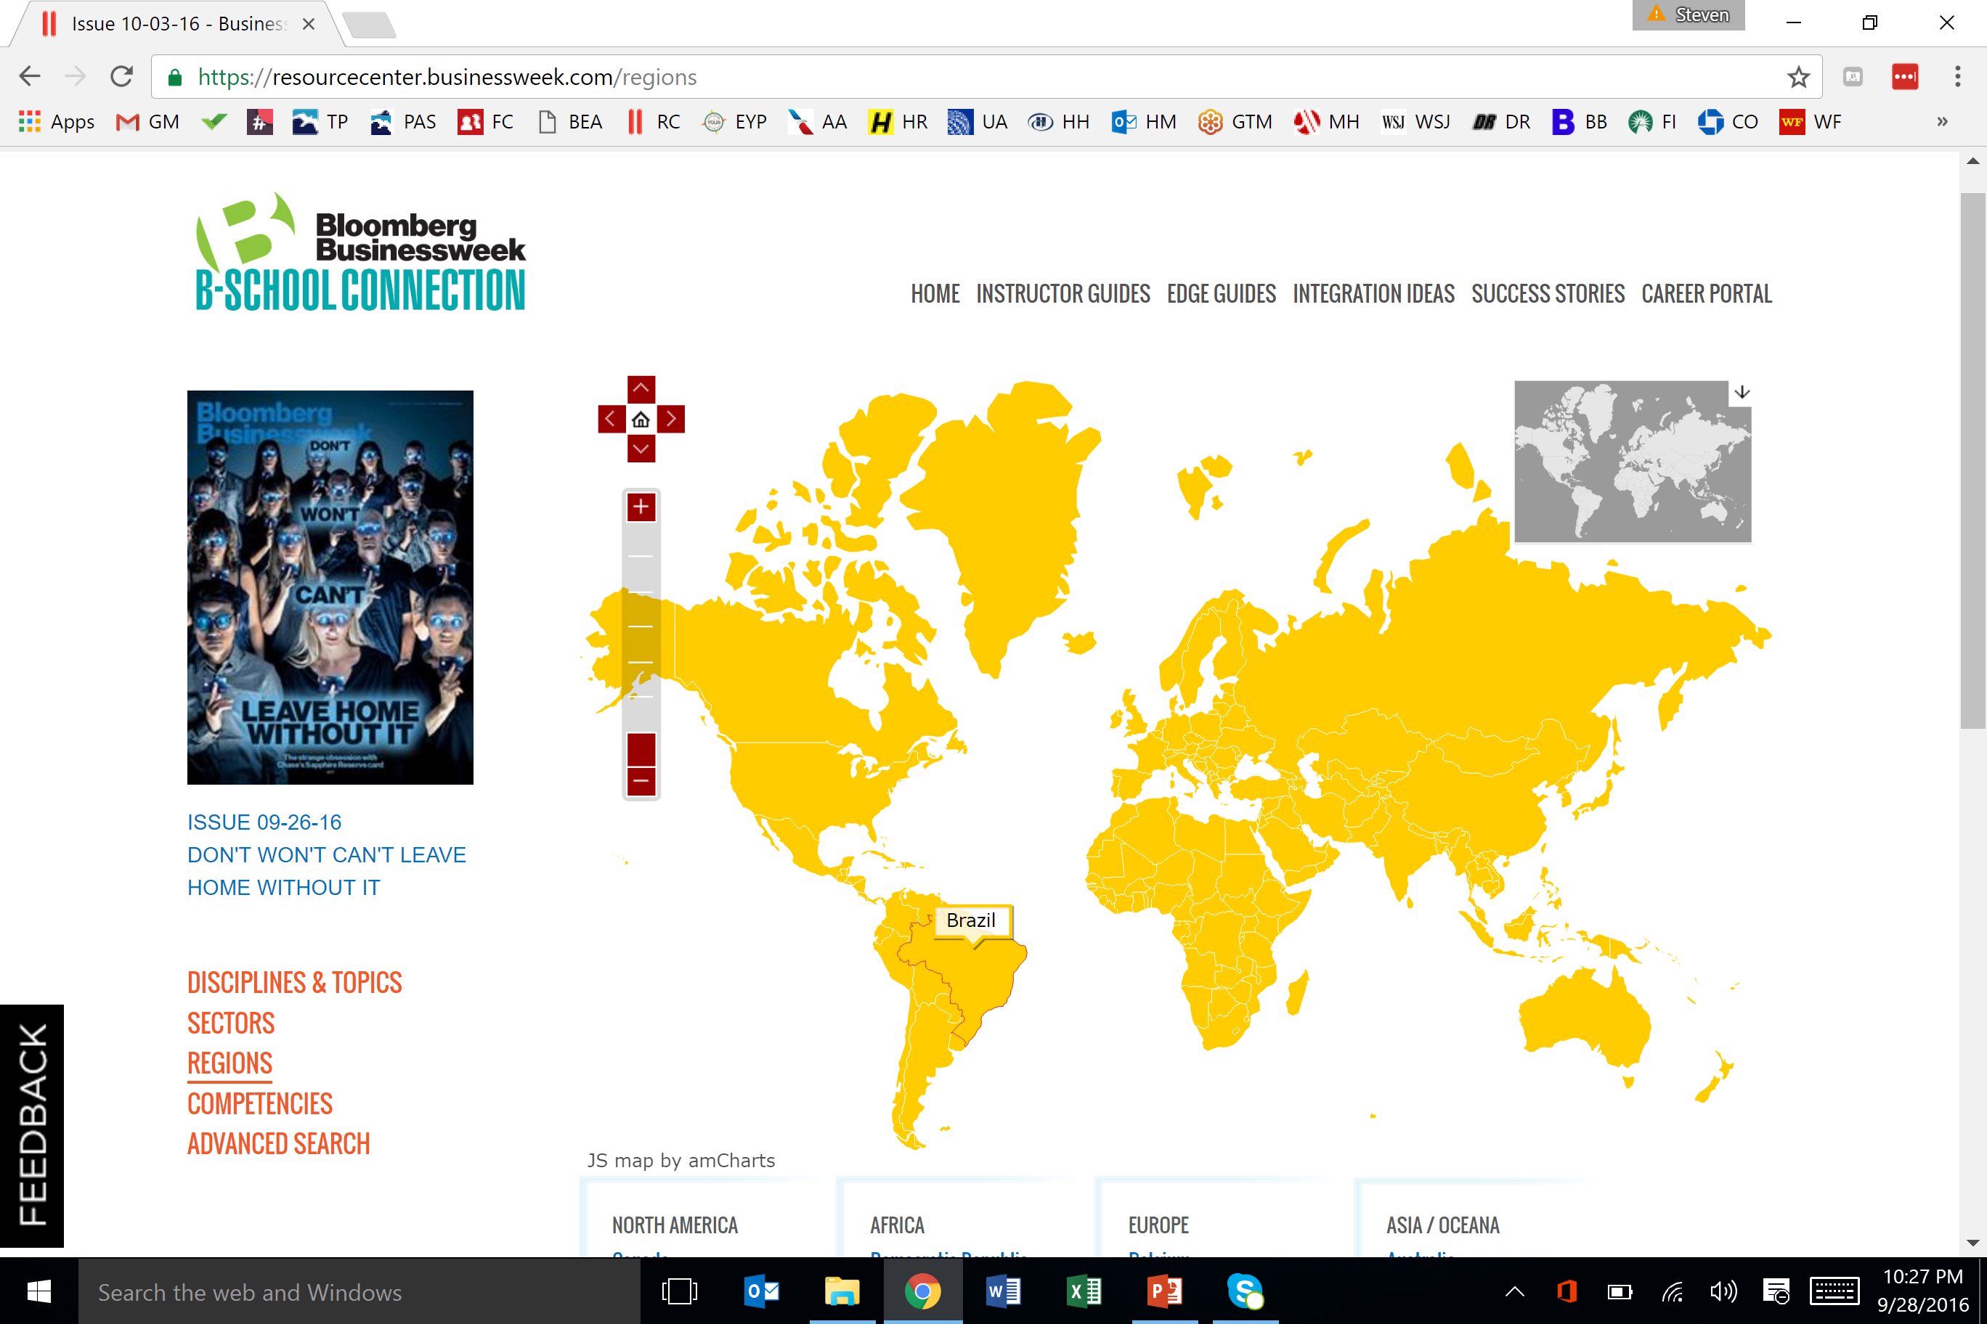

Slide 9
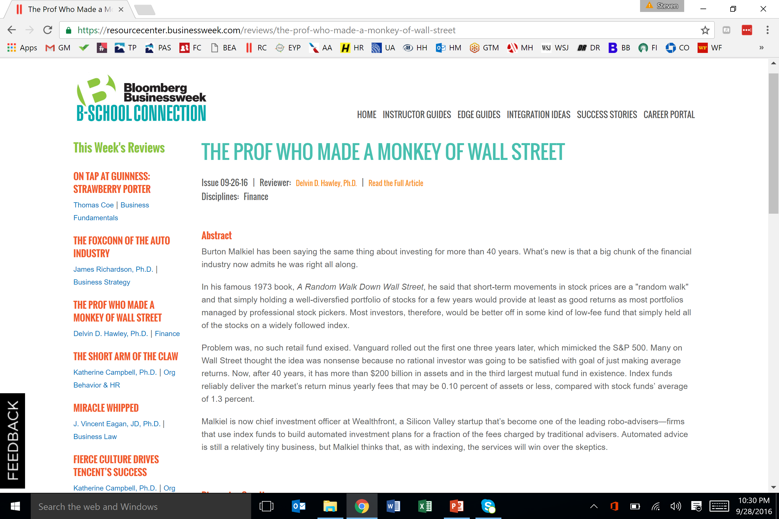

Slide 10
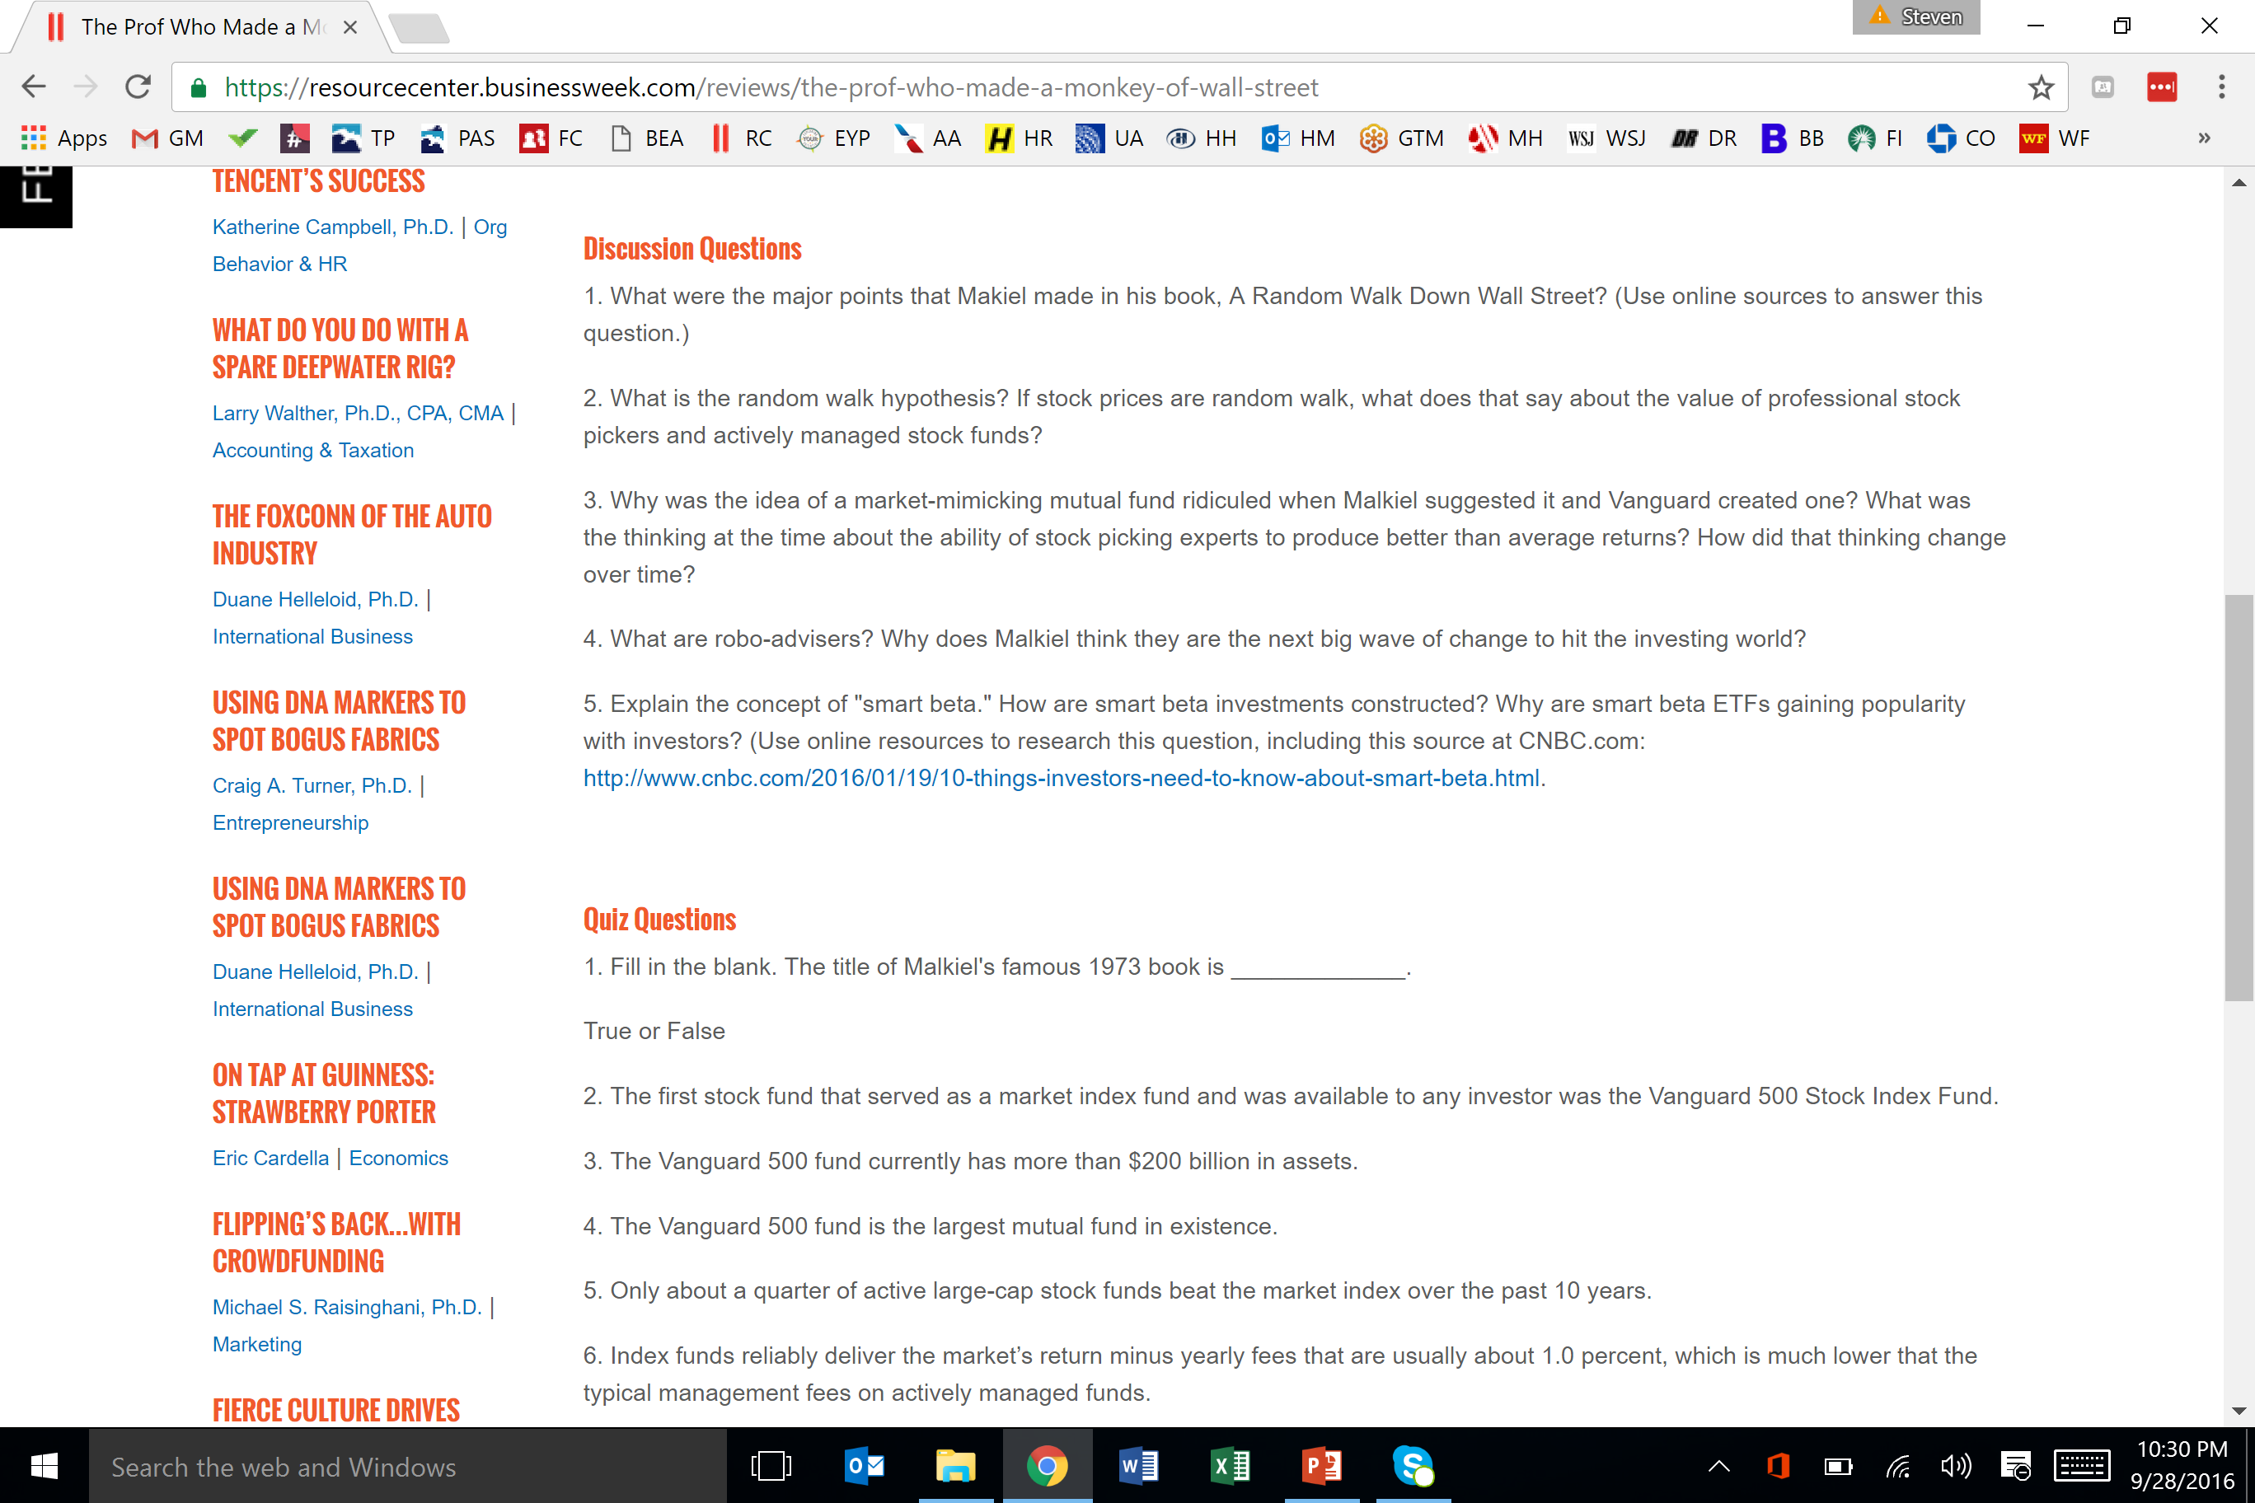

Slide 11
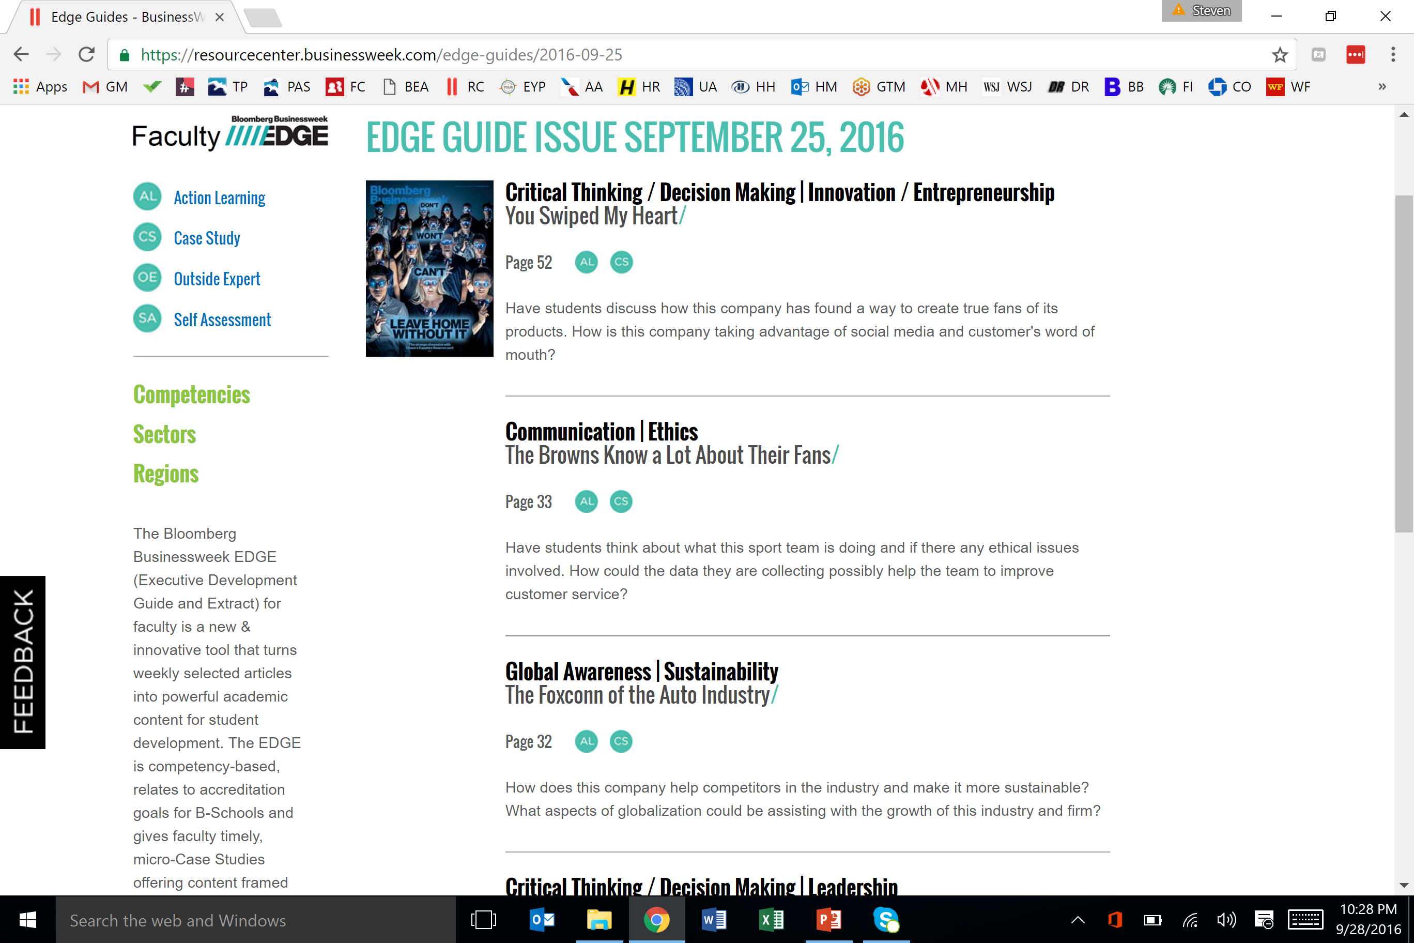

Slide 12
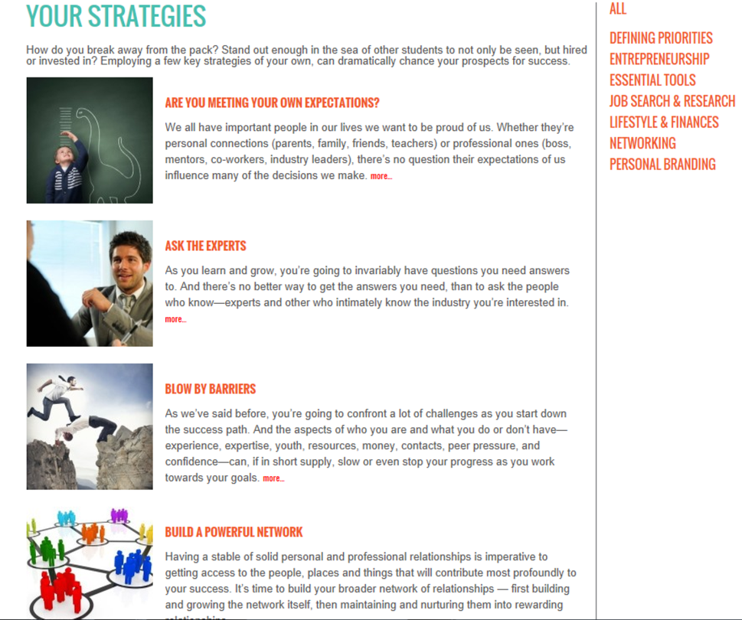
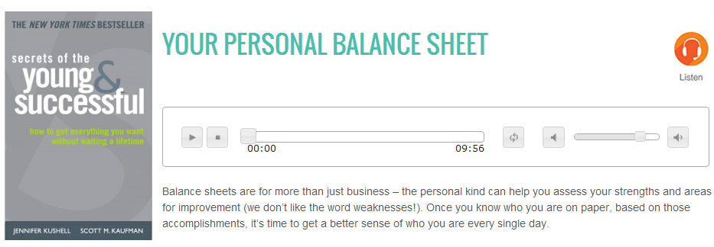
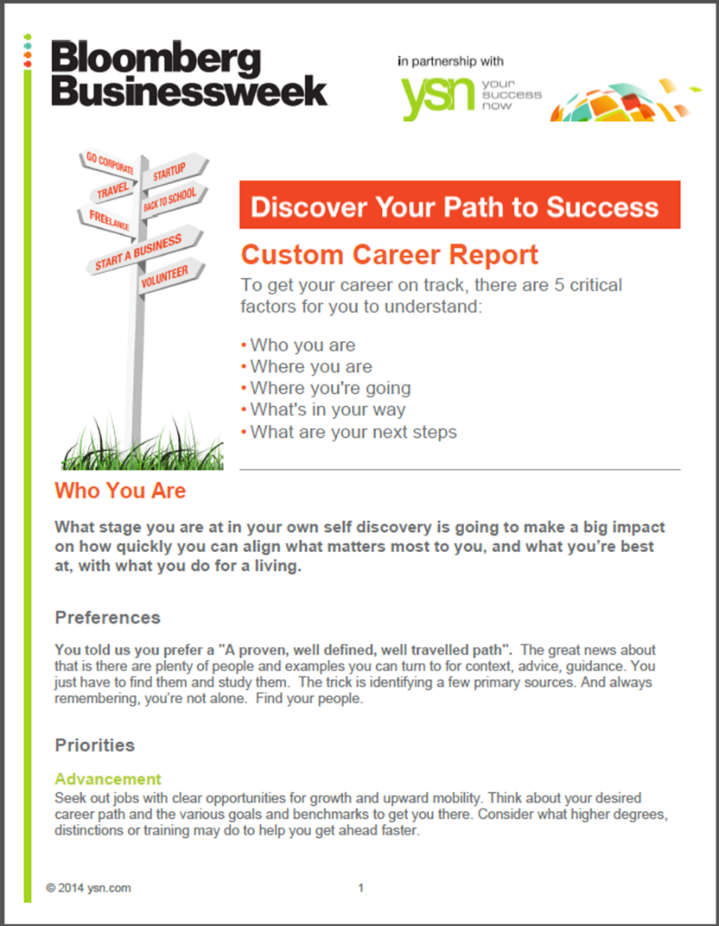
Prepare students for career success

Slide 13
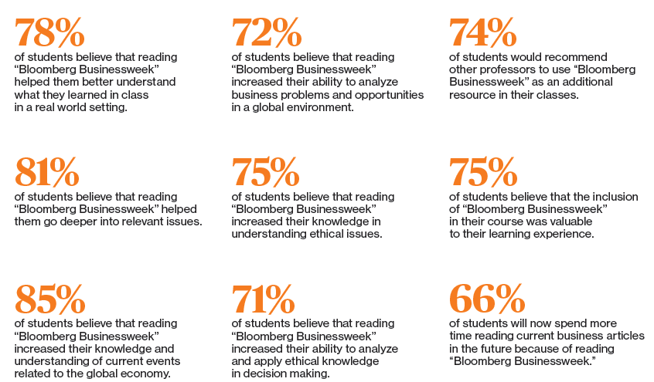
University of north Alabama student survey

Slide 14


To Learn More:
Peregrineacademics.com/home/bsc
Resourcecenter.Businessweek.com
Contact: Steven Pietsch
Pietsch@peregrineacademics.com

