Slide 1
AACSB International
Presented by
Amy Memon, Manager, Accreditation Services (Asia-Pacific)

Slide 2
AACSB’s Mission and Vision
Notes:
The VISION of AACSB International is to transform business education for global prosperity. Business and business schools are a force for good, contributing to the world’s economy and to society, and AACSB International plays a significant role in making that benefit better known to all stakeholders − serving business schools, students, business and society.
The MISSION of AACSB International is to foster engagement, accelerate innovation, and amplify impact in business education.
aligned with AACSB accreditation standards for business schools.
AACSB strives to continuously improve engagement among business, faculty, institutions, and students so that business education is aligned with business practice.
To fulfill this goal, AACSB International will encourage and accelerate innovation to continuously improve business education. As a result, business education will have a positive impact on business and society − and AACSB will amplify that impact.
In achieving its mission and vision, AACSB will emphasize and model the following
VALUES: Quality, Inclusion & Diversity, a Global Mindset, Ethics, Social Responsibility, and Community.
These values will drive AACSB’s future initiatives and interactions with the business education community worldwide.
[not included in the image, but for reference]
Over the next few years, AACSB International will focus strategically on five key customer‐focused areas as well as key enablers to deliver on our mission:
Quality Assurance & Quality Improvement (Accreditation)
Advocacy & Awareness
The AACSB Network
Professional Development
Business Education Intelligence
Enablers

Slide 3
What does AACSB Offer?
AACSB Global Network
Business Education Intelligence
Professional Development
Quality Assurance & Quality Improvement (Accreditation)
Advocacy & Awareness
Notes:
Internationally recognized accreditation for undergraduate, master’s, and doctoral programs in business and accounting (Note: Membership does not imply accreditation.).
Conferences, seminars, symposiums, and webinars that provide global professional development opportunities for business school administrators and faculty.
Publications that provide insight into the business education industry.
Access to extensive global data and corresponding reports related to business schools.
Networking through affinity groups and events held both online and in live environments.
Sponsorships, exhibiting, and business development opportunities.
In addition to providing its members with products and services, AACSB International strives to identify challenges and trends that are facing the business education industry through its research and various initiatives. The association also educates students, parents, employers, and counselors about accreditation and how to choose a quality business degree program that will fit their needs.

Slide 4
The AACSB Network
Global Network of Educational Institutions and Business Organizations

Slide 5
Reach of AACSB International
AACSB-accredited members present
AACSB members present
No AACSB members present
Distribution of schools as of August 31, 2016.
Notes:
Note: Some island nations are too small to depict.

Slide 6
The AACSB Landscape
1,548
775
1,487
61
52
97
185
IN 2015-16,
88
5
As of 31 October 2016
Notes:
The AACSB Landscape:
Total Members: 1,548
Educational Members: 1,487
Business Members & Management Associations: 61
Total Countries/Territories: 97
775 accredited business schools in 52 countries
185 holding accounting accreditation in 8 countries
Events
SEMINARS: Public Seminars: 75 spanning 5 continents, 16 countries/territories.
CONFERENCES: There were 13 conferences in the following countries: U.S., Peru, China, Germany, Singapore, Italy

Slide 7
Educational Membership
Eligibility for Educational Institutions:
Open to institutions offering bachelors, masters, and doctoral degree programs in business, management, and/or accounting.
Require the school be authorized to grant degrees by appropriate governing body in country which they operate
Offer at least one degree independently
AACSB grants membership to the highest level institution (university vs. business school); the entity that is authorized to grant degrees

Slide 8
Applying for Educational Membership
Complete Membership Application and provide supporting documentation as outlined
Require 30 days for review & decision
Membership period July 1 – June 30
Annual membership dues are 3000 USD
Initial fee prorated monthly (250 USD/month) based on join date
Notes:
Beginning July 2016: monthly proration
New Member Dues Rates
As of July 1, 2016, new member dues rates will be prorated according to the month in which the institution joins membership. Following is the revised initial dues fee schedule:
July: 3,000 USD
August: 2,750 USD
September: 2,500 USD
October: 2,250 USD
November: 2,000 USD
December: 1,750 USD
January: 1,500 USD
February: 1,250 USD
March: 1,000 USD
During the membership renewal period (April-June), new member initial dues are extended rates for membership effective through June 30th of the following year:
April: 3,750 USD (membership effective April 01, 2017 - June 30, 2018)
May: 3,500 USD (membership effective May 01, 2017 - June 30, 2018)
June: 3,250 USD (membership effective June 01, 2017 - June 30, 2018)

Slide 9
Member Benefits
AACSB Global Network
Affinity Groups
Exchange
Collaboration Concourse
Business Education Intelligence
Industry Reports
DataDirect
Country Profiles
Customized Data Reports
Exhibiting & Sponsorship
Quality Assurance & Quality Improvement (Accreditation) Services
Publications & Media
BizEd Magazine
AACSB LINK
AACSB Explores
Career Services
BizSchoolJobs.com
Advertising
Professional Development Events
Conferences
Seminars
Webinars
eLearning

Slide 10
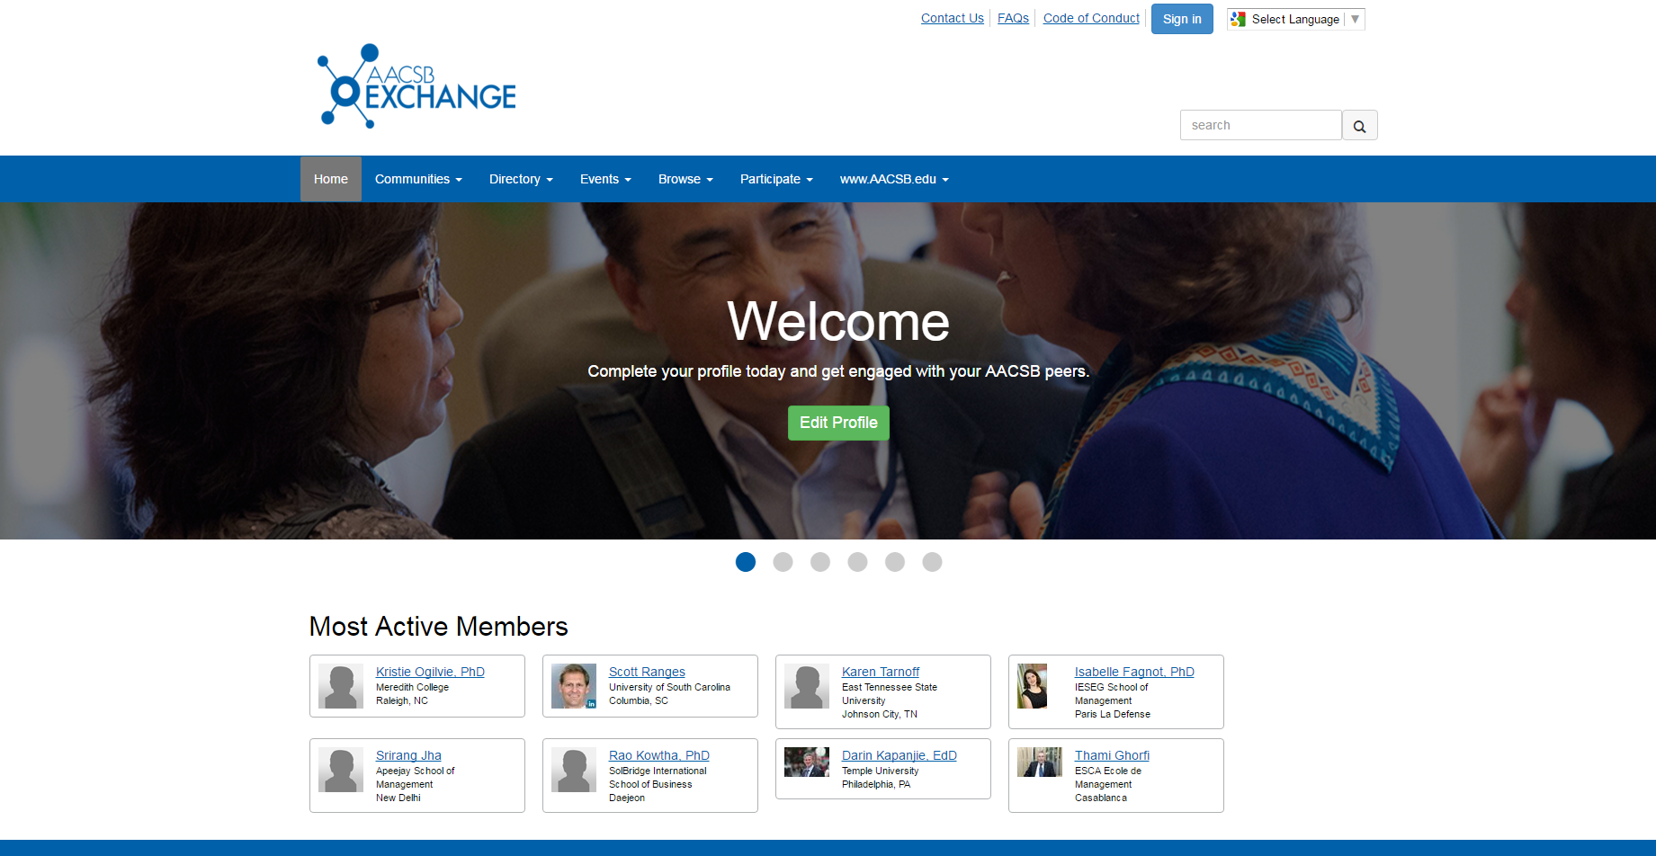
Notes:
The Exchange is a member’s networking site which includes member profiles and directories, online discussion forums, resource libraries, event materials and presentations for registered events, and blogging capabilities. You can access the site directly at TheExchange.aacsb.edu, or by clicking on the blue Exchange logo anytime you see it in an email from us or at the bottom of our website.
Mobile app now available

Slide 11
AACSB Member Forum
Sharing materials
Discussing experiences
Finding solutions
Notes:
AACSB Member Forum
Your connection to an incredible resource - 33,000+ of your colleagues who share your challenges, uncertainties, and successes.
Builds on the value of networking and educational opportunities we provide through our conferences, seminars, regional events, and online communities throughout the year→ additional level of member collaboration, this online community allows AACSB members worldwide to connect, engage and share experiences, industry information and best practices, seek and share advice, exchange resources and build relationships.
The AACSB Member Forum is an evolving collaborative community and your participation will enhance its value and strengthen this network of members worldwide.
E-mail notifications daily by default – manage in my subscriptions under your profile

Slide 12
AACSB Annual Surveys
Business School Questionnaire (BSQ)
BSQ Finances Module
BSQ Employment Module
Global Salary Survey (SS)
Accounting Program Questionnaire (APQ)
Collaborations Survey (CS)*
*Data entry available multiple times throughout year;
annual snapshots taken
Notes:
The DataDirect system was implemented in 2005 to simplify school data collection, enhance benchmarking capabilities and provide report dissemination online. Initially, there were three annual surveys: 1) The BSQ gathers data on business school characteristics such as enrollment, degrees, programs, and admissions; 2) The Salary Survey collects salary information for administrators by position and for faculty by rank and discipline; 3) The APQ gathers data similar to the BSQ, but is only issued to members with accounting accreditation and is focused on only those programs within the larger business unit.
In the 2007-08 academic year, DataDirect began collecting data from outside the United States, and added the Effective Practices survey. In 2008-09 the Collaborations Survey was added to capture information on existing partnerships between AACSB member schools and other institutions around the world, as well as desired partnerships they want to pursue. In 2012, DataDirect transitioned from its previous subscription model to a participation-based model, as a new member benefit for all survey participants. Schools now have unlimited access to data from all surveys in which they participate, free of charge.
In 2013-14, DataDirect began a process of modularizing the BSQ. This process is designed to streamline our most comprehensive annual survey, while allowing our members to drill down more deeply into the sections that are of greatest interest. The BSQ Finances Module was released beginning in the 2013-14 survey year, and the Employment section was launched in the 2014-15 survey year. Today, data collected from our members has helped us create the most comprehensive business education database in the world.
These are the primary annual surveys with which AACSB currently collects data. With the exception of the APQ, which is sent only to schools with AACSB’s accounting accreditation, the Primary Contacts of all AACSB’s educational members, and/or those they assign data entry access, receive invitations to each of these surveys every year.
Note that though we close the Effective Practices and Collaborations Surveys to take an annual snapshot of the data, those two surveys are open multiple times throughout the year and the data entered are rolled forward each time, unless altered by the school.

Slide 13
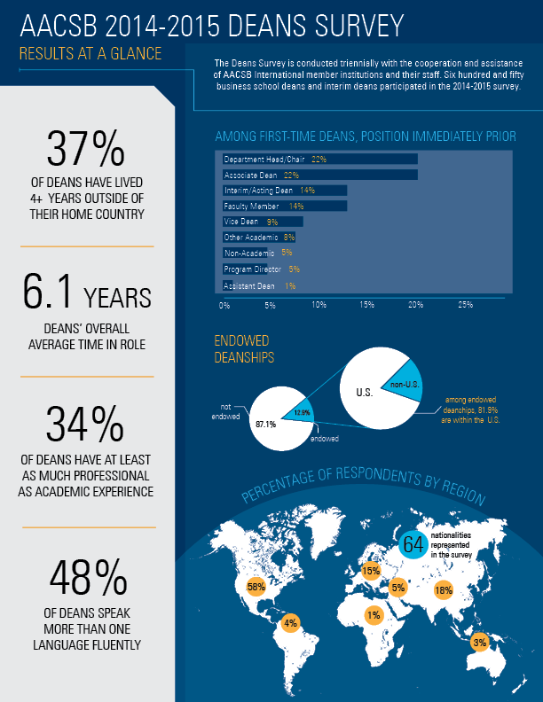
Types of Data Available
Students
Admissions, Enrollment, Degrees Conferred, Employment, Demographics, Class Sizes
Programs
Education Levels, Degree Titles, Delivery Methods
Faculty, Administrators, Staff
Demographics, Numbers Employed, Teaching Loads, Compensation and Salary data (aggregated)
General Institution Data
Institutional Control (Public vs. Private), Accreditation Status, Location, Mission and Research Priorities, Operating Budgets, Endowments, Uses and Sources of Funds, Effective Practices, Partnerships and Collaborations (Existing & Desired)
Notes:
The various surveys that AACSB regularly runs via DataDirect collectively gather a wealth of data from participating schools. They include data on Students at all levels; Degree programs of all levels and all delivery methods; Statistics on various categories of Faculty, Administrators, and Staff; and General data pertaining to the institutions that participate in the surveys.
AACSB also conducts a number of ad hoc surveys, or ones that span a few years, for example the Deans Survey which is conducted every 3 years. Most recent was launched at the end of 2014 and provides a profile of the business school dean. In the 2014-15 survey, 650 business school deans and interim deans participated.

Slide 14
Using the Data
Determine your peers and aspirants for continuous improvement benchmarking and/or quality assurance purposes
Find potential collaborative partners
Understand trends in the management education industry
Doctoral faculty demand
Popularity of different degree types
Operating budget trends
Notes:
As an AACSB member, regardless of accreditation status, the data AACSB collects can be useful to you in a number of ways:
Identify business schools with similar characteristics that may be peer or aspirant schools.
Find other AACSB member schools that are looking for partnerships with schools like yours.
Understanding trends related to the industry; e.g., doctoral faculty production, enrollment levels in various types of programs, or trends in operating budget levels.
******most importantly, we have a dedicated DataDirect team in place to assist you with accessing the site at anytime.

Slide 15
www.aacsb.edu/vision
Notes:
AACSB’s new mission was developed in close collaboration with “A Collective Vision for Business Education” report which has identified five opportunities for business schools to thrive as: Catalysts for Innovation, Co-Creators of Knowledge, Hubs of Lifelong Learning, Leaders on Leadership, and Enablers of Global Prosperity.
AACSB will support members in these roles and will be recognized as the premier peer-based accreditation organization for business schools, continuously improving the accreditation process and business education.
AACSB will strongly advocate for and increase awareness of the value of business education and accreditation.
The desired outcome of the AACSB mission and vision is to provide the world with better leaders who have a positive impact on global prosperity.

Slide 16
Accreditation

Slide 17
Purpose of Accreditation
Promote high quality and continuous improvement supported by engagement, innovation, and impact.
Use internal self-assessment and external peer review to confirm delivery of high quality management education and overall mission achievement.

Slide 18
Value of Accreditation
Cultivates meaningful interactions between
students and a qualified faculty
Produces graduates who have achieved
specified learning goals
Ensures currency of curricula and importance
of quality teaching
Makes a statement to external communities
about your commitment to quality and
continuous improvement

Slide 19
Accreditation is . . . .
Mission-driven
Principles based rather than rules based
Peer review – multiple levels
Focused on continuous improvement
Staff supported

Slide 20
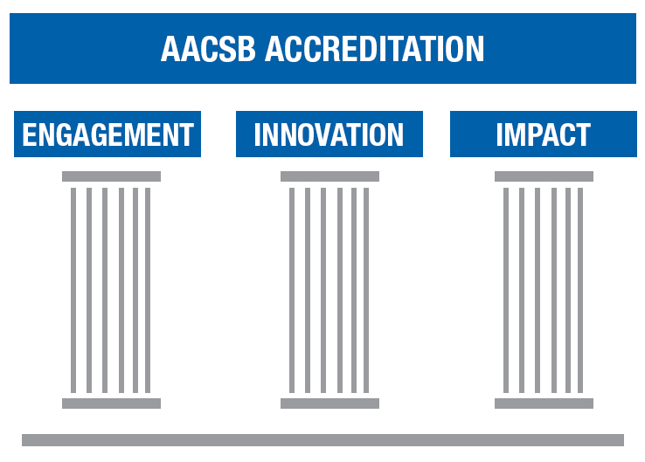

Slide 21
Delivering Relevant & High-Quality Management Education
Engagement
Innovation
Impact
Notes:
AACSB’s 2013 Standards, which focus on engagement, innovation, and impact, can help us meet the new challenges and opportunities, mitigating and taking advantage of disruptive forces. By being better engaged with business, we can keep our finger on the pulse of management needs and make sure we are “in the loop” for potential disruptions. By being innovative, schools can maximize the possibility that they are prepared for and can benefit from disruptions. We know in science and fields like venture capital, there are potentially high returns to innovation—whether on a large-scale experimentation or through “little bets.” As a result, business schools can make the positive impact on business, society, and their graduates that they were created to make.

Slide 22
Engagement
Schools are expected to:
Achieve both academic and professional engagement
Identify desired characteristics of engagement, aligned with the school’s mission

Slide 23
Innovation
Schools are expected to:
Be entrepreneurial and experiment
Innovations should be well-developed and aligned with mission & strategy
Innovation includes both the potential for success and risk of failure

Slide 24
Impact
Schools are expected to:
Focus on high quality outcomes that have impact
Produce intellectual contributions that have a positive impact on theory, teaching and practice
Demonstrate that the business school is “making a difference” in business and society

Slide 25
Discussion
Reflect and share 3 to 4 examples of Engagement, Innovation and Impact from your school and share with your table-mates. Share 3 to 4 of these examples with the workshop group.

Slide 26
Initial Accreditation Process

Slide 27
Eligibility Criteria
Demonstrating commitment to Core Values and Guiding Principles
A: Ethical Behavior
Establishing a fundamental expectation
B: Collegiate Environment
Advanced level, engagement, and faculty involvement
C: Commitment to Corporate and Social Responsibility
Fostering responsibility in society
Notes:
Establishes the context for accreditation reviews
Engages students, faculty, support staff, and the business community in the life of the business school
Implies stability and sufficient human resources to accomplish the mission
Implies sufficient infrastructure provided by the institution to accomplish the mission

Slide 28
Eligibility Criteria
Setting and framing the foundation for review
D: Accreditation Scope and AACSB Membership
Flexibility and criteria
E: Oversight, Sustainability, and Continuous Improvement
Foundations and context for accreditation review
F: Policy on Continued Adherence to Standards and Integrity of Submissions to AACSB
Consistency and Integrity
Notes:
Accreditation of the business programs must be embraced as a key strategic goal of the university
The magnitude of the necessary culture transformation and sustainable rate of change must be supported

Slide 29
Scope of Accreditation
Is the institution by default (programs that meet certain criteria may be excluded)
A school may request that a unit within a larger institution be the unit of accreditation
The unit seeking accreditation must be determined prior to the submission of Eligibility Application

Slide 30
Unit Criteria
Branding
External market perception
Financial relationships with the institution
Business academic unit autonomy

Slide 31
Reasons for Program Exclusion
Business content less than 25% (undergraduate) and 50% (graduate)
Demonstrate program distinctiveness from those programs included in the review
Demonstrate lack of operational control of program

Slide 32
Accounting Accreditation
Accounting academic unit may seek an additional programmatic accreditation in accounting from AACSB as an extension of the business accreditation process.
Accounting unit may pursue accreditation at the same time as business accreditation or once the school receives business accreditation.

Slide 33
Initial Accreditation Process

Slide 34
Eligibility Process
Institution | Academic Unit
Complete Eligibility Application | Complete academic unit request application and submit to accreditation@aacsb.edu
Request program exclusions as necessary | Complete Eligibility Application
 | Request program exclusions as necessary

Slide 35
Guidelines for Completion
Be detailed and concise
Judgment on satisfaction of eligibility criteria and preparedness for accreditation
Include: organizational chart, financial statements and school’s strategic plan

Slide 36
Guidelines for Submission
Applications accepted on a rolling basis
Reviewed every month
Staff review followed by committee review

Slide 37
Eligibility Application Next Steps
Outcome of review:
Acceptance
Revise/resubmit
Rejected
If application is accepted a mentor and staff liaison are assigned

Slide 38
Assignment of Mentor
AACSB staff, in consultation with IAC Chair, makes suggestion
The school accepts or declines
If accepted the mentor is invited
If mentor accepts, school is provided with mentor contact information
School contacts mentor to schedule first on-site visit

Slide 39
What to expect from the Mentor
Helps to respond to issues raised by IAC
Identifies challenges and opportunities
Assists in Initial Self-Evaluation Report (iSER) development
Confirms that processes and controls ensure continuous improvement and accomplishment of the mission

Slide 40
Working with your mentor
Establish contact with Mentor
Plan on-site visit – develop agenda
Provide information prior to the visit
Prepare draft documents for review by the mentor before submission to IAC

Slide 41
Working with your AACSB Staff Liaison
Dedicated point of contact at AACSB
Knowledgeable resource
Reviews documentation in advance (upon request)
Attends accreditation committee meetings and conveys decision to school

Slide 42
Guidelines for Development of the initial Self-Evaluation Report (iSER)
Plan for alignment with standards
Discuss key strategic initiatives
Keep the school’s mission in mind
Identify gap per standard, action to rectify, responsible party, resources and timeline
Supported by narrative
Supported by mentor (iSER Review Template to be submitted)

Slide 43
Gap Analysis
For each standard, analyze and document:
Where are you now?
Where do you want to be?
What do you have to do to get there?

Slide 44
iSER Development
Three separate and distinct sections:
Executive Summary
Introduction: background information on the institution
Standard-by-standard self-assessment and action plan

Slide 45
Characteristics of the iSER
Systematic (standard-by-standard)
Objective-based in reality
Multiple sources of input
Multiple reviewers for objectivity and accuracy
Realistic representation of strengths, weaknesses, opportunities, and threats

Slide 46
iSER Process
School has up to two years to develop
Review by IAC
Accepted: Initial Accreditation Visit
Accepted: Implementation of action items and provide annual updates or invited to apply for visit
Revise and resubmit
Request to withdraw

Slide 47
iSER update process
At least one iSER update submitted per year
Report describes the progress made related to objectives and action plan as well as responses to the IAC’s concerns
Original action summary table should be included indicating the status of each action item

Slide 48
iSER update con’d
Report on changes in the environment (internal and/or external)
Explain how existing strengths have been maintained or improved
Report new areas of improvement
Include the appropriate signatures

Slide 49
Evaluation of Alignment Progress
Points to consider:
Are the actions as outlined in the iSER completed?
Any remaining major gaps?
What is the probability of a successful visit?

Slide 50
Application for Initial Accreditation Visit
Letter of application
Scope of accreditation
Comparable peers, aspirants and competitors
Preferred date for visit
Suggestions for peer review team members
Collaborative process

Slide 51
The Initial Accreditation Visit
Work transitions from Mentor to Peer Review Team Chair
Development of Final Self Evaluation Report
Pre-Visit Letter
Visit occurs
Recommendation: accredit, deferral, denial
IAC and Board of Directors need to concur
Accreditation is extended for 5 years

Slide 52
Elements of a Positive Visit
Clear communication between the team and the applicant
Well prepared team members
Flexibility by the team and applicant
A good working relationship among team members
Sufficient “alone-time” for team

Slide 53
Elements of a Positive Visit- continued
Team members who avoid reacting to personal agendas
A team approach that is both evaluative and consultative
Adequate time to draft a clearly written team visit report

Slide 54
Continuous Improvement Review Process

Slide 55
Continuous Improvement Review Philosophy
The review begins from the premise of the accredability of the institution:
- The institution has previously been accredited
Show actions to continuously improve quality from one 5-year cycle to the next
Report on actions taken to address issues raised during the prior PRT visit
Process is forward looking and focused on continuous improvement, strategy and consultative issues

Slide 56
Continuous Improvement Review Summary
Year 3:
Repeat steps listed for year 1 and 2
Submit Continuous Improvement Review Application with preferred visit dates
Submit List of Degree Programs with links to course descriptions
Submit List of Comparison Groups (Peer, Competitive, and Aspirant)
Consultative elements
Year 1 and 2:
Review and refine Strategic
Management Plan
Complete Key Data and Accreditation
Data Sections of the Business School
Questionnaire or Accounting Program
Questionnaire for prior academic year

Slide 57
Continuous Improvement Review Summary
Year 5:
Repeat steps for year 1 and 2
Submit Fifth Year Continuous Review Improvement Report
Optional, request Accreditation Statistical Reports
Prepare visit schedule with Peer Review Team Chair
Peer Review Team visit occurs
Peer Review Team recommendation and committee review
Year 4:
Repeat steps listed for year 1 and 2
CIRC determines exclusions and
the scope of accreditation
AACSB Peer Review Team established
from peer and aspirant groups
Work with AACSB to set the visit date

Slide 58
Accreditation Standards Overview

Slide 59
Strategic Management and Innovation
Standard 1: Mission, Impact, and Innovation
Standard 2: Intellectual Contributions & Alignment with Mission
Standard 3: Financial Strategies and Allocation of Resources

Slide 60
Participants – Students, Faculty and Professional Staff
Standard 4: Student Admissions, Progression & Career Development
Standard 5: Faculty Sufficiency & Deployment
Standard 6: Faculty Management & Support
Standard 7: Professional Staff Sufficiency & Deployment

Slide 61
Learning and Teaching
Standard 8: Curricula Management & Assurance of Learning
Standard 9: Curriculum Content
Standard 10: Student–Faculty Interactions
Standard 11: Degree Program Educational Level, Structure, & Equivalence
Standard 12: Teaching Effectiveness

Slide 62
Academic and Professional Engagement
Standard 13: Student Academic & Professional Engagement
Standard 14: Executive Education
Standard 15: Faculty Qualifications & Engagement

Slide 63
Accreditation Volunteer
Roles

Slide 64
AACSB – Accreditation Volunteer Roles
Mentor
Member of peer review team
Initial accreditation
Continuous Improvement Review
Committee member:
Chair
Vice Chair
Reader/ Liaison

Slide 65
Role of the Mentor
Mentor/school relationship for multiple years
Visit the school
Helps the school determine if the accreditation effort is realistic
Educate the school on the standards
Provide guidance in developing and implementing plans to meet accreditation standards
Keeps the accreditation committee informed of the school’s progress

Slide 66
Initial Accreditation Chair
Responsibilities of the Chair:
Ensure team performs cohesively
Review applicant’s final SER
Chair the visit and coordinate the writing of the team report
Notes:
.

Slide 67
Initial Accreditation Team
Responsibilities of member:
Reviews the final SER
Provides input for the pre-visit letter
Actively participates in the on-site visit
Writes part of the team report

Slide 68
The Continuous Improvement Review Team Chair
Team Chair Responsibilities
May visit the school before the actual visit
Answers questions during development of the CIR report
Analyzes data, develops visit schedule and prepares the visit team report
Chairs the visit and coordinates the writing of the team report
Ensures the team performs effectively

Slide 69
Continuous Improvement Review Team Members
Team Member Responsibilities:
Reviews CIR Report
Provides Chair with questions/discussion items before the visit
Actively participates in the on-site review
Participates in the writing of the team report

Slide 70
Committee Member
Board of Directors delegates to:
3 Operating Committees:
Initial Accreditation Committee (IAC)
Continuous Improvement Review Committee (CIRC)
Accounting Accreditation Committee (AAC)
1 Oversight Committee
Committee on Accreditation Policy (CAP)

Slide 71
Committee Member
Attends 2-3 meetings per year
Reviews documentation submitted by schools
Serves as Reader or Liaison for assignments
Contacts team chair or mentor for additional information
Presents school information to committee and makes recommendation
About 10-15 hours preparation time

Slide 72
Comparison of Volunteer Roles
Mentor | Peer Review Team Member | Committee Member
2-5 year commitment | Assigned 12-18 months prior to visit | 2-3 year term
Visit school annually (or as needed) | Assist school with final SER or Fifth Year CIR report | Meet 2-3 times per year
Assist school in development and implementation of iSER | Conduct pre-visit (optional) and participate in peer review team visit (1 ½ - 2 ½ day visit) | Review school and team documentation; liaison/reader present assigned cases during meeting
Submit mentor reports to school and AACSB | Complete pre-visit letter (initial visits only); complete PRT report | Review decision letters and provide feedback
Provide feedback to IAC/AAC | Provide feedback to IAC/AAC/CIRC (if requested) | Consult with AACSB staff and mentors/PRT members (as needed)

Slide 73
Questions?

