Slide 1
AACSB International
SEAA Trust, November 2018
Amy Memon, Manager, Accreditation (Asia-Pacific)

Slide 2
Inspiring Transformation
Mission
We foster engagement, accelerate innovation, and amplify impact in business education.
Vision
Transforming business education for global prosperity.
Values
Quality • Inclusion and Diversity • Global Mindset
• Ethics • Social Responsibility • Community
Notes:
•The VISION of AACSB International is to transform business education for global prosperity. Business and business schools are a force for good, contributing to the world’s economy and to society, and AACSB International plays a significant role in making that benefit better known to all stakeholders − serving business schools, students, business and society.
•The MISSION of AACSB International is to foster engagement, accelerate innovation, and amplify impact in business education.
•aligned with AACSB accreditation standards for business schools.
•AACSB strives to continuously improve engagement among business, faculty, institutions, and students so that business education is aligned with business practice.
•To fulfill this goal, AACSB International will encourage and accelerate innovation to continuously improve business education. As a result, business education will have a positive impact on business and society − and AACSB will amplify that impact.
•In achieving its mission and vision, AACSB will emphasize and model the following
•VALUES: Quality, Inclusion & Diversity, a Global Mindset, Ethics, Social Responsibility, and Community.
•These values will drive AACSB’s future initiatives and interactions with the business education community worldwide.

Slide 3
The AACSB Global Network

Slide 4
The AACSB Landscape
1,657
831
1,580
77
54
101
187
TAMPA | SINGAPORE | AMSTERDAM
IN 2017-18
105
Spanning 5 Continents
5
Notes:
We have 3 offices worldwide to serve our members from each region. We have the Americas office is in Tampa, AP office in Singapore, and the Europe, Middle East, and Africa office in Amsterdam.
CONFERENCES
12 conferences + 4 Best Practice Series = 16
SEMINARS
Americas: 40 +3 onsite seminars + 1 bridge program = 44
EMEA: 20 + 3 onsite seminars + 1 bridge program = 24
AP: 20 + 1 onsite seminars = 21

Slide 5
Macro-Regions
Macro-Regions | AACSB Educational Members |  | AACSB-Accredited |  | In Accreditation Process
Americas | 762 | 48% | 574 | 70% | 58 | 21%
Asia-Pacific | 357 | 23% | 122 | 15% | 90 | 32%
EMEA | 461 | 29% | 135 | 16% | 127 | 46%
Global | 1,580 | 100% | 831 | 100% | 277 | 100%
Source: AACSB data and analysis as of 11/25/2018.
Note: Percentages may not sum to 100 due to rounding.

Slide 6
Sub-Regions
Macro-Regions | Sub-Regions | AACSB Educational Members |  | AACSB-Accredited |  | In Accreditation Process
Americas | Canada | 45 | 3% | 24 | 3% | 6 | 2%
Americas | United States | 641 | 41% | 527 | 64% | 37 | 13%
Americas | Latin America & Caribbean | 76 | 5% | 21 | 3% | 15 | 5%
Asia-Pacific | Central, Southern, South-Eastern, and Eastern Asia | 312 | 20% | 100 | 11% | 80 | 28%
Asia-Pacific | Oceania | 45 | 3% | 22 | 3% | 10 | 4%
EMEA | Africa | 33 | 2% | 5 | 1% | 6 | 2%
EMEA | Middle East | 82 | 5% | 18 | 2% | 26 | 10%
EMEA | Europe & Near East | 346 | 22% | 109 | 13% | 95 | 34%
Global | Global | 1,580 | 100% | 831 | 100% | 277 | 100%
Source: AACSB data and analysis as of 11/15/2018.
Note: In this table, “United States” excludes U.S. territories in Oceania and the Caribbean. Percentages may not sum to 100 due to rounding.
Notes:
Note: “Near East” and “Middle East” are AACSB subdivisions of the UN region known as Western Asia.

Slide 7
South Asia
Country/Territory Name | AACSB Member Schools | AACSB-Accredited Schools | In Pre/Initial Accred. Process
Afghanistan | 3 | 0 | 0
Bangladesh | 7 | 0 | 0
India | 53 | 9 | 17
Pakistan | 11 | 0 | 3
Sri Lanka | 4 | 0 | 0
Total | 78 | 9 | 20
Source: AACSB data and analysis as of 11/25/2018

Slide 8
India’s Accredited Schools

Slide 9
Be Part of the Business Education Alliance
Global Network
Affinity Groups
Exchange
Collaboration Concourse
Volunteer Opportunities
Quality Assurance and Quality Improvement (Accreditation)
Professional Development Events
Conferences
Seminars
Webinars and eLearning
Exhibiting and Sponsorship
Business Education Intelligence
Industry Reports
DataDirect Database
Country Profiles
BizEd Magazine
Career Services
AACSB Career Connection
Advertising
Notes:
Internationally recognized accreditation for undergraduate, master’s, and doctoral programs in business and accounting (Note: Membership does not imply accreditation.).
Conferences, seminars, symposiums, and webinars that provide global professional development opportunities for business school administrators and faculty.
Publications that provide insight into the business education industry.
Access to extensive global data and corresponding reports related to business schools.
Networking through affinity groups and events held both online and in live environments.
Sponsorships, exhibiting, and business development opportunities.
In addition to providing its members with products and services, AACSB International strives to identify challenges and trends that are facing the business education industry through its research and various initiatives.
The association also educates students, parents, employers, and counselors about accreditation and how to choose a quality business degree program that will fit their needs.

Slide 10
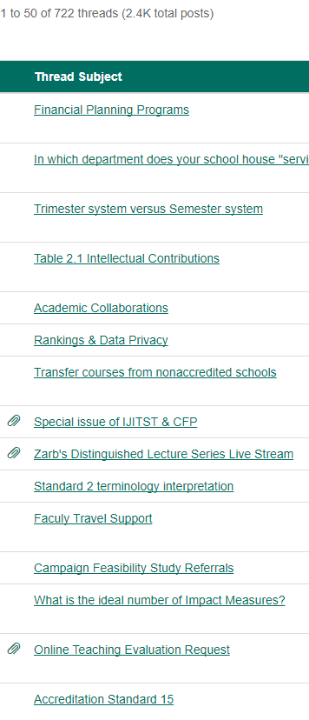
The Exchange: AACSB Member Forum
Discussing experiences
Finding solutions
Sharing materials
Notes:
This online community allows AACSB members worldwide to connect, engage and share experiences, industry information and best practices, seek and share advice, exchange resources and build relationships.
The AACSB Member Forum is an evolving collaborative community and your participation will enhance its value and strengthen this network of members worldwide.

Slide 11
Affinity Groups and Networks
Email membership@aacsb.edu to join!
Collaborate with peers in the same region or with the same interests or job responsibilities, online and in person
Asia Pacific
Associate Deans
Development Professionals
Digital Transformation
Diversity & Inclusion
DocNet
Entrepreneurship Programs
European
Marketing and Communications Council
MBA for Working Professionals
Metropolitan Business Schools
Middle East and North Africa
New Deans Learning Community
Online Learning
Quality Assurance Professionals and Accreditation Support
Responsible Management Education
Small Schools Network
Technology in Business Schools Roundtable
Women Administrators in Management Education
Notes:
AACSB Affinity Groups facilitate the professional development, networking and communication among members that share common interests or job responsibilities, contributing to members achieving their quality and continuous improvement objectives. The AACSB Board of Directors has endorsed Affinity Groups as an effective way to create knowledge-sharing and communities of practice among segmented portions of the membership. Groups are volunteer led and peer-engaged, with logistical support offered by AACSB.
There are currently 18 AGs listed on our website, and participation in affinity groups is exclusively limited to AACSB members and membership is free of charge, although some groups may charge a nominal registration fee to cover meeting expenses.

Slide 12
The Exchange: Volunteer Portal
Notes:
Our goal here is to share volunteer opportunities and establish a simple process to engage with AACSB. What you need to do is to complete your volunteer profile to indicate your academic & business expertise. This profile setup should take no more than 10 minutes.

Slide 13
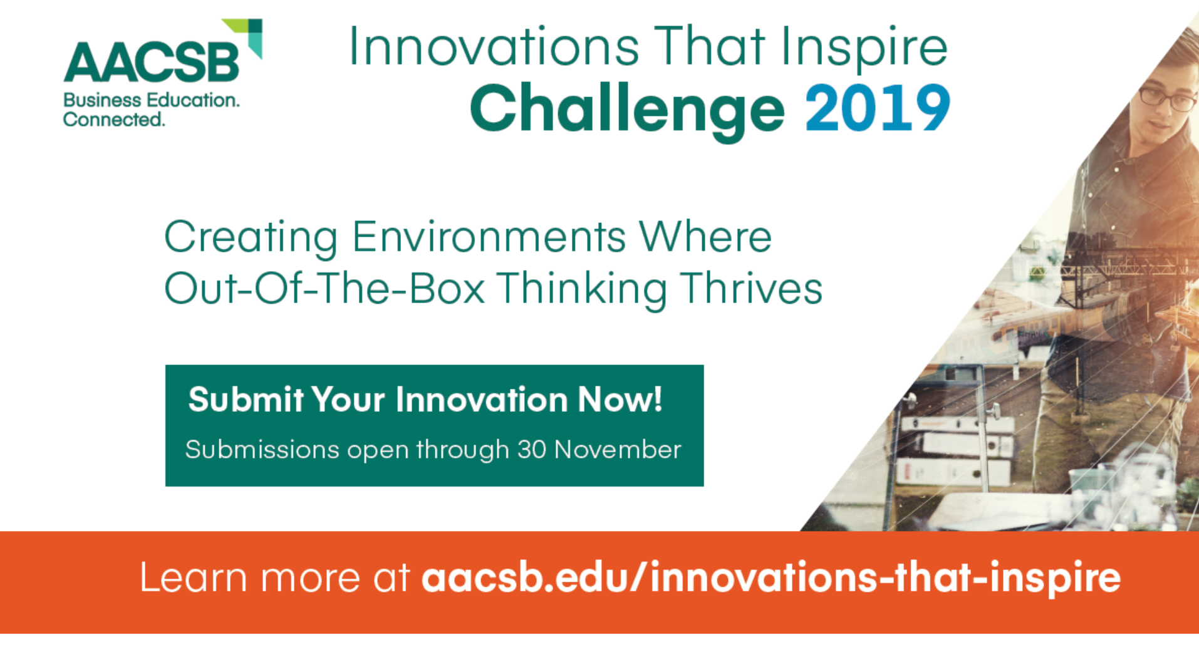
Notes:
o innovate in the way they create and disseminate knowledge

Slide 14
Upcoming Events
Hyderabad, India
Business Accreditation Seminar (25–26 February 2018)
Accreditation Eligibility Workshop (27 February 2018)
Bangkok, Thailand
Assurance of Learning Seminar I (March 27–28, 2019)
Assurance of Learning Seminar II (March 29–30, 2019)
Kuala Lumpur, Malaysia
Annual Accreditation Conference: Asia Pacific (26–28 May 2019)
Quality Assurance Professionals Workshop (24 May 2019)
Continuous Improvement Review Seminar (25 May 2019)
Business Accreditation Seminar (29–30 May 2019)

Slide 15
DataDirect: The Most Comprehensive Database on Business Schools in the World

Slide 16
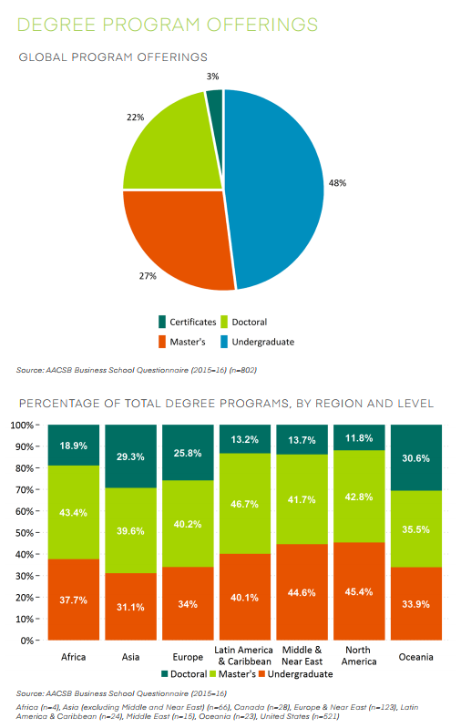
Types of Data Available
Students
Admissions, Enrollment, Degrees Conferred, Employment, Demographics, Class Sizes
Programs
Education Levels, Degree Titles, Delivery Methods
Faculty, Administrators, Staff
Demographics, Numbers Employed, Teaching Loads, Compensation and Salary data (aggregated)
General Institution Data
Institutional Control (Public vs. Private), Accreditation Status, Location, Mission and Research Priorities, Operating Budgets, Endowments, Uses and Sources of Funds, Effective Practices, Partnerships and Collaborations (Existing & Desired)
Notes:
The various surveys that AACSB regularly runs via DataDirect collectively gather a wealth of data from participating schools. They include data on Students at all levels; Degree programs of all levels and all delivery methods; Statistics on various categories of Faculty, Administrators, and Staff; and General data pertaining to the institutions that participate in the surveys.
AACSB also conducts a number of ad hoc surveys, or ones that span a few years, for example the Deans Survey which is conducted every 3 years. Most recent was launched at the end of 2014 and provides a profile of the business school dean. In the 2014-15 survey, 650 business school deans and interim deans participated.
Understanding trends related to the industry; e.g., doctoral faculty production, enrollment levels in various types of programs, or trends in operating budget levels.

Slide 17
BizEd Magazine
Notes:
A bi-monthly magazine published by AACSB in print and online for our members which covers insights, trends, and innovations in the global business education.

Slide 18
Accreditation

Slide 19
AACSB Accreditation Philosophy
Mission-driven
Standards are guidelines, not a checklist. Diversity expected
Emphasis on high quality and continuous improvement
Internal self-assessment & External peer review: Reviewers are business school leaders, trained and knowledgeable on accreditation standards and processes
3 themes:
Innovation
Engagement
Impact

Slide 20
Initial Accreditation Process

Slide 21
Multiple Levels of Peer Review
Operating Committees –
Initial Accreditation Committee (IAC)
Continuous Improvement Review Committee (CIRC)
Accounting Accreditation Committee (AAC)
Mentor for initial accreditation
Peer Review Team – 3 members: PRT Chair & 2 other members

Slide 22
Initial Accreditation Process
Year 1
Mentor assignment and onsite visit
Year 2
iSER development cont'd
Onsite mentor visit, if necessary
Year 3
Year 4
Year 5
Year 6
Year 7
iSER development
Committee review: iSER
Possible invitation to apply for a visit
Onsite mentor visit, if necessary
Committee review: 1st iSER Update
Committee review process: EA
Possible invitation to apply for a visit
Possible invitation to apply for a visit
Committee review: 2nd
iSER Update
Onsite mentor visit, if necessary
Invited to apply for a visit or asked to withdraw
Committee review: 3rd iSER Update
Onsite mentor visit, if necessary
PRT appointed and visit dates confirmed
PRT Chair optional pre-visit
Finalize SER
PRT sends pre-visit letter (PVL)
SER submitted
IAC review of PRT report and Board ratification
Visit conducted
School responds to PVL
Option:
1-yr extension of iSER
(up to 2)
Gap Analysis iSER
Closing Gaps / iSER Updates
Gaps Closed / SER / Visit
Ready for SER and Visit
Notes:
Orange = school submission to AACSB
Establish eligibility and early stage readiness
School develops iSER with guidance from mentor
Feedback provided by IAC and mentor
The iSER is generally developed within one year, although a maximum of two years is allowed
School documents readiness for initial accreditation
Feedback from IAC and mentor
The iSER implementation period lasts a maximum of three years; the IAC decides when the school is ready to progress to the visit stage
Two years allowed for final self-evaluation report and review
Visit typically occurs four to six months following submission of final SER
PRT conducts visit and submits report with recommendation
IAC reviews PRT report and recommendation
Board of Directors reviews accredit, extend or revoke recommendations

Slide 23
Continuous Improvement Review Philosophy
The institution/business academic unit is AACSB accredited
Forward-looking process with a focus on strategy and consultative issues, and continuous improvement
Actions taken to address issues raised during the prior visit
Show actions to continuously improve quality from one 5-year cycle to the next

Slide 24
Continuous Improvement Review Process
Year 1
Complete Key Data and Accreditation Sections of the Business School Questionnaire
Year 2
Review and refine Strategic Management Plan
Year 3
Year 4
Year 5
Review and refine Strategic Management Plan
Review and refine Strategic Management Plan
CIRC determines exclusions and the scope of accreditation
Review and refine Strategic Management Plan
Complete Key Data and Accreditation Data Sections of the Business School Questionnaire
Complete Key Data and Accreditation Data Sections of the Business School Questionnaire
Submit Continuous Improvement Review Application with preferred visit dates on July 1
Peer Review Team established from PRT nomination form, peer and aspirant groups
Work with AACSB to set the visit date
Review and refine Strategic Management Plan
Complete Key Data and Accreditation Data Sections of the Business School Questionnaire
Complete Key Data and Accreditation Data Sections of the Business School Questionnaire
Submit Fifth Year Continuous Review Improvement Report
Request Accreditation Statistical Reports (optional)
Prepare visit schedule with Peer Review Team Chair
Peer Review Team visit occurs over 2 days
Peer Review Team recommendation and committee review
Submit PRT nomination form
Notes:
Orange = submissions to AACSB

Slide 25
AACSB Accreditation Standards
Strategic Management and Innovation
Mission, Impact, and Innovation
Intellectual Contributions and Alignment With Mission
Financial Strategies and Allocation of Resources
Learning and Teaching
8. Curricula Management and Assurance of Learning
9. Curriculum Content
10. Student-Faculty Interactions
11. Degree Program Educational Level, Structure, and Equivalence
12. Teaching Effectiveness
Participants: Students, Faculty and Professional Staff
4. Student Admissions, Progression, and Career Development
5. Faculty Sufficiency and Deployment
6. Faculty Management and Support
7. Professional Staff Sufficiency and Deployment
Academic and Professional Engagement
13. Student Academic and Professional Engagement
14. Executive Education
15. Faculty Qualifications and Engagement

Slide 26
Useful Links
Resource | Link
Eligibility application form | https://www.aacsb.edu/-/media/aacsb/docs/accreditation/business/eligibility/business-eligibility-application.ashx?la=en
Standards (now contains samples of Tables) | https://www.aacsb.edu/accreditation/standards/business
Actions and Timeframe policy – Process | https://www.aacsb.edu/-/media/aacsb/docs/accreditation/policies/actions-time-frame-policy.ashx?la=en
Unit of accreditation application form | https://www.aacsb.edu/-/media/aacsb/docs/accreditation/academic-unit/application-unit-of-accreditation.ashx?la=en
Initial accreditation - key submission guidelines and templates | https://www.aacsb.edu/accreditation/business/initial-accreditation
Useful events | https://www.aacsb.edu/events/seminars/business-accreditation (Business Accreditation Seminar) https://www.aacsb.edu/events/seminars/aol-one (Assurance of Learning I Seminar) https://www.aacsb.edu/events/seminars/accreditation-eligibility (Eligibility Workshop)
Committee meeting dates | https://www.aacsb.edu/volunteers/accreditation

Slide 27
Thank you! Amy Memon amy.memon@aacsb.edu +91-91-6753-9116

