Slide 1
AACSB International Quality Assurance
Amy Memon- Manager, Accreditation Services (Asia-Pacific)
November 2017 – New Delhi

Slide 2
Notes:
Our new brand essence (and tagline), “Business Education. Connected.” crystalizes our role in connecting the world’s business educators, corporate learning executives, and business students. Through connection and sharing of global, diverse perspectives, we are all stronger.
What is the significance of the pattern in our visual brand?
The weave pattern is a prominent feature of our new visual brand. It represents how we connect people (from academia and business) and ideas to create strong results. The dynamic nature of the pattern lends impact to all of our communications, and its flexibility conveys AACSB’s adaptive nature. The pattern comprises our core color palette, which is anchored by dark teal and accented by a suite of bright colors. This palette was designed to convey the optimism and forward-thinking nature of AACSB.
Why did AACSB decide to create a new brand?
AACSB’s Advocacy and Awareness initiative supports the new mission, strategies, and collective vision for business education that were released as part of our centennial celebration in 2016. With those important milestones comes a renewed focus on how we communicate to help business educators, students, business, industry stakeholders, and the world understand the critical role that business education plays in developing the leaders of tomorrow. It represents the optimism we all feel and how AACSB can contribute to the success of our members and, through them, to a more prosperous world in support of our mission and vision for the future.
How was the brand developed?
We created the brand by engaging the people who know us best—AACSB staff and global membership—through interviews and online surveys. We also surveyed students and business learning executives. Our goal was to acquire a truly 360-degree understanding of how we are perceived by our most important audiences and what they need and expect from us to make them more successful. The perspectives and insights from this research informed every aspect of the brand, from the research phase to strategy development to visual design—and now to our launch.
What is the ‘big idea’ behind the brand?
The research revealed to us that our members value the connections AACSB provides: connections to their colleagues, to their peers in other regions and countries, and to businesses. They value the connections we provide to new ideas and best practices through our publications and research. They value the connections they make through networking at our many events. They value our quality assurance tools and expertise. This insight into what our members most value led to the essence of the brand: “Business Education. Connected.”

Slide 3
Inspiring Transformation
Mission
We foster engagement, accelerate innovation, and amplify impact in business education.
Vision
Transforming business education for global prosperity.
Values
Quality • Inclusion and Diversity • Global Mindset
• Ethics • Social Responsibility • Community
Notes:
The VISION of AACSB International is to transform business education for global prosperity. Business and business schools are a force for good, contributing to the world’s economy and to society, and AACSB International plays a significant role in making that benefit better known to all stakeholders − serving business schools, students, business and society.
The MISSION of AACSB International is to foster engagement, accelerate innovation, and amplify impact in business education.
aligned with AACSB accreditation standards for business schools.
AACSB strives to continuously improve engagement among business, faculty, institutions, and students so that business education is aligned with business practice.
To fulfill this goal, AACSB International will encourage and accelerate innovation to continuously improve business education. As a result, business education will have a positive impact on business and society − and AACSB will amplify that impact.
In achieving its mission and vision, AACSB will emphasize and model the following
VALUES: Quality, Inclusion & Diversity, a Global Mindset, Ethics, Social Responsibility, and Community.
These values will drive AACSB’s future initiatives and interactions with the business education community worldwide.
[not included in the image, but for reference]
Over the next few years, AACSB International will focus strategically on five key customer‐focused areas as well as key enablers to deliver on our mission:
Quality Assurance & Quality Improvement (Accreditation)
Advocacy & Awareness
The AACSB Network
Professional Development
Business Education Intelligence
Enablers

Slide 4
The AACSB Network
Global Network of Educational Institutions and Business Organizations

Slide 5
The AACSB Landscape
1608
796
1,540
68
53
100
185
TAMPA | SINGAPORE | AMSTERDAM
IN 2016-17,
89
Spanning 5 Continents
5
Notes:
The AACSB Landscape:
Total Members: 1,580
Educational Members: 1,517
Business Members & Management Associations: 63
Total Countries/Territories: 97
786 accredited business schools in 53 countries
186 holding accounting accreditation in 8 countries
Events
SEMINARS: Public Seminars: 75 spanning 5 continents, 16 countries/territories.
CONFERENCES: There were 13 conferences in the following countries: U.S., Peru, China, Germany, Singapore, Italy

Slide 6
AACSB – Founded in 1916
Americas Office in Florida in the USA
Asia Pacific Office in Singapore
Europe, the Middle East and Africa Office in Amsterdam
Total 80 employees
1250 volunteer assignments annually

Slide 7
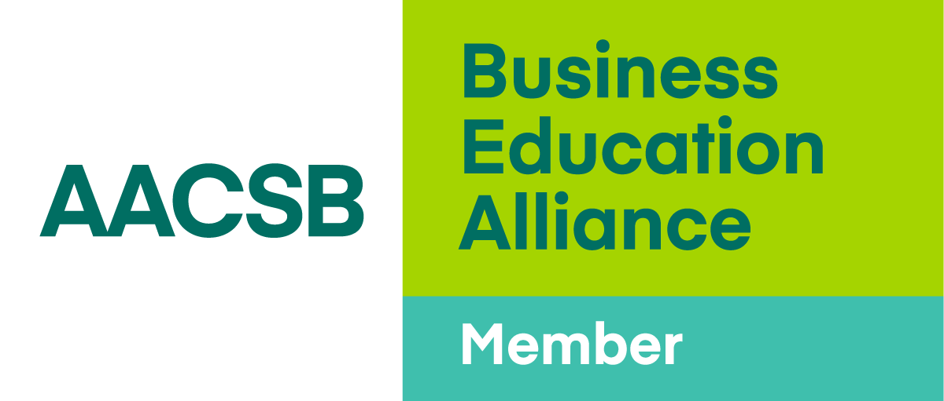
Join the AACSB Global Network
Membership application-form
An organizational chart of the full institution, as well as an organizational chart of the Business faculty
A listing of institutions where the institution is currently collaborating with.
Documentation from a government body that certifies that the institution is authorized to grant degrees

Slide 8
Be part of the Business Education Alliance
Global Network
Affinity Groups
Exchange
Collaboration Concourse
Volunteer Opportunities
Quality Assurance and Quality Improvement (Accreditation)
Business Education Intelligence
Industry Reports
DataDirect Database
Country Profiles
BizEd Magazine
Professional Development Events
Conferences
Seminars
Webinars and eLearning
Exhibiting and Sponsorship
Career Services
BizSchoolJobs.com
Advertising
Notes:
Membership Benefits

Slide 9
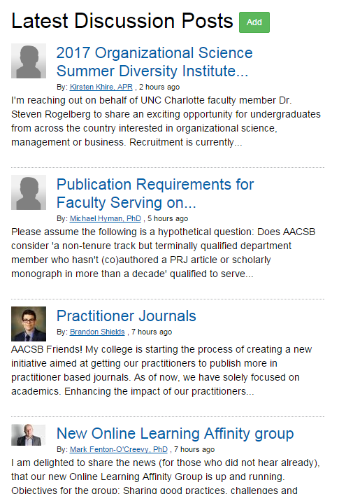
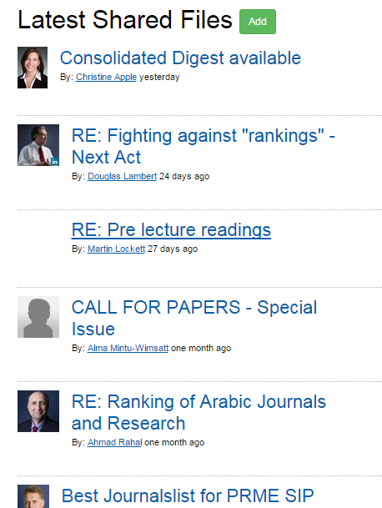
AACSB Exchange: Get Connected
AACSB Exchange Get Connected.
http://theexchange.aacsb.edu/home
Discuss Experiences
Share Materials
Discuss Experiences
Find Solutions
Find Solutions
Share Materials

Slide 10
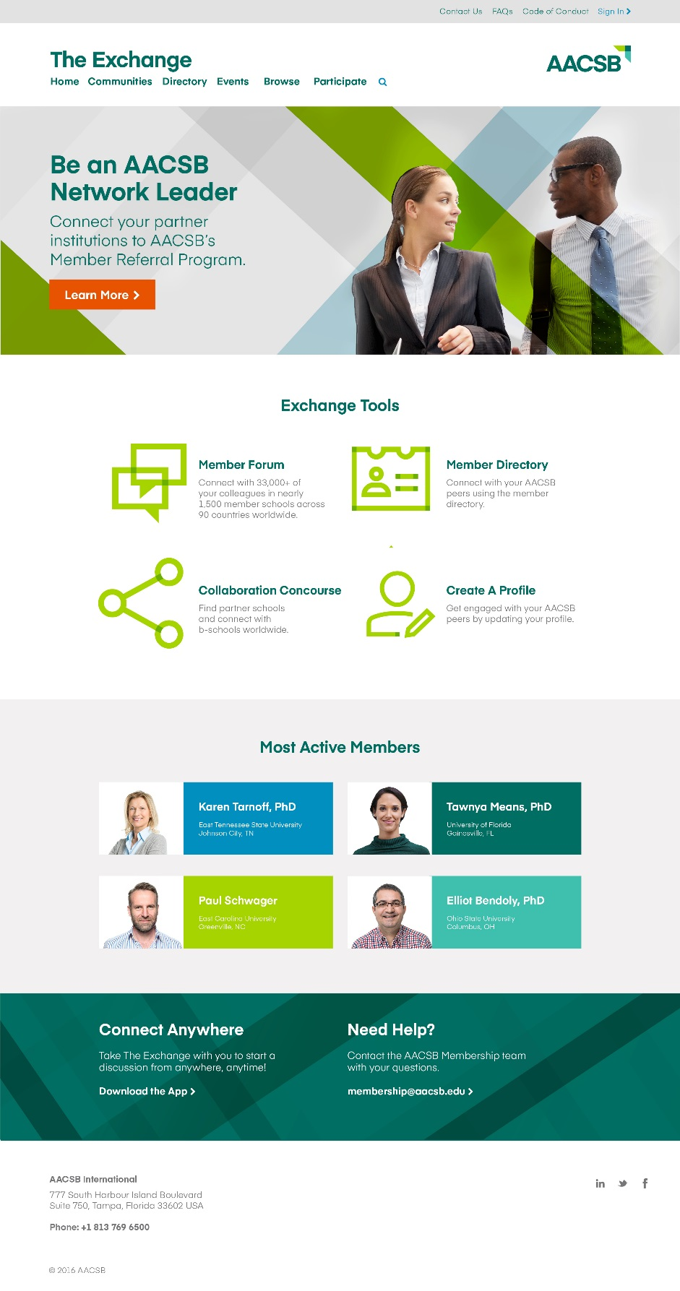
AACSB Exchange: Collaboration Concourse Find institutions that want to collaborate with your school.

Slide 11
Quality Improvement - Innovations That Inspire
The AACSB International initiative shines a spotlight on a variety of ways that business schools are changing the face of management education.
Categories:
Engagement Across Disciplines
Engagement With Business
Engaging A Diverse Community
Exemplify some of the ways business schools are taking a forward-looking approach to education, establishing cutting-edge ties with industry, and even championing revolutionary initiatives for the betterment of higher education as a whole.

Slide 12
Professional Development

Slide 13
Get connected at AACSB events
Asia–Pacific Accreditation Conference – 23-25 May 2018 – Hong Kong
aacsb.edu/events

Slide 14
Business Education Intelligence

Slide 15
Envisioning the Future: Business Schools Will Be…
Co-Creators of Knowledge
Catalysts for Innovation
Enablers of Global Prosperity
Leaders on Leadership
Hubs of Lifelong Learning

Slide 16
AACSB DataDirect Turn Data Into Action.
Benchmark Against Peers
Create Customizable Comparison Groups
Identify Trends
Notes:
As an AACSB member, regardless of accreditation status, the data AACSB collects can be useful to you in a number of ways:
Identify business schools with similar characteristics that may be peer or aspirant schools.
Find other AACSB member schools that are looking for partnerships with schools like yours.
Understanding trends related to the industry; e.g., doctoral faculty production, enrollment levels in various types of programs, or trends in operating budget levels.
Determine your peers and aspirants for continuous improvement benchmarking and/or quality assurance purposes
Find potential collaborative partners
Understand trends in the management education industry
Doctoral faculty demand
Popularity of different degree types
Operating budget trends
******most importantly, we have a dedicated DataDirect team in place to assist you with accessing the site at anytime.

Slide 17
Advocacy and Awareness

Slide 18
Advocating for Business Education
Showcasing the work of business schools as a force for good in society.
Increasing AACSB awareness among students and business practice
Staff survey
Showing the value of business education through data and stories
Notes:
Prioritize resources A&A and highlight.

Slide 19
Leading Conversations

Slide 20
Quality Assurance and Quality Improvement

Slide 21
AACSB Accreditation
The most rigorous standards of excellence in business education
Demonstrates your commitment to quality and continuous improvement to faculty, students, and business

Slide 22
Accreditation is…
Mission-driven
Principles based rather than rules based
Peer review – multiple levels
Focused on continuous improvement
Staff supported

Slide 23
Value of Accreditation
Cultivates meaningful interactions between students and a qualified faculty
Produces graduates who have achieved specified learning goals
Ensures currency of curricula and importance of quality teaching
Makes a statement to external communities about your commitment to quality and continuous improvement
Notes:
Some features of AACSB accreditation. Again, the focus is on quality and continuous improvement. Accreditation process is mission driven and therefore supports and encourages variety in mission statements. AACSB has a very diverse population of accredited schools (i.e. top research institutions, teaching schools, large, small, etc.). Research and the advancement of knowledge is also a central tenet in AACSB accreditation. Quote Jerry: research is a non-negotiable aspect of accreditation and we will discuss this later on. Also currency of the curriculum and its ability to prepare students not only for the present but also the future is important.

Slide 24
The Real Value of AACSB Accreditation*
89% of graduates from AACSB accredited schools rate their education as good to outstanding value
89% of graduates from AACSB accredited schools would recommend their graduate management program to others
90% of ranked schools globally are AACSB accredited
*Graduate Management Admissions Council Research

Slide 25
The Real Value of AACSB Accreditation*
4/5 alumni from AACSB accredited schools say their graduate management education has contributed to improvements in their competitiveness, proactiveness, innovativeness and creativity
9/10 alumni from AACSB accredited schools say their education increased their earning power and are satisfied with their current earnings
5 years after graduation the majority were senior-level or higher in their organization
*Graduate Management Admissions Council Research

Slide 26
Delivering Relevant & High-Quality Management Education
Engagement
Innovation
Impact
Notes:
AACSB’s 2013 Standards, which focus on engagement, innovation, and impact, can help us meet the new challenges and opportunities, mitigating and taking advantage of disruptive forces. By being better engaged with business, we can keep our finger on the pulse of management needs and make sure we are “in the loop” for potential disruptions. By being innovative, schools can maximize the possibility that they are prepared for and can benefit from disruptions. We know in science and fields like venture capital, there are potentially high returns to innovation—whether on a large-scale experimentation or through “little bets.” As a result, business schools can make the positive impact on business, society, and their graduates that they were created to make.

Slide 27
Engagement
Schools are expected to:
Achieve both academic and professional engagement
Identify desired characteristics of engagement, aligned with the school’s mission
Notes:
Shared common purpose across all b schools is the preparation of students for meaningful professional, social and personal lives
Criterion B UNDER Part 1: Core Values and Guiding Principles- page 5 accreditation standards- COLLEGIATE ENVIRONMENT
Standard 1: The school articulates a clear and distinctive mission, the expected
outcomes this mission implies, and strategies outlining how these outcomes will be
achieved. The school has a history of achievement and improvement and specifies future
actions for continuous improvement and innovation consistent with this mission,
expected outcomes, and strategies. [MISSION, IMPACT, AND INNOVATION]
Examples: having practitioners on the Board or reviewing curriculum; internships; organizing public events on campus

Slide 28
Innovation
Schools are expected to:
Be entrepreneurial and experiment
Have innovations that are well-developed and aligned with mission & strategy
Have innovation that includes both the potential for success and risk of failure
Notes:
Standard 1: The school articulates a clear and distinctive mission, the expected outcomes this mission implies, and strategies outlining how these outcomes will be achieved. The school has a history of achievement and improvement and specifies future actions for continuous improvement and innovation consistent with this mission, expected outcomes, and strategies. [MISSION, IMPACT, AND INNOVATION]
Global partnerships; joint programs; digital learning (NEOMA > immersive virtual reality courses with headsets: breaking the learning routine and hands-on experience of new technology)

Slide 29
Impact
Schools are expected to:
Focus on high quality outcomes that have impact
Produce intellectual contributions that have a positive impact on theory, teaching and practice
Demonstrate that the business school is “making a difference” in business and society
Notes:
Be aware of focus first on high quality inputs (human, financial, physical) and the outcomes of those inputs within the context of the b schools mission and strategies
IC impact on theory = creation of new knowledge
IC impact on teaching = spreading this new knowledge
IC impact on practice = the use of this new knowledge
Examples:
- Uni of Manchester: creater Health Services Research Centre, bringing together health and business researchers to develop new perspectives on how health and social care can be delivered;
- DCU delivers 2 programs at Princess Nora bint Abdulrahman University (PNU) in Riyadh, Saudi Arabia. With over 50, 000 students, PNU is the world's largest female only university. DCU faculty teaches online.

Slide 30
AACSB Accreditation: 15 Standards
Strategic Management & Innovation (3)
Participants (4)
Learning and Teaching (5)
Academic & Professional Engagement (3)

Slide 31
Initial Accreditation Process

Slide 32
Initial Accreditation Timeline
Eligibility Application | Initial Self-Evaluation Report | Initial Accreditation Readiness | Final Self-Evaluation Report and Review
Submission at anytime | 2 years allowed | 3 years allowed | 2 years allowed
Eligibility Application: establishes eligibility and early-stage readiness, followed by additional feedback from Initial Accreditation Committee (IAC)
iSER: documents readiness for initial accreditation, followed by feedback from IAC and mentor
iSER implementation period lasts a maximum of three years (iSER Updates); the IAC decides when the school is ready to progress to the visit stage (final SER)
Initial visit: typically occurs four to six months following submission of final SER
Peer Review Team (PRT) conducts visit and submits report with recommendation
IAC reviews PRT report and recommendation
Board of Directors reviews accredit, extend or revoke recommendations
Notes:
Link to Initial Accreditation page: http://www.aacsb.edu/accreditation/business/initial-accreditation.aspx
Link to CIR page: http://www.aacsb.edu/accreditation/business/continuous-improvement-review/

Slide 33
ELIGIBILITY CRITERIA
A: Ethical Behavior
Establishing a fundamental expectation
B: Collegiate Environment
Advanced level, engagement, and faculty involvement
C: Commitment to Corporate and Social Responsibility
Fostering responsibility in society
D: Accreditation Scope and AACSB Membership
Flexibility and criteria
E: Oversight, Sustainability, and Continuous Improvement
Foundations and context for accreditation review
F: Policy on Continued Adherence to Standards and Integrity of Submissions to AACSB
Consistency and Integrity
Notes:
Establishes the context for accreditation reviews
Engages students, faculty, support staff, and the business community in the life of the business school
Implies stability and sufficient human resources to accomplish the mission
Implies sufficient infrastructure provided by the institution to accomplish the mission
Accreditation of the business programs must be embraced as a key strategic goal of the university
The magnitude of the necessary culture transformation and sustainable rate of change must be supported

Slide 34
Continuous Improvement Review Process

Slide 35
Continuous Improvement Review Philosophy
Review occurs every 5 years | Must document continuous improvement | Standards alignment expected | Strong focus on consultative feedback and continuous improvement
The review begins from the premise of the accreditability of
the institution:
The institution has previously been accredited
Show actions to continuously improve quality from one 5-year cycle to the next
Report on actions taken to address issues raised during the prior Peer Review Team visit
Process is forward looking and focused on continuous improvement, strategy and consultative issues

Slide 36
Accreditation Standards: Overview and Tips for Success

Slide 37
AACSB Accreditation Standards
Mission, Impact, and Innovation
Intellectual Contributions and Alignment With Mission
Financial Strategies and Allocation of Resources
8. Curricula Management and Assurance of Learning
9. Curriculum Content
10. Student-Faculty Interactions
11. Degree Program Educational Level, Structure, and Equivalence
12. Teaching Effectiveness
4. Student Admissions, Progression, and Career Development
5. Faculty Sufficiency and Deployment
6. Faculty Management and Support
7. Professional Staff Sufficiency and Deployment
13. Student Academic and Professional Engagement
14. Executive Education
15. Faculty Qualifications and Engagement

Slide 38
Tips for success in the Indian context
Become mission-driven:
Take the time to understand what it means to be mission-driven.
Stakeholder engagement must be and authentic and holistic for strategic management.
Connect past achievements with future plans and expected outcomes to the mission.
Drive the mission down to the program level.

Slide 39
Tips for success in the Indian context
Lead the process:
Accreditation requires a team that includes senior administrators.
Don’t underestimate the power of polished and complete documentation.
Faculty engagement increases throughout.
Continuity of engagement with mentor and AACSB staff liaison is important.
Demonstrating continuous improvement is the goal

Slide 40
Tips for success in the Indian context
Assurance of learning
Focus on program-level assessment.
Keep it simple but meaningful
Trial and error. Expect tweaks to the system before valid results can be achieved.
Curricular changes need to be the result of direct assessment.
Focus on the what the assessment data tell you.

Slide 41
Thank you!

Slide 42
Most significant changes – July 2017
Preamble and Eligibility Criteria
Criteria C: Added a definition of diversity and guidance. Added diversity guidance in Standards 4, 5, 6, 7, 10 and 12
Criteria D: Added guidance regarding program inclusion
Criteria F: Added guidance regarding accreditation timeline
Standard 2:
Updated Table 2-1 guidance regarding which faculty to include in the table, external recognition for quality and impact, impact on professional practice
Added Table 2-2 – list of most frequent PRJ citations
Standard 3:
Added guidance regarding changes in resources or financial model during the last 5 years, and projections for the next five years

Slide 43
Most significant changes – July 2017
Standard 9:
Added guidance in the General Business Knowledge Area regarding evidence-based decision-making and data analytics - Drawn from the Accounting standards
Standard 11:
Added guidance regarding competency based education
Standard 15:
Clarified timeline guidance regarding new doctoral degrees and ABD status
Added guidance regarding engagement with professional standards setting bodies
Added guidance about describing faculty deployment in the past five years and the plans for future deployment
Added guidance regarding non-alignment with the standard, especially as it relates to emerging disciplines
Added guidance in the basis for judgement and guidance for documentation to align with the word “guideline” in Table 15-1
Updated Tables 15-1 and 15-2

Slide 44
Most significant changes – July 2017
Appendices:
Updated and renamed Appendix I: Examples of Impact Metrics in Support of Documentation.
Added Appendix II: A Collective Vision for Business Education: Utilizing the Framework within the Context of Strategic Planning & Accreditation Reviews

