Slide 1
AACSB International:
Reimaging Business Accreditation
Amy Memon
Manager, Accreditation Services (Asia-Pacific)
AACSB International
Notes:
This presentation is current as of November 11, 2019. It will be updated on an on-going basis for LT and accreditation team to use as needed. We have taken the approach of anchoring on the current exposure draft and providing dynamic updates embedded within the slides so it is always current. As the slides change, I will include a “current as of” date in the file name.

Slide 2
Today’s Goals
Overview of AACSB Accreditation
Global Trends in Business Education
Overview of first exposure draft of proposed 2020 business accreditation standards

Slide 3
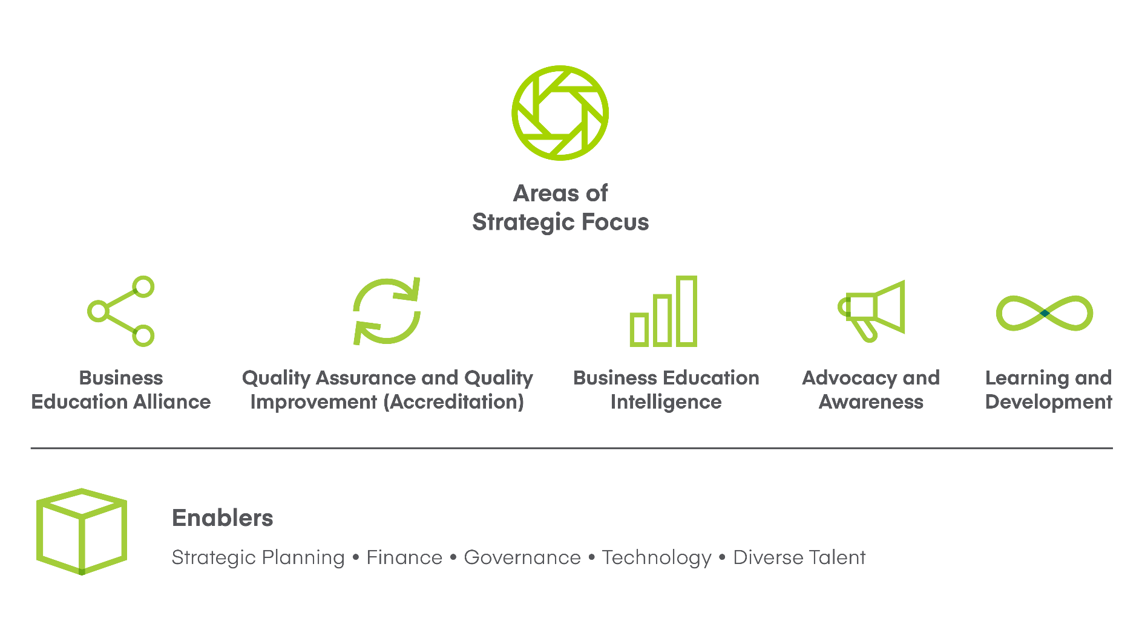
AACSB: Strategy Map
Notes:
As the world’s largest business education alliance, AACSB International connects educators, students, and business to achieve a common goal: to create the next generation of great leaders. We are a global association of leaders in education and business, dedicated to supporting and advancing quality business education worldwide.

Slide 4
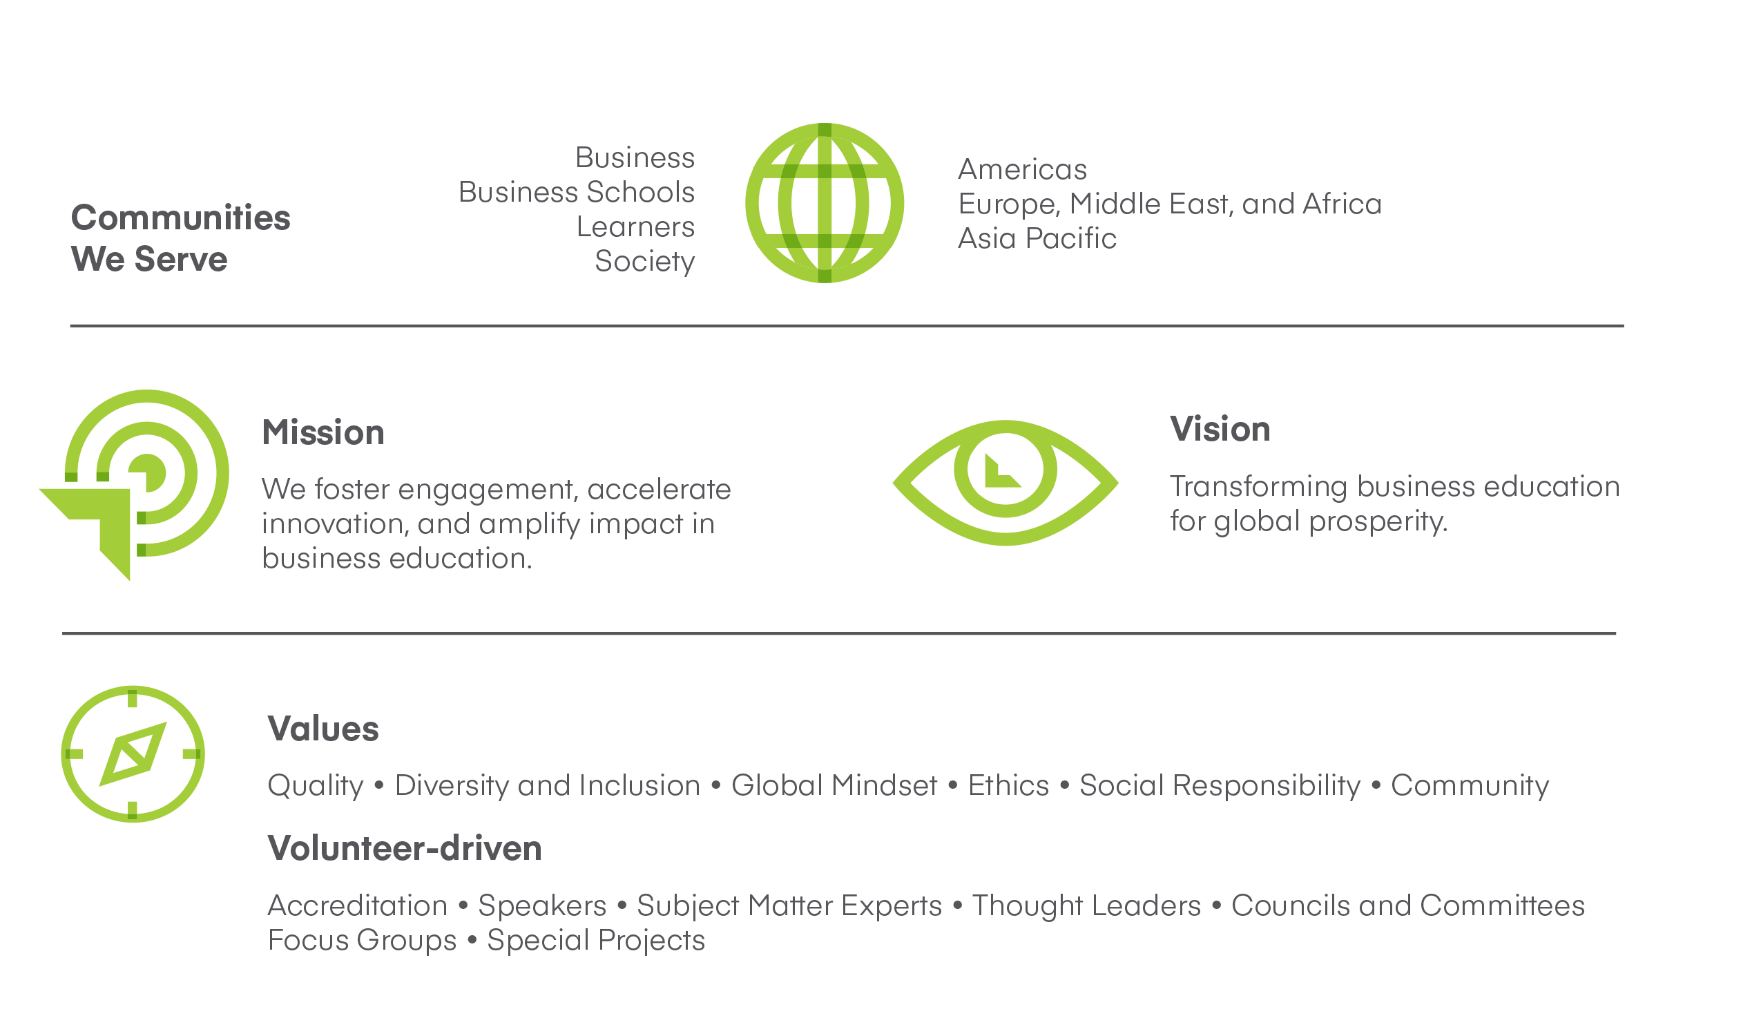
AACSB: Our mission, together
Notes:
As the world’s largest business education alliance, AACSB International connects educators, students, and business to achieve a common goal: to create the next generation of great leaders. We are a global association of leaders in education and business, dedicated to supporting and advancing quality business education worldwide.

Slide 5

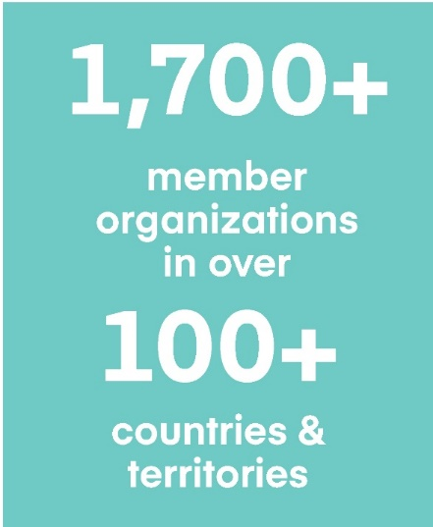
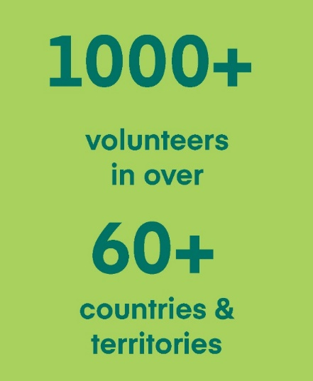
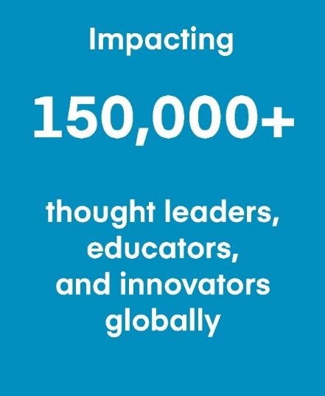
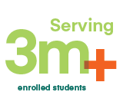
AACSB at a Glance
Notes:
Stats updated: June 2019

Slide 6





Business Education Alliance
Quality Assurance and Quality Improvement (Accreditation)
Global Network
Affinity Groups
Exchange
Collaboration Portal
Volunteer Opportunities
Advocacy & Awareness
Business Education Intelligence
BizEd Magazine
Benchmarking: DataDirect Database
Industry Reports & Analysis
Learning & Development
Conferences
Seminars
Digital Learning
Career Services
CareerConnection.aacsb.edu
Advertising
Notes:
An ecosystem for engagement, innovation, and impact

Slide 7
Quality Assurance and Quality Improvement: Accreditation

Slide 8
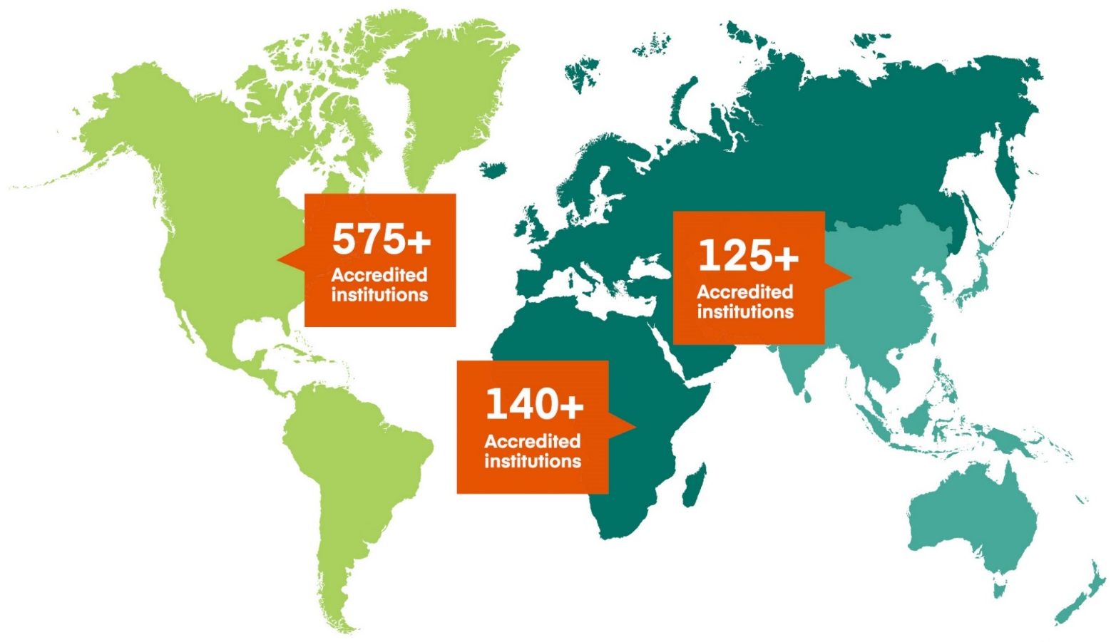
Accredited Institutions by Region
130+
Accredited institutions
Notes:
Stats updated: Nov 2019

Slide 9
India
AACSB Member Schools | AACSB-Accredited Schools | In Initial Accred. Process | Estimate of Total Number of Schools w/ Business Programs
65 | 11 | 17 | 3,902
Notes:
Stats as of Nov 2019

Slide 10

AACSB Accreditation
  The most rigorous standards of excellence in business education
  Demonstrates your commitment to quality and continuous improvement to faculty, students, and business

Slide 11
Framework of a Quality Business School
Expectations: Stability, strategic mindset, collegial environment
Derive from: Good processes and systems, leadership, organization, institutional support and resources
Essential elements: Quality teaching, evidence of learning, relevant curriculum, and impactful research and engagement with the business community and society
Notes:
A quality business school exhibits specific items, noted in this slide.
A successful accreditation journey begins with stability of the business school and university, a strategic mindset and plan, and and collegial environment in which faculty and other key stakeholders are engaged.
A successful accreditation journey sets up good processes and systems, strong leadership, organization to plan for , implement and document alignment with each of the accreditation standards
The essential elements of a quality business school are noted.

Slide 12

AACSB Accreditation Foundations
Mission-driven and linked to school’s strategic plan and priorities
Emphasis on high quality and continuous improvement
Self assessment & peer review
Reviewers trained and knowledgeable on accreditation standards and processes
Standards are guidelines and reviewers use judgement
3 themes:
Notes:
Important to document distinctiveness through examples, defining stakeholders served, HOW they are served

Slide 13

Multiple Levels of Peer Review
(All AACSB Volunteers)
Operating Committees –
      Initial Accreditation Committee (IAC)
        Meets February, April, July, and November
      Continuous Improvement Review Committee (CIRC)
      Accounting Accreditation Committee (AAC)
Mentor for initial accreditation
Peer Review Team – 3 members: PRT Chair & 2 other members
Notes:
The accreditation process involves multiple levels of peer review
IAC meets: January/February, April, July/August & October/November
CIRC meets: January and June
AAC meets January and June
CAP meets: January, April and September

Slide 14
Impact of Accreditation
External
Internal
  Employability of Graduates
  Institutional Image and Rankings
  Recognition from Professional/Governmental Bodies
  Global Mobility of Graduates/Faculty Members
  Opportunities for Global Partnerships
  Marketability of Programs
  Accountability
Strategic Orientation and Benchmarking
Culture of Continuous Improvement
Process Improvement
Consistency and Sustainability
Data-driven Decision-making
Student Learning Outcomes
Notes:
TAPMI, IIM Udaipur, and Indore

Slide 15
The Accreditation Journey
From establishing Eligibility through Initial Accreditation

Slide 16
Initial Accreditation Timeline
Eligibility Application Accepted
initial Self Evaluation Report Accepted
Progress Reports Reviewed
Invitation To Apply
Visit
Final Self-Evaluation Report Reviewed
Max. 2 years
Must be completed within 5 years
1 - 2 years
School establishes eligibility criteria are met.
School works with a mentor to conduct a gap analysis and develop a detailed plan to align with the standards.
School reports on progress and addresses issues identified by the Initial Accreditation Committee (IAC).
IAC agrees school is ready for a visit and gaps are closed.
School works with Chair to prepare a final report demonstrating standard by standard alignment.
Peer Review Team provides a pre-visit analysis and visits the school.

Slide 17

Establishing Eligibility
Step 0: Which entity? Institution vs Academic Unit
Institutions with multiple academic units offering business programs should seek the advice of an AACSB accreditation manager before completing an Eligibility Application. Contact accreditation@aacsb.edu
Step 1: Eligibility Application
2013 Eligibility Criteria
A: Ethical Behavior
B: Collegiate Environment
C: Commitment to Corporate and Social Responsibility
D: Accreditation Scope and AACSB Membership
E: Oversight, Sustainability, and Continuous Improvement
F: Policy on Continued Adherence to Standards and Integrity of Submissions to AACSB

Slide 18
2013 Business Accreditation Standards
Strategic Management
2 - Intellectual Contributions and Alignment with Mission
3 - Financial Strategies and Allocation of Resources
5 - Faculty Sufficiency and Deployment
6 - Faculty Management and Support
7 - Professional Staff Support and Sufficiency
Learning and Teaching
9 - Curriculum Content
10 - Student-Faculty Interactions
11 - Degree Program Educational Level, Structure, and Equivalence
12 - Teaching Effectiveness
Academic and Professional Engagement
14 - Executive Education
15 - Faculty Qualification and Engagement
1 - Mission, Impact, and Innovation
Participants – Students, Faculty and Professional Staff
4 - Student Admission, Progression, and Career Development
8 - Curricula Management and Assurance of Learning
13 - Student Academic and Professional Engagement

Slide 19

Challenges and opportunities
  Implementing a strategic plan
  Establishing an institutional effectiveness system
  Updating educational policies and procedures
  Involving stakeholders in the academic processes
  Reviewing academic programs periodically
  Improving programs and facilities continuously
  Engaging students in the academic activities
  Meeting the standards - accreditation.
Notes:
What the standards help a school achieve and what challenges have to be addressed

Slide 20
Types of Issues in building a quality assurance system to meet the standards
Process
Standards
Setting up a QA team
Building accreditation knowledge and mindset
Setting expectations
Leadership continuity
Documentation!
Time and resource intensive standards: 1, 2, 5, 8, and 15
Themes: Engagement, Innovation and Impact
Identifying gaps and planning for improvement
Notes:
Other issues related to internal management

Slide 21
Dos & Don’ts for accreditation
Establish a culture to support continuous improvement & high quality
Don’t delegate this role of building culture & knowledge to junior faculty or professional staff.
Areas to be prepared for: accreditation standards, process, timeline, funding involved (for accreditation & to support improvements internally)
Build an institutional and peer network
Notes:
Village to raise a kid – takes a network to be a good school, because you learn from your peers. You look outward to see your school can improve.
Have knowledge about the standards, process, timeline
Know what it takes to get there
Be friendly with AACSB staff, network with schools through event attendance,
Who? FACULTY!
How do you drive it?
Senior leadership! Senior management! They have to walk the talk!
Accreditation personnel: Standards, process timeline, data collection, contacts such as accreditation volunteers, AACSB staff & other schools
Head of business school (dean): Standards, contacts as above, set example to faculty, lead internal conversations, morale driver
Faculty – what do they need to know? Their role in accreditation – AoL carrying out assessment & analysis, Faculty data supply, at times their FQ if that helps them to align with FQ
Dept chair – faculty supervisors responsible for performance appraisal may have knowledge of FQ (license to stand infront of class and teach, at the basic. Can be more than that depending on how far a school wants to tie this with performance)
Professional staff: data collection (see ‘accreditation personnel’)
Program director: curriculum management/improvements and AoL

Slide 22
AACSB Data Collected:
Students:
  Admissions
  Enrollment
  Degrees Conferred
  Employment
  Demographics (incl. domestic vs. internationally mobile)
  Class Sizes
Programs:
  Education Levels Offered
    Undergraduate
    Master’s – incl. specialized master’s and general business degrees (e.g., MBA)
    Doctoral
  Degree Titles
  Disciplinary Fields
  Delivery Methods
    Full-time
    Part-time
    Evenings & Weekends
    One-Year
    Distance Learning
    Online
    Off-campus Location(s)
    With Partner(s)
Faculty, Administrators & Staff:
  Demographics (incl. domestic vs. internationally mobile)
  Numbers Employed
  Full-time and Part-time
    Including Full-time Equivalency (FTE) of Part-time
  Teaching Loads
  Compensation and Salary data (aggregated)
General Institution Data:
  Location
  Institutional Control (e.g., Public, Private Not-for-Profit, Private For-Profit)
  Mission and Research Priorities
    Teaching, Intellectual Contributions, and Service
    Teaching & Learning Scholarship, Applied or Integration/Application Scholarship, and Basic or Discovery Scholarship
  Operating Budgets
  Endowments
  Uses of Operating Funds (incl. scholarships)
  Sources of Operating Funds (incl. fundraising)
  Governance Models
  Partnerships and Collaborations (Existing & Desired)
  Innovations that Inspire

Slide 23
Mission & Research Priorities: Global Participants
Notes:
Data come from 479 AACSB members globally, whose 2018-19 BSQ is locked.

Slide 24
Mission & Research Priorities: Indian Participants
Notes:
Data come from 7 AACSB members in India, whose 2018-19 BSQ is locked.

Slide 25
Average Percentage of Domestic Graduate Students Enrolled
Notes:
This the average percentage of domestic students enrolled in Masters or doctoral programs in each school, NOT the total percent across all schools.

Slide 26
Average Percentage of Domestic Full Time Faculty
Notes:
This the average percentage of domestic fulltime faculty in each school, NOT the total percent across all schools.

Slide 27
Global Trends in Business Education

Slide 28
The Future of Business Schools and Faculty
A Changing World
VUCA World
Entrepreneurship
Revolution
Specialization
Globalization Vs. Nationalization
Changing Demographics
The Gig Economy
4th Tech Revolution

Slide 29
Faculty Qualifications at AACSB-accredited Schools
Academic
Applied/Practice
Scholarly Practitioners (SP) | Instructional Practitioners (IP)
Scholarly Academics (SA) | Practice Academics (PA)
59
%
Professional Experience
of faculty at AACSB-accredited schools are designated as Scholarly Academics.*
Doctoral Degree
*Source: Business School Questionnaire and Staff Compensation & Demographics Survey (2017-18) n=79,783 faculty
By faculty headcount. Does not include faculty where qualification is not listed or unknown.
Notes:
Scholarly Academics (SA) sustain currency and relevance through scholarship and related activities. Normally, SA status is granted to newly hired faculty members who earned their research doctorates within the last five years prior to the review dates. Subsequent to hiring, SA status is sustained as outlined below.
Practice Academics (PA) sustain currency and relevance through professional engagement, interaction, and relevant activities. Normally, PA status applies to faculty members who augment their initial preparation as academic scholars with development and engagement activities that involve substantive linkages to practice, consulting, other forms of professional engagement, etc., based on the faculty members’ earlier work as an SA faculty member. PA status is sustained as outlined below.
Scholarly Practitioners (SP) sustain currency and relevance through continued professional experience, engagement, or interaction and scholarship related to their professional background and experience. Normally, SP status applies to practitioner faculty members who augment their experience with development and engagement activities involving substantive scholarly activities in their fields of teaching. SP status is sustained as outlined below.
Instructional Practitioners (IP) sustain currency and relevance through continued professional experience and engagement related to their professional backgrounds and experience. Normally, IP status is granted to newly hired faculty members who join the faculty with significant and substantive professional experience as outlined below. IP status is sustained as outlined below

Slide 30
Faculty Qualifications at AACSB-accredited Schools
*Source: Business School Questionnaire and Staff Compensation & Demographics Survey (2017-18) n=79,783 faculty
By faculty headcount. Does not include faculty where qualification is not listed or unknown.
Notes:
Participating faculty members

Slide 31
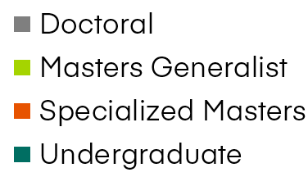
Enrollment Distribution (2017-18)
Source: Business School Questionnaire (2017-18)
Notes:
Key Points
Significance of undergraduate business enrollments as well as specialty graduate business enrollments – its not just about the MBA

Slide 32
Global 5-Year Enrollment Change
Global 5-Year Enrollment Change
*Based on ’13-14 to ’17-18 controlled set
of AACSB-accredited schools
5-Year Enrollment Change By Region, Level
*Based on ’13-14 to ’17-18 controlled set
of AACSB-accredited schools
Program Level | Americas | Asia-Pacific | EMEA
Undergraduate | 12.65% | 7.25% | -3.19%
Masters-Specialist | 26.74% | 35.38% | 2.99%
Masters-Generalist | 3.96% | 11.53% | -1.83%
Doctoral | 6.23% | 19.51% | -1.1%
Source: Business School Questionnaire (2013-14, 2017-18)

Slide 33
Business Schools Tomorrow …
Catalysts for Innovation
Hubs of Lifelong Learning
Enablers of Global Prosperity
Co-Creators of
Knowledge
Leaders on
Leadership
A COLLECTIVE VISION
FOR BUSINESS EDUCATION
Notes:
Catalysts for Innovation:
i. While there has been progress, “the role of business schools in supporting innovation remains underdeveloped, undervalued, and too-often unnoticed” according to the AACSB Task Force on Business Schools and Innovation.
ii. Management is a key, but under-appreciated, player in the innovation agenda (as shown through research for "Business Schools on an Innovation Mission")
iii. Economic development initiatives are expected to continue to focus on innovation and new business creation—especially enterprises with high growth potential, at the local, national, and regional levels—offering opportunities across the spectrum of business school missions.
iv. Business school multi-disciplinary approaches, strong alumni, donor, and business networks, and the power to convene across sectors represent significant assets for taking a lead role in fostering innovation in society.
v. Building on research across disciplines (inside and outside of “business”), business schools have already taken the lead in developing a body of knowledge about entrepreneurship and innovation.
vi. Greater emphasis on interdisciplinary collaboration across university campuses, particularly with schools of engineering and sciences, will leverage the strengths of different kinds of drivers and leaders within the innovation ecosystem.
vii. Business schools will rely on new metrics (such as new businesses and jobs created) to tell the story of their impact in this area.
Enablers of Shared Prosperity:
i. The traditional view of business (and business schools) as agents of wealth creation recognizes that wealth creation is an important and necessary component of economic and societal development.
ii. But there are numerous dimensions to the concept of “prosperity”, including wealth creation but also a healthy environment, meaningful employment, and work-life balance. Business has a role to play in support of all of these necessary dimensions.
iii. Increasingly, the public expects business to address a growing array of social problems (reference 50+20 and other related platforms), and to be an active participate in addressing broader societal goals (e.g., United Nations’ Sustainable Development Goals) and grand challenges.
iv. Business schools and their alumni have a positive impact on the world around them, though there are opportunities both to more strongly reinforce the potential for positive impact, and to ensure this message is more widely understood and embraced.
v. The research and education delivered by business schools results in better management practices, which are associated with higher performance of firms (citing research by Bloom & Van Reenen).
vi. B-schools must be advocates for the human dimension of business, with attention to ethics, diversity, and personal well-being.
vii. The responsibility of business to generate wealth and economic development, as well as enable individuals and communities to prosper, applies to the entire population rather than a segment of the population at the expense of others.
viii. Business schools continue to lead in the development of insights about the benefits of, and effective practices for cultivating, a diverse and inclusive workforce.
Leaders on Leadership:
i. Business schools’ role in continuing to lead the discovery of new insights into effective leadership, and creating the environments that train and nurture effective leaders, is a key asset on which to continue to build competitive advantage.
ii. Business schools should more assertively stake a claim for developing the evidence-based theoretical and practical foundations of leadership, while building on the contextual knowledge of other disciplines/schools.
iii. One way this can be done is by partnering with companies/industries to analyze data related to career progression and leadership development.
iv. Business schools also can position themselves as sought-after partners/supporters for other schools’ leadership training (e.g., educational leadership, engineering leadership, etc.).
v. This claim to having deep expertise on effective leadership is relevant to all sectors, not just the corporate sector.
vi. Leadership is no longer reserved for the executive suite, rather it is something expected from everyone in organizations.
vii. The constituents for leadership expertise are diverse, including the full spectrum of career demographics, as well as within different business/economic models and maturity levels, suggesting the need for depth and breadth in approaches to leadership development across the business school industry.
viii. For some schools, their strategies for taking a leadership role in developing insights into effective leadership and nurturing effective leaders may raise questions about whether the appropriate designation might include “management school” or “leadership school” rather than “business school.” Not every school will approach this the same way.
ix. Business schools
Co-Creators of Knowledge:
i. Increasingly, the identification and prioritization of questions to explore, research to be undertaken, and consideration of potential implications will be done in partnerships involving a variety of academics and practitioners.
ii. Schools will pursue operational models and strategies that firmly position themselves at the intersection of industry and practice, as conveners and partners in the knowledge creation ecosystem rather than just suppliers.
iii. Stronger connections with academics in other disciplines will foster more cross-disciplinary research which is necessary to address a wide range of social issues that are complex and multidisciplinary.
iv. Co-creation also refers to collaborative arrangements that leverage the diverse strengths, different contexts, and shared interests of the faculty, staff, and networks of multiple business schools.
v. Schools will complement research rigor with more emphasis on relevance, facilitated by new connections between business schools and organizations and changing structures in academic publishing (such as open publishing, academic blogging, social media).
vi. The concept includes partnerships with industries or industry clusters to create platforms for incubating new management ideas, or to analyze big data across firms to better understand and customize talent development needs.
vii. Pedagogical research, or the scholarship of teaching, may be better enabled by partnerships with learners and in turn support (e.g., through cases) more contextualized learning.
viii. Intellectual contributions in the form of basic theoretical research continue to be extremely valuable even if not intended to directly impact practice. These collaborations have the potential to influence the development of both theoretical and applied knowledge in ways that strongly align with organizational and societal needs.
Hubs of Lifelong Learning:
i. The need for management skills, leadership development, and business acumen is pervasive; business schools have the potential to contribute to learning opportunities for a wide variety of individuals, at different points in their career life cycles.
ii. Doing so will likely require business schools to move beyond the bounds of traditional degree-based education, or at least the traditional markets served by degree-based education, as well as to create stronger connections with schools of other disciplines.
iii. Most discussions about business schools have focused on degree education and “preparing graduates for successful management careers.” The future of learning, however, will involve smaller, more modular units, with students consuming education from a variety of providers and building a portfolio of credentials over time.
iv. A “student to consumer revolution” is not only forcing improvements in convenience and service orientation, but also introducing new intermediaries to the business education ecosystem.
v. Business schools will need agility in order to meet learners wherever they may be – in terms of geography, career life cycle, industry focus, personal and professional maturity, education level, and lifestyle.
vi. A shift toward more experiential learning and business engagement will mean that more business schools may be seen more as learning laboratories than the traditional view of a classroom learning environment.
vii. As “hubs” of learning, business schools deliver learning in conjunction with other schools on campus, with other business schools, industry clusters, and organizations within the public and private sectors.
viii. As hubs of learning, business schools and their faculty can facilitate the knowledge exchange that both learns from, and informs, customized courses and programs for specific organizations or within corporate universities.
ix. Innovations in assessments, experiential learning, and gamification will create new opportunities for business schools to leverage scholarship and expertise in teaching to create new learning pathways, practice fields, and platforms to support these needs
x. Additionally, business schools will rely heavily on platforms, such as LinkedIn, that create new opportunities to communicate with and engage past and future learners.

Slide 34
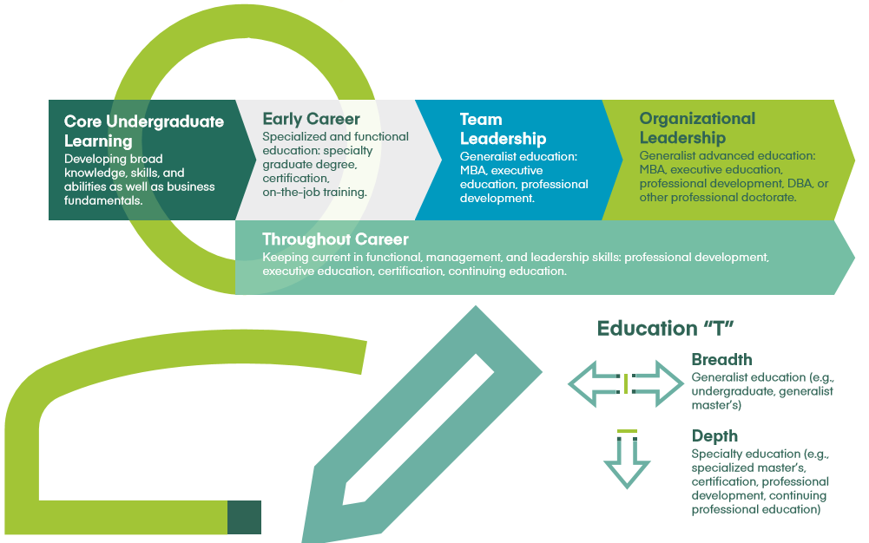
Lifelong Learning: Business and Leadership Education

Slide 35
The Business School of the Future
Embraces the Concept of Lifelong Learning
Has a Strong Partnership with Business
Leverages Technology
Is Agile & Innovative
Infuses active, experiential & project-based learning
Fosters Professionalism
Is Glocal
Has No Silos
Notes:
Has a strong partnership with business
Co-creation of programs and curriculum
Co-creation of research/solutions (for business and the world; multidisciplinary; Govt/NGO involvement)
Embraces the concept of lifelong learning
Can take a portfolio approach or focus on a niche of LL (reward relative to risk)
Focus on learners (not students and alumni)
Is glocal
Has a global orientation but also prepares students to succeed locally (whether in a large multinational or a local start-up)
Fosters professionalism
Preparing students to be ethical leaders
Making the world a better place
Leverages technology
Blended Learning
Is agile & Innovative
Keeping the pulse on what is needed
Continuous improvement
Has no silos
Research or Teaching

Slide 36
AACSB Business Education Alliance
A Global Network

Slide 37
Business Education Alliance
Quality Assurance and Quality Improvement (Accreditation)
Global Network
Affinity Groups
Exchange
Collaboration Portal
Volunteer Opportunities
Advocacy & Awareness
Business Education Intelligence
BizEd Magazine
Benchmarking: DataDirect Database
Industry Reports & Analysis
Learning & Development
Conferences
Seminars
Digital Learning
Career Services
CareerConnection.aacsb.edu
Advertising
Notes:
An ecosystem for engagement, innovation, and impact

Slide 38

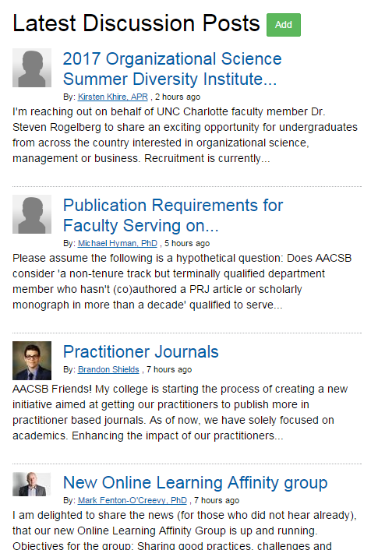
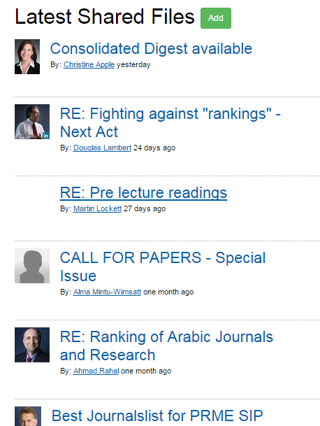
AACSB Exchange: Get Connected
AACSB Exchange
Get Connected.
https://theexchange.aacsb.edu/home
Discuss Experiences
Share Materials
Discuss
Experiences
Find
Solutions
Find Solutions
Share
Materials

Slide 39


Affinity Groups
Collaborate with peers in the same region or with the same interests, online and in person.
  Digital Transformation
  Women Administrators
  Entrepreneurship
  Small Schools
  Asia Pacific
  Associate Deans
  Quality Assurance
  Online Learning
  New Deans
  And more!
Notes:
The AACSB Digital Transformation Affinity Group (the “AACSB DTAG”), under the leadership of Stevens and with the financial support of PwC USA is undertaking a project to create a Business Curriculum for the Digital Era for broad adoption throughout the global business school community. Select universities within the AACSB DTAG will work with Stevens, PwC USA and other members of the Steering Committee as a consortium to develop and promote the Curriculum.

Slide 40
Quality Improvement - Innovations That Inspire
The AACSB International initiative shines a spotlight on a variety of ways that business schools are changing the face of management education.
Categories:
Engagement Across Disciplines
Engagement With Business
Engaging A Diverse Community
Exemplify some of the ways business schools are taking a forward-looking approach to education, establishing cutting-edge ties with industry, and even championing revolutionary initiatives for the betterment of higher education as a whole.

Slide 41

AACSB Business
Education Intelligence
Notes:
As an AACSB member, regardless of accreditation status, the data AACSB collects can be useful to you in a number of ways:
Identify business schools with similar characteristics that may be peer or aspirant schools.
Find other AACSB member schools that are looking for partnerships with schools like yours.
Understanding trends related to the industry; e.g., doctoral faculty production, enrollment levels in various types of programs, or trends in operating budget levels.
Determine your peers and aspirants for continuous improvement benchmarking and/or quality assurance purposes
Find potential collaborative partners
Understand trends in the management education industry
Doctoral faculty demand
Popularity of different degree types
Operating budget trends
******most importantly, we have a dedicated DataDirect team in place to assist you with accessing the site at anytime.

Slide 42

Business Education Intelligence Briefings
Briefing Paper Series: Technologies with Potential to Transform Business Education
  Artificial Intelligence
  Virtual and Augmented Reality
  Mobile and Micro-Learning
  Blockchain
  Other Briefing Papers:
  Chief Learning Officer Survey: To Empower Learning Over a Lifetime
  Lifelong Learning and Talent Management
  aacsb.edu/publications/researchreports
Notes:
Chief Learning Officer Survey: To Empower Learning Over a Lifetime – How academia and businesses can instill a culture of learning for organizational success
Lifelong Learning and Talent Management: introduction to the environment, challenges, and opportunities related to lifelong learning and talent management, after which an overview of the perspectives explored during this planning meeting is presented.

Slide 43
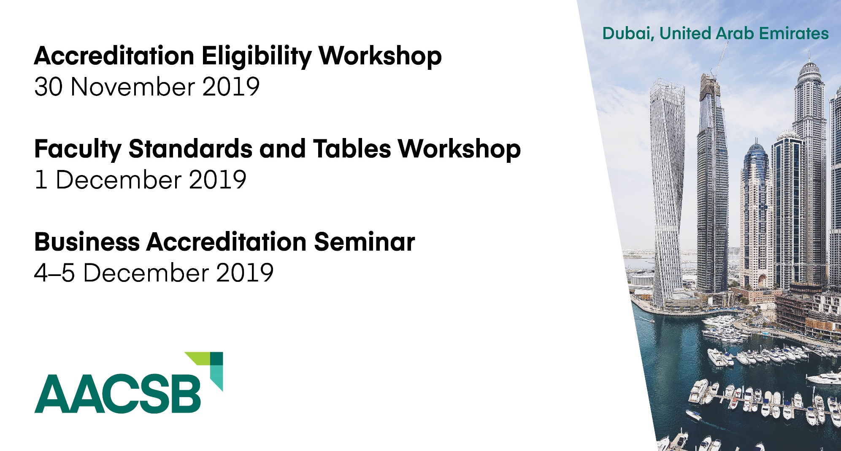
Upcoming Events - Dubai
Faculty Standards and Tables Workshop
December 8, 2019
Middle East Summit
9-10 December 2019
Business Accreditation Seminar
December 11–12, 2019
Notes:
The seminars are for schools interested in business accreditation by AACSB international. AACSB only accredits educational member institutions which offer business degrees. If schools are interested in learning and understand more about AACSB business accreditation and wish to develop a strategy for eligibility to enter into the AACSB accreditation process, it will be good to attend these seminars.

Slide 44

AACSB accreditation processes earned ISO 9001:2015 certification
Quality Assurance and Quality Improvement
Global recognition
Focus on customer satisfaction and continuous improvement
Applies to accreditation processes
Recertification every three years

Slide 45
The Value of AACSB Accreditation
Cultivates meaningful interactions between
students and a qualified faculty
Produces graduates who have achieved
specified learning goals
Ensures currency of curricula and importance
of quality teaching
Makes a statement to external communities
about your commitment to quality and
continuous improvement
Notes:
Some features of AACSB accreditation. Again, the focus is on quality and continuous improvement. Accreditation process is mission driven and therefore supports and encourages variety in mission statements. AACSB has a very diverse population of accredited schools (i.e. top research institutions, teaching schools, large, small, etc.). Research and the advancement of knowledge is also a central tenet in AACSB accreditation. Quote Jerry: research is a non-negotiable aspect of accreditation and we will discuss this later on. Also currency of the curriculum and its ability to prepare students not only for the present but also the future is important.

Slide 46



Foundations for Accreditation
Engagement in strategic management
Building a research culture
Setting expectations
Leadership and key person turnover
Mission
Society/Board
Management
Faculty and Staff
Students and Parents
Employers
Community
Strategies, policies, actions
Research outcomes
Eco-system
Culture
Top Down: Leadership long-term vision
Bottom Up:
Continuous improvement culture
Notes:
Observations from a decade of working with schools in the country…
The governing structure of many Indian schools is not initially set up for strategic management, whereby multiple stakeholders are included in the strategic development of school. The competitive and regulatory environment in India lends to generic outcomes expectations that don’t reflect the environment and strengths of the school. This process of alignment to AACSB expectations requires significant engagement and reflection by all stakeholders. It’s a very involved process.
Subsequent to that, AACSB expects accredited schools to be actively engaged in high quality research and intellectual contributions. Most Indian schools developed their roots as teaching institutions. The transition from teaching to research AND teaching also takes considerable time and resources. A culture of inquiry and research is not built overnight.
That’s why setting expectations is also important. The accreditation process is designed to allow time to reflect, design, plan and implement complex processes, and there needs to be the long-term vision from the top down to ensure these efforts have the necessary support throughout the process. Also there is often the initial motivation to get accredited quickly for the external recognition it affords, but it is just as important to cultivate an internal process improvement mindset from the bottom up.
Always when schools embark on the process of reflection and strategic visioning, I’ve just described, there is bound to be some turnover of those who don’t buy in and commit to the school’s mission or find that they don’t meet the level of expectations required to meet the school’s aspirational vision. Losing leaders and key persons in the early stages of the process often causes delays and loss of momentum. Its important for a successful accreditation journey to have bottom up and top down commitment. No one person can make it happen.

Slide 47
The Future of AACSB Accreditation

Slide 48
Business Accreditation Task Force (BATF):
Reimagining Business Accreditation
The BATF will examine the processes around AACSB business accreditation—and the standards themselves—to support the primary strategic goal for AACSB accreditation to “be recognized worldwide as the premier mission-driven accreditation for business education, employing a peer review and principles-based methodology that leverages technology to streamline the accreditation process.”
aacsb.edu/BATF
Notes:
3 Goals – Standards, Training, and Technology
Standards
•Streamline
•Eliminates redundancy
•Moves interpretive guidance to a master white paper
•Simplifies language
•No appendices in the new standards
•Reduces standards from 15 to 9 without losing content
•More principles-based and outcomes focused
•More globally-oriented
•Focused on competencies
•More flexible on faculty qualifications

Slide 49
WHY?

Slide 50
Because we must
“If we do not disrupt ourselves, the world will do it for us” – Michael Arena, Adaptive Space
The Fourth Industrial Revolution is here, forcing change

Slide 51
How?

Slide 52
BATF Composition
Diverse and Experienced:
15 academic leaders from around the globe
More than 250 years of collective accreditation experience
Business education experience on 6 continents
Business experience in a wide variety of fields and levels
Representatives from different types of schools

Slide 53
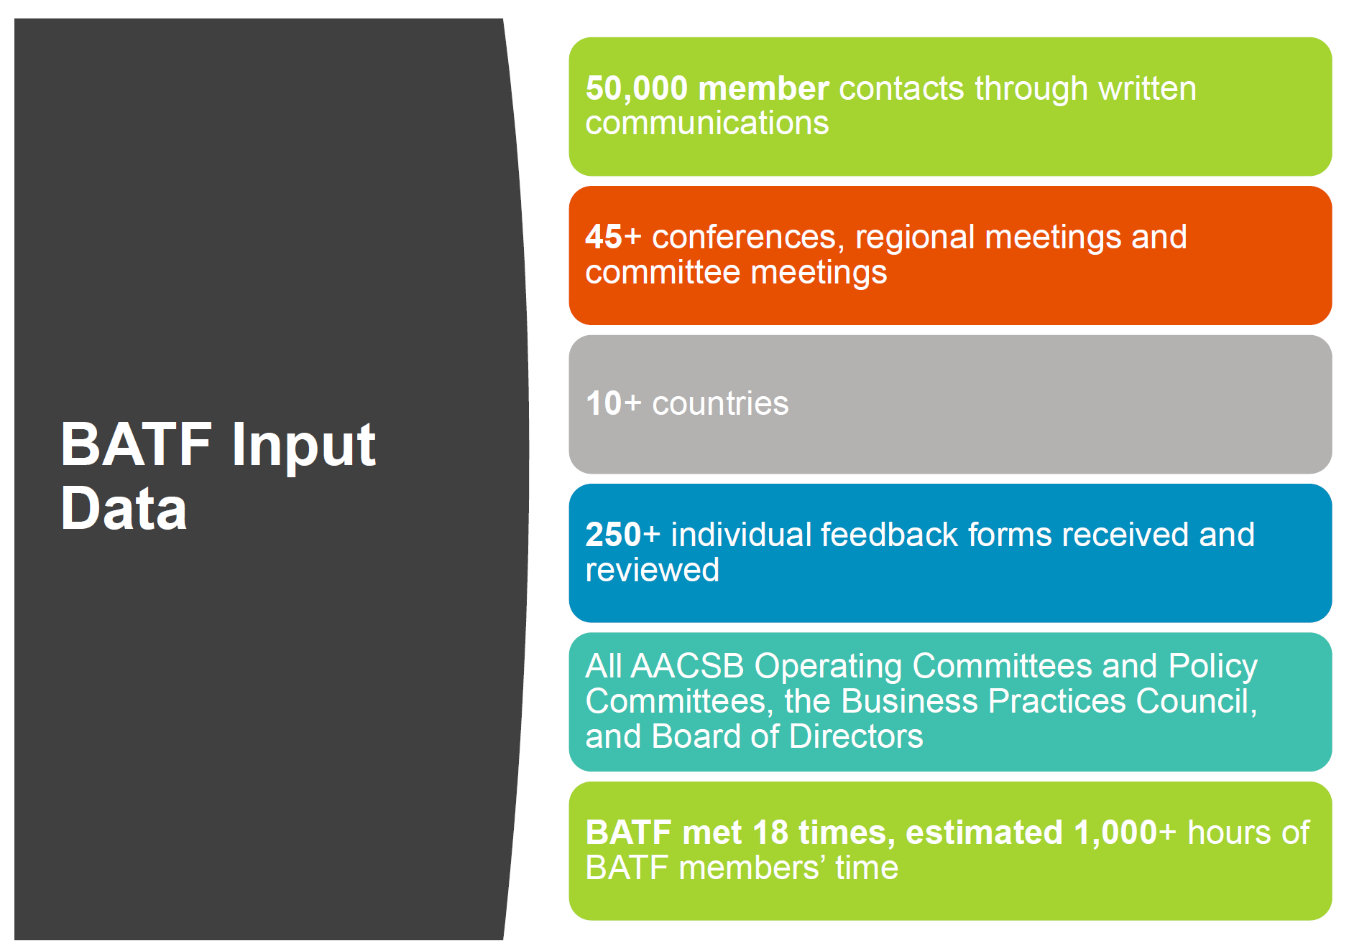

Slide 54
Establishing Eligibility
2013
Eligibility Criteria
2020
Guiding Principles + Eligibility Procedures
(work in progress)
Notes:
Guiding principles replaces accreditation criteria. Not all current eligibility criteria are covered by guiding principles. There will likely be some “eligibility procedures” which will address things such as scope. Language on guiding principles, scope, etc. needs to be added to Interpretive Guidance which will be done in the coming months.
Ethics and Integrity
Mission-driven
Peer Review
Continuous Improvement
Collegiality
Agility
Global Mindset
Diversity and Inclusion
Financial Vitality
Cont. Adherence to Guiding Principles and Business Standards

Slide 55
Transition for Schools Entering the Process
Apr. 2021
Last EA under 2013 standards accepted
Apr. 2021
Last 2013 Initial Self-Evaluation Report (iSER)/ Standards Alignment Plan (SAP) under 2013 standards accepted
Apr. 2022
Last Progress Reports under 2013 standards accepted
July 1, 2022– June 30, 2023
Last Initial Accreditation Visits conducted under 2013 standards
Notes:
REMEMBER the process takes an average of 5 years. Most schools that will complete their initial visit under the 2013 standards are already in process. Most schools entering the process in the next three years will transition to the new standards before entry or at a minimum by completing the the initial Self-Evaluation Report (which will then be know as an SAP – standard alignment plan)
If you enter the process between July 1 2020 and April 2021 you will have the option to complete the eligibility process under the 2013 or the 2020 standards
If you enter the process between now and April 2020 – you will have the option to complete the initial Self-Evaluation Report (iSER) under the 2013 standards or the 2020 standard
If you submit your iSER/SAP, under the 2013 standards, you will have until AY 2022-23 to complete your visit under the 2013 or you may transition to the new standards at some point in that process.

Slide 56
3 Goals of the BATF (based on listening to you – remember these are YOUR standards)
Goal 1: Update Standards
  Streamline
    Eliminates redundancy
    Moves interpretive guidance to a master white paper
    Simplifies language
    No appendices in the new standards
    Reduces standards from 15 to 9 without losing content
  More principles-based and outcomes focused without sacrificing rigor
  More globally-oriented
  Focused on competencies
  Aligns faculty qualifications and faculty sufficiency by discipline, which is a more accurate, truer picture of these.
  Allows for more innovation by schools
Notes:
Introduce this section with an overview of the 3 components of the “reimagining” project: standards, volunteer training, processes – these three elements will together reimagine business accreditation.
Streamline- Eliminates redundancy ; Moves interpretive guidance to a master white paper; Simplifies language; Additional tables for easing PRT review (more on this); No appendices in the new standards; Reduces standards from 15 to 9 (currently). Please emphasize that we did not “reduce” the content of the standards. We kept the many good elements of the 2013 standards but streamlined the standards.

Slide 57
3 Goals of the BATF (Cont’d)
Goal 2: Mandatory Volunteer Training on 2020 standards
  Get everyone on the same page
  Dispel myths
  Replace legacy knowledge with a new mindset
  Will be mandatory for all volunteers (mentors, peer review teams members, committee members) and schools going up under 2020 standards
  Will be available both live and digitally
  No charge
Notes:
Beginning this year, all new PRT members and mentors who have not yet been trained will be required to participate in training before going on a visit. When 2020 standards are released all volunteers will be required to complete training before going on a visit under this new set of standards.

Slide 58
3
Goals of the BATF (Cont’d)
  Goal 3: Inject Agility into Accreditation Processes
  Non-technology related
    Streamlining visits for proven schools – more consultative, strategic, forward-looking for these schools
  Technology-related
    Leverages technology to:
      Provide data-driven support for consultative advice to schools
      Is a multi-year, staged project
Notes:
Note that changes in processes will be shared in conjunction with the deans conference but focus is to heighten the consultative nature of visits. BATF and policy committees are discussing changes to accreditation processes this fall and spring. Standards are the first priority.

Slide 59
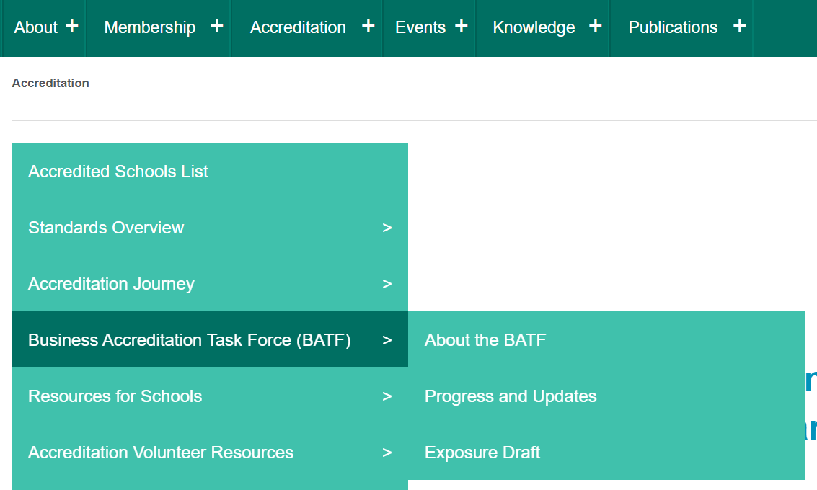
Let’s take a look
Exposure Draft #1 is available on the AACSB website.
https://www.aacsb.edu/accreditation/business-accreditation-task-force/exposure-draft
Notes:
Note that the Exposure Draft posted on the website is as of the date of issue. We are making changes dynamically offline as we receive input. This presentation will incorporate changes we have made so you have current information.

Slide 60
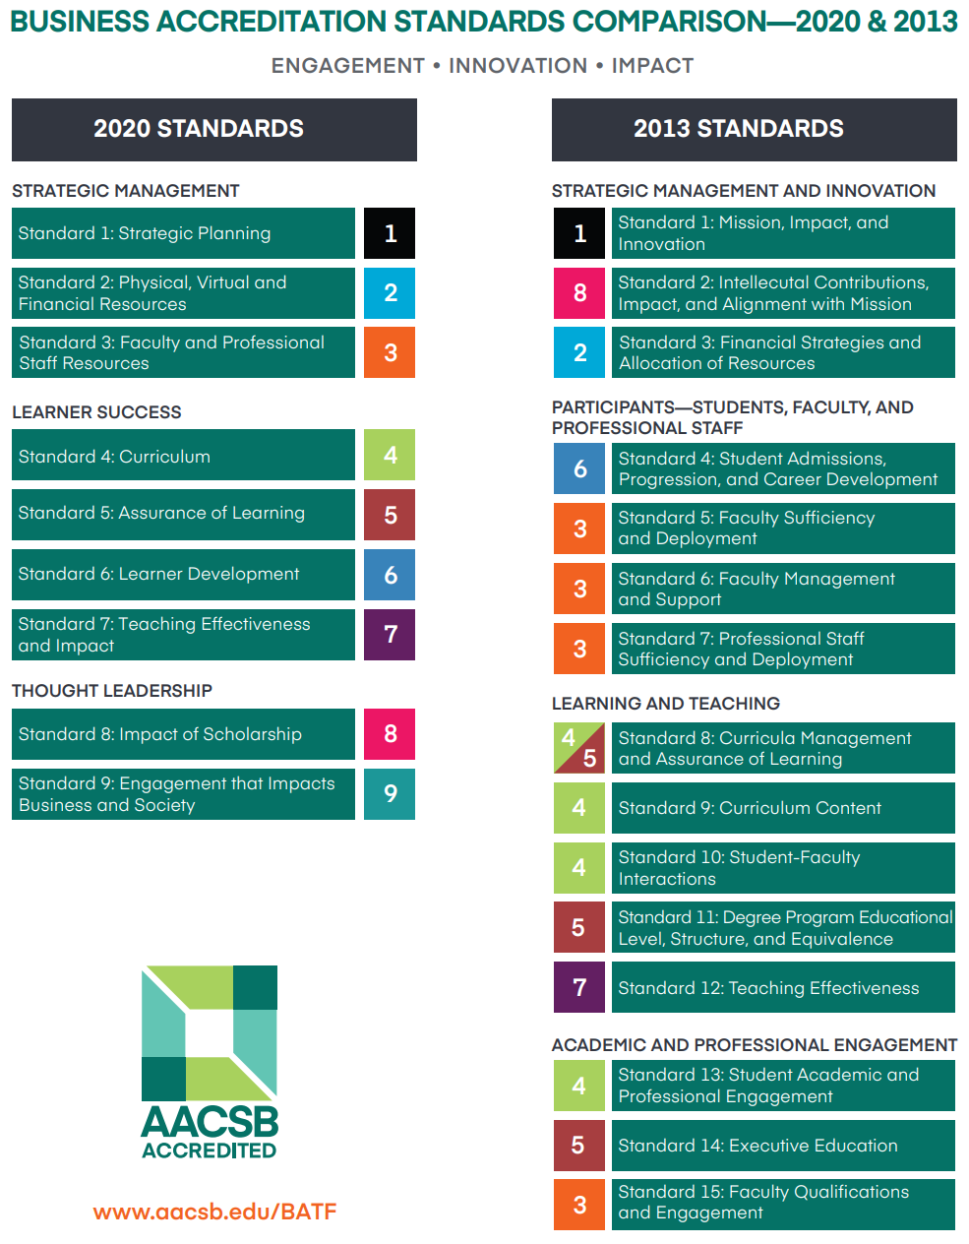
Business Accreditation Standards Comparison 2020 & 2013

Slide 61
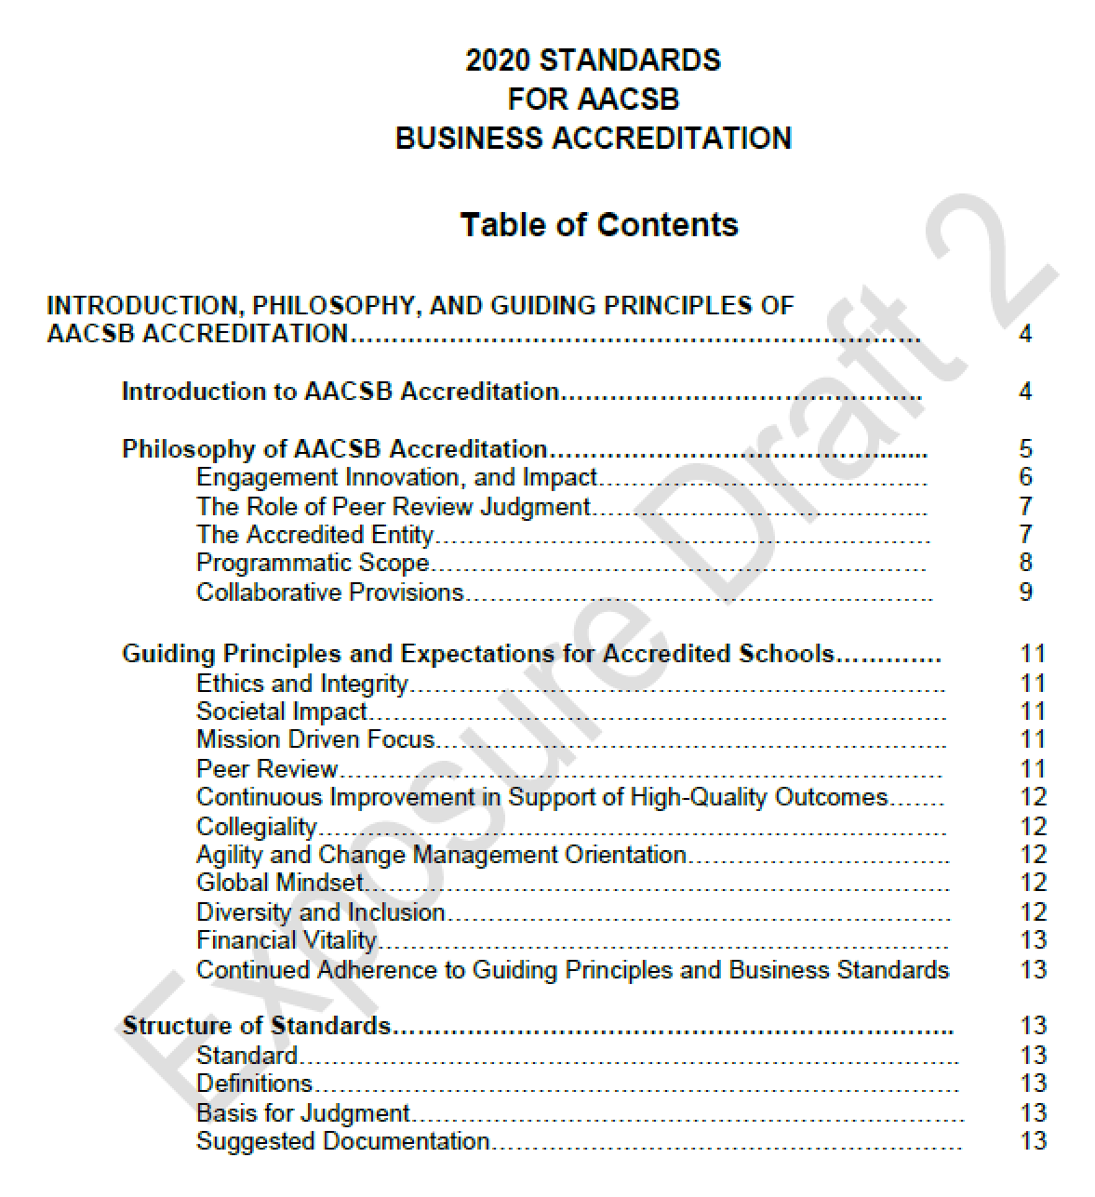
Accreditation Standards
Notes:
Here is the first reference to the “pre-sections” of the standards (e.g. Philosophy, Guiding Principles, etc.)
Philosophy: Programmic Scope eliminates 2 of the 4 provisions that were not widely relied on before (financial relationship with the institution and business academic unit autonomy)
This decision will rest on branding and external market perception.
Guiding Principles: Discuss the replacement of eligibility criteria with 11 guiding principles that represent core values of AACSB and accreditation. Note that “Societal Impact” has been added and is #2 after “Ethics and Integrity.” Schools are still expected to align with the guiding principles. AACSB policies in place for when schools do not – whether in initial phase or CIR phase.
Structure of Standards: Suggested documentation clarifies that CIR schools are not expected to provide every piece of documentation listed in each standard, while initial schools general are expected. CIR schools are guided by the AACSB school template and dialogue with the PRT chair/team as to what documentation they should be prepared to provide.

Slide 62
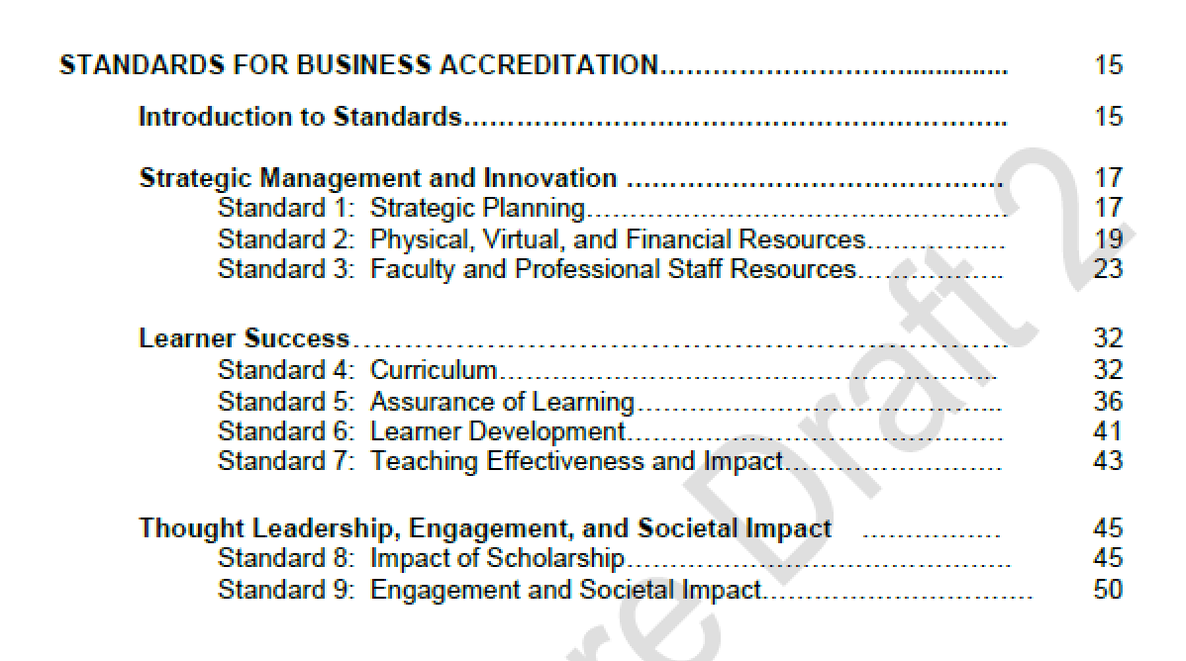
Accreditation Standards
Notes:
3 categories of standards:
Strategic Management and Innovation (3 standards)
Learner Success (4 standards)
Thought Leadership (2 standards)
Biggest changes are:
Societal impact is threaded throughout (strategy, curriculum, intellectual contributions, and other activities sponsored by the b-school that promote positive societal impact.
Faculty qualifications, sufficiency, and Ics are reported by discipline
Faculty deployment is a strategic choice, within limits –
AoL: Some programs can be assessed through indirect measures only
Expectation that schools provide thought leadership – recognized expertise, and what is your school doing with engagement that promotes global prosperity IMPACT and ENGAGEMENT

Slide 63
Strategic Management and Innovation (1-3)

Slide 64
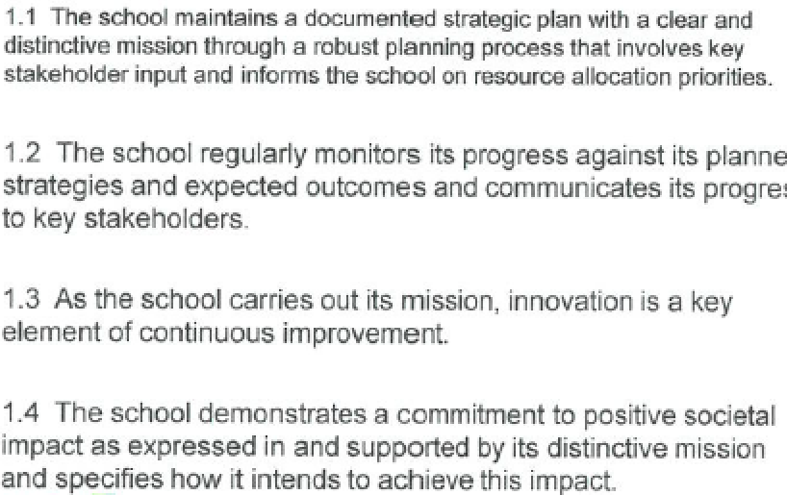
Strategic Planning
Standard
1
Notes:
Suzanne
Key changes: Schools required to demonstrate how they are making an impact on society, as identified in their mission and strategic plan.
Rationale for changes: Greater alignment with AACSB’s vision “to transform business education for global prosperity;”
Addresses the belief that business schools should make a positive impact on society.

Slide 65
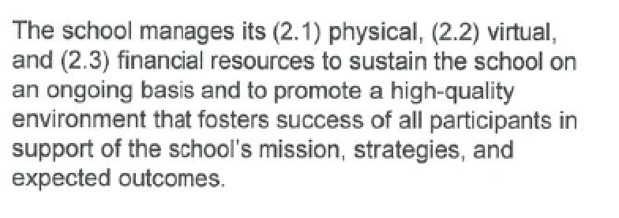
Physical, Virtual, and Financial Resources
Standard
2
Notes:
Suzanne
Key changes:
Merged non-faculty/staff resources into a single standard
Increased emphasis on the future and appropriate financial planning, including a plan for the next five years
Added expectation that schools describe underlying assumptions and include a risk analysis related to their current and future financial position
Added expectation for schools to describe major resource commitments and development projects undertaken and/or completed since the last review.
Addition (now eliminated) of Table 2-1 (Financial Vitality-Operational Considerations) and Table 2-2 (Financial Vitality-Strategic Initiatives and Sources of Funds). Current operating situation now required in a narrative.
Rationale for changes:
Provides AACSB assurance of the school’s future financial viability.
Ensures consistent reporting of financial data by schools.
Provides overview of major projects started/completed requiring significant funding in last five years.

Slide 66
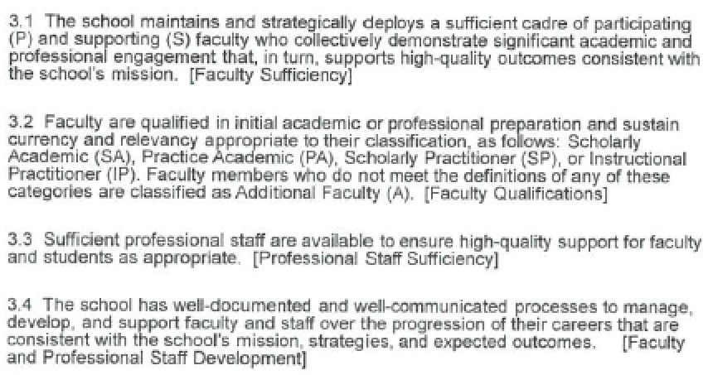
Faculty and Professional Staff Resources
Standard
3
Notes:
Suzanne
Key changes:
Merged all human resources into a single standard.
Renamed “Other” faculty to “Additional” faculty.
Language around SA and PA now refers to terminally qualified rather than the expectation of a research doctorate.
JD, MST, DBA, etc.
Removed current requirement of 60% SA+PA+SP faculty, leaving expectation that 40% in a discipline and overall will be SA and 90% SA+PA+SP+IP in a discipline and overall.
Discipline is the default level of reporting
Discipline here is defined as at the macro level so SA percentages are not by degree program. The 40% is at the top level discipline.
Emphasized that deployment of faculty is a strategic choice of the school and thus AACSB does not mandate percentages by programs. Related to this, schools will be required to provide narrative describing their strategy for deployment of appropriately qualified faculty across degree programs, locations, and modalities and how that strategy assures high-quality outcomes. Table 3-2 (formerly 15-2) will still be required to facilitate consultative discussion between the school and peer review team on deployment strategies; however, the intent is not to apply the same ratios to degree programs.
Recognizes that schools should have the latitude to deploy faculty strategically, in a manner consistent with their mission instead of being held to the same ratio guidelines as expected for disciplines.
Addresses an emerging theme gathered during the issues-storming phase that schools wanted more flexibility with how faculty were deployed across programs.

Slide 67
Implications of Standard 3
Addresses an emerging theme gathered during the issues-storming phase that schools wanted more flexibility with how faculty were deployed across programs.
Language around SA and PA now refers to terminally qualified rather than the expectation of a research doctorate.
  JD, MST, DBA, etc.
Removed current requirement of 60% SA+PA+SP faculty, leaving expectation that 40% in a discipline and overall will be SA and 90% SA+PA+SP+IP in a discipline and overall.
Discipline is the default reporting unit; deviations must be justified
Discipline here is defined as at the macro level so SA percentages are not by degree program. The 40% is at the top level discipline. (More principles based, more flexible, NOT LESS RIGOROUS)

Slide 68
Standard 3 (Cont’d)
Emphasizes that deployment of faculty is a strategic choice of the school and thus AACSB does not mandate percentages by programs.
Schools will be required to provide narrative describing their strategy for deployment of appropriately qualified faculty across degree programs, locations, and modalities and how that strategy assures high-quality outcomes.
Table 3-2 (formerly 15-2) will still be required to facilitate consultative discussion between the school and peer review team on deployment strategies; however, the intent is not to apply the same ratios to degree programs.

Slide 69

Some “guardrails” still
However, while AACSB does not prescribe deployment percentages, a peer review team would normally expect to see an appropriate blend of faculty across degree programs, locations, and modalities. That is, it would not be acceptable to staff any degree program with all IP faculty, or all Supporting faculty. Additionally, master’s degrees and doctoral degrees should reflect a faculty with qualifications consistent with what is needed to provide high quality experiences and outcomes with respect to master’s and doctoral degree learners.

Slide 70
Some “guardrails” still
Consistent with 2013 standards, peer review teams can request faculty qualifications and AoL by location and modality if they have concerns about inadequate quality. Not required on its face.
Question: What do you think about location and modality being “on demand” reports? Keep in mind our goal to reduce administrative burden on schools, especially AoL.

Slide 71

Implications of Standard 3 (Cont’d)
Recognizes that schools should have the latitude to deploy faculty strategically, in a manner consistent with their mission instead of being held to the same ratio guidelines as expected for disciplines.
More flexible with deployment, while still maintaining overall high quality faculty qualifications guidelines.

Slide 72
Discipline Taxonomy
Discipline Taxonomy is proposed to standardize reporting of faculty qualifications, sufficiency, and intellectual qualifications
Consistent across AACSB’s compensation survey and is drawn from CIP Codes (US DOE), ISCED codes (UNESCO), and HESA codes (UK Higher Ed Statistical Assoc) and GMAC are similarly all oriented towards programs of study.
Notes:
The focus for that effort was originally grounded in understanding how to classify programs. The CIP codes (US DOE), ISCED codes (UNESCO), and HESA codes (UK Higher Ed Statistical Assoc), and GMAC are similarly all oriented toward programs of study.

Slide 73
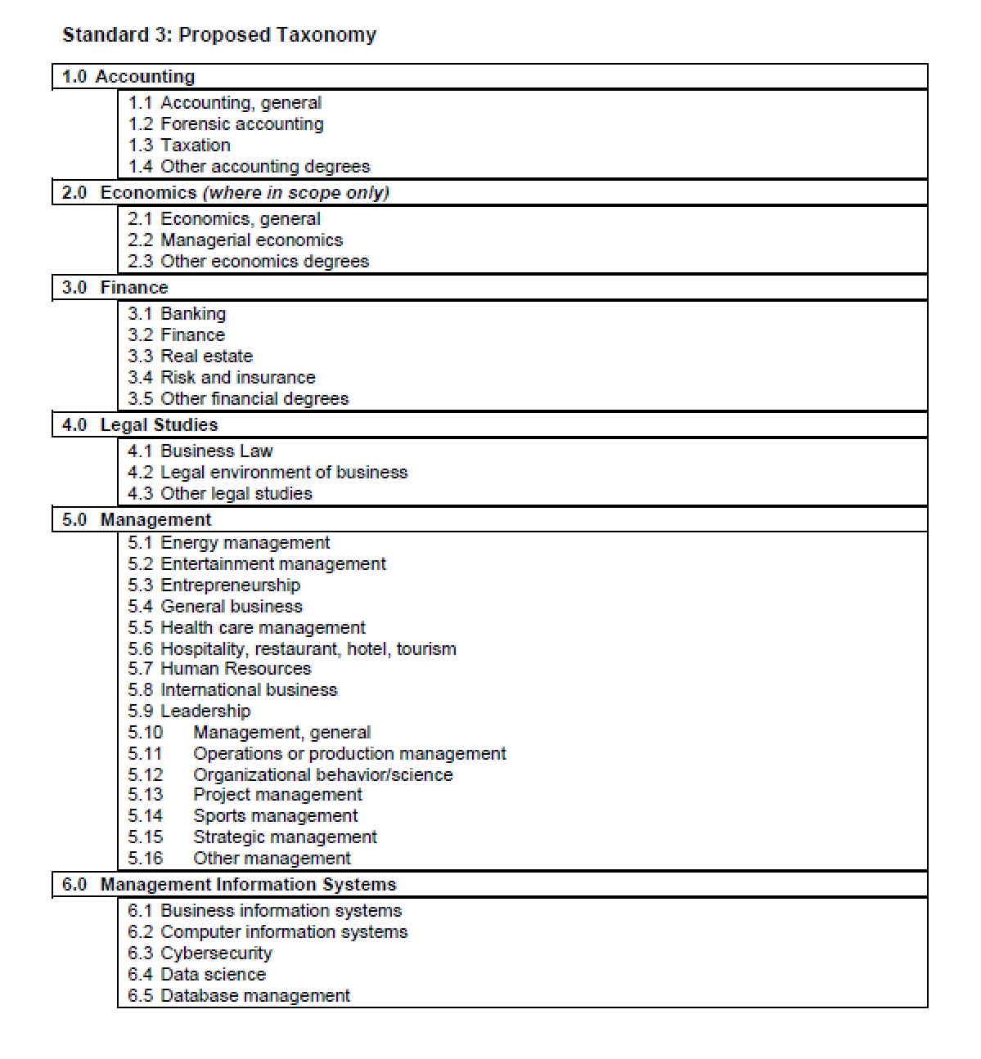
Discipline Taxonomy

Slide 74
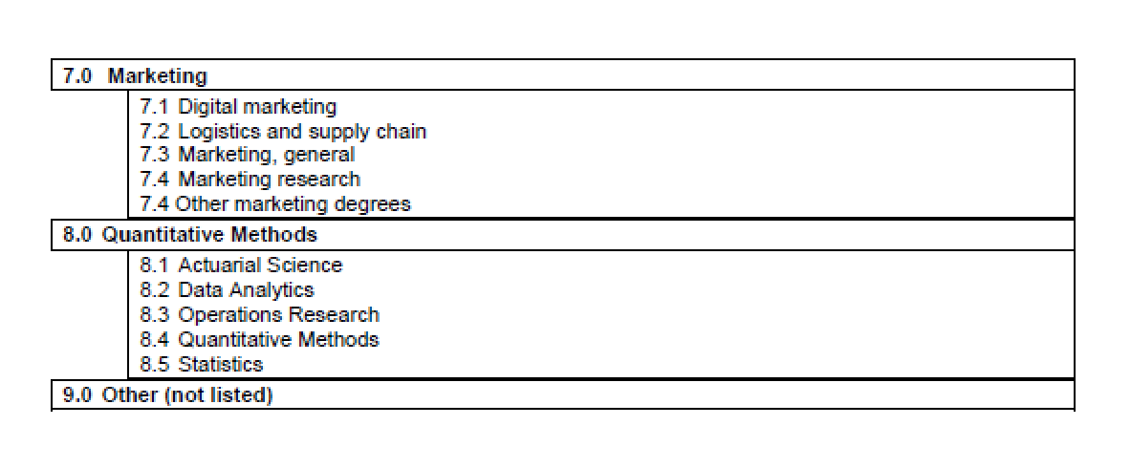
Discipline Taxonomy

Slide 75
Discipline Taxonomy
Same as before only classification is by discipline, not organizational structure, which often yields departmental ratios that are meaningless
The taxonomy includes common fields, courses, modules but does not purport to include every possible subcomponent. Industry specialty offerings are limitless. Placeholders provided where necessary
In preparing tables 3-1, 3-2 and 8-1, faculty should be placed within the appropriate discipline

Slide 76
Learner Success(4-7)

Slide 77
Lifelong Learning: Business and Leadership Education

Slide 78
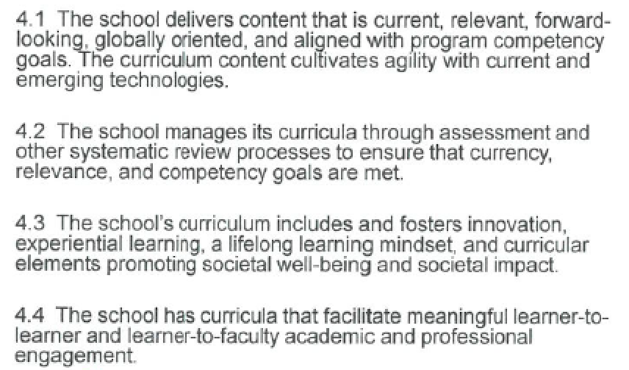
Curriculum
Standard
4
Notes:
Have since deleted Table 4-1 (Current and Emerging Technologies Employed for the Most Recently Completed Normal Academic Year by Degree Program) that was in Exposure Draft #1
New expectation for schools to describe how degree programs include learning experiences that develop competencies related to the integration of information technology.
Expectation that any contents of degree programs (including stackable micro-learning certifications and executive education programs leading to a degree) include relevant competencies to prepare graduates for business and management careers and lifelong learning.
Rationale for changes:
Reinforces the need for students to be technologically agile upon graduation and also more closely aligns with the 2018 accounting standards (Table A6). It is envisioned in the future that this will provide a searchable resource for schools to determine trends in the use of technology.
Addresses changing landscape of degree programs and how degrees can be earned.

Slide 79
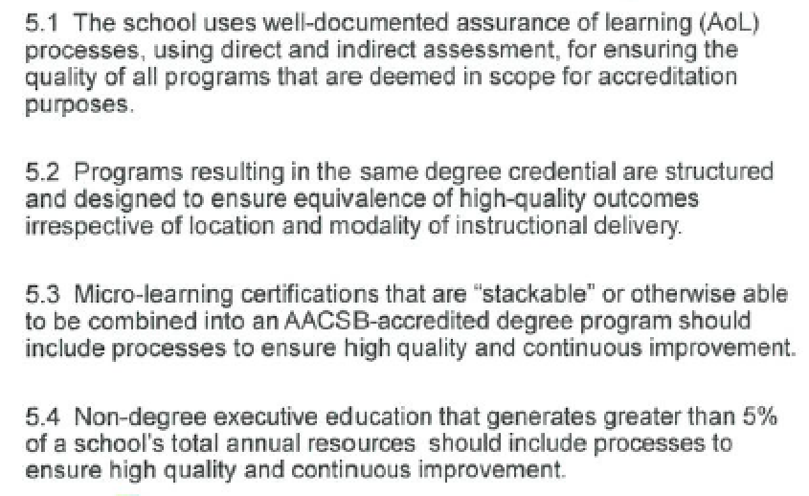
Assurance of Learning
Standard
5
Notes:
Key changes:
Replaced “learning goals” with “competencies,” which is more globally inclusive.
Added language that specialized new and emerging programs may have modified AoL processes.
Added expectation that micro-credentials stacking into a degree program should have appropriate quality assurance processes in place.
Mandates indirect assessments but allows the school to decide in what proportion
Added expectation for schools to provide evidence that faculty are sufficiently and meaningfully engaged in AoL.
Allows for leverage of work done for AoL regional/national regulatory bodies for AACSB purposes. Table 5-1 must still be completed.
Added Table 5-1 (Assessment Plan and Results for Past Five Years)
Rationale for changes:
Focus on competencies aligns with trends in higher education in recent years.
Gives schools greater flexibility already being afforded to them in new or low enrollment programs in terms of AoL.
Recognizes diverse types of business offerings and the need to assure quality for non-degrees that may stack into degrees.
Elevates the importance of indirect measures.
Emphasizes the importance of faculty engagement in AoL.
Aims to streamline AoL processes required for both national/regional bodies as well as AACSB.
Ensures consistent reporting of important AoL data by schools.

Slide 80
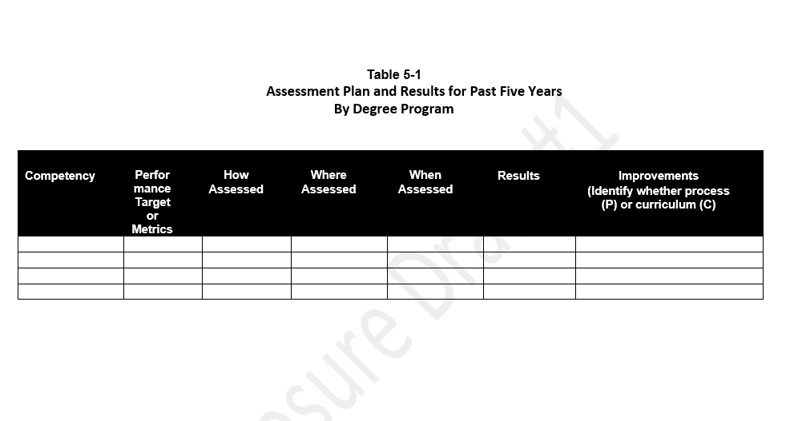
Table 5-1
Notes:
The purpose of this table is to standardize reporting and ease the cognitive load.

Slide 81
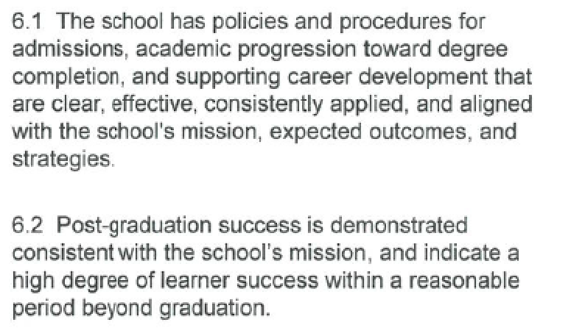
Learner Development
Standard
6
Notes:
Suzanne
Key changes (minimal changes – much of this carried over from Current Standard 4 as it was all still very relevant).
Added expectation that post-graduate success indicate a high degree of learner success within a reasonable period beyond graduation.
Rationale for change:
Aligns with the more outward and outcomes focused nature of the 2020 standards.

Slide 82
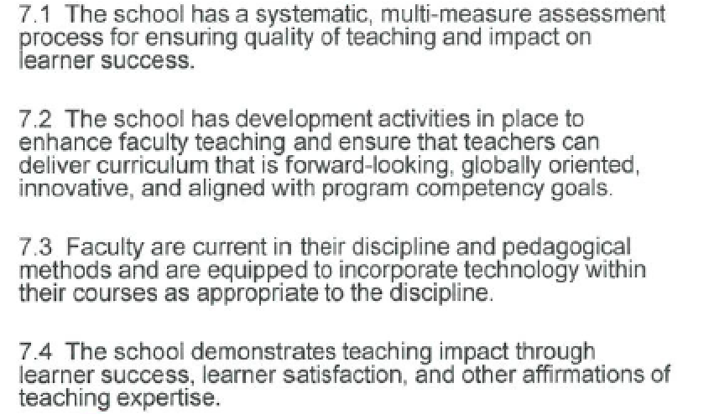
Teaching Effectiveness and Impact
Standard
7
Notes:
Key changes:
Added emphasis on impact and outcomes vs. focus solely on policies and processes for enhancing teaching effectiveness.
Rationale for change:
Aligns with the more outward and outcomes focused nature of the 2020 standards by focusing beyond just processes related to teaching effectiveness.

Slide 83
Thought Leadership (8-9)

Slide 84
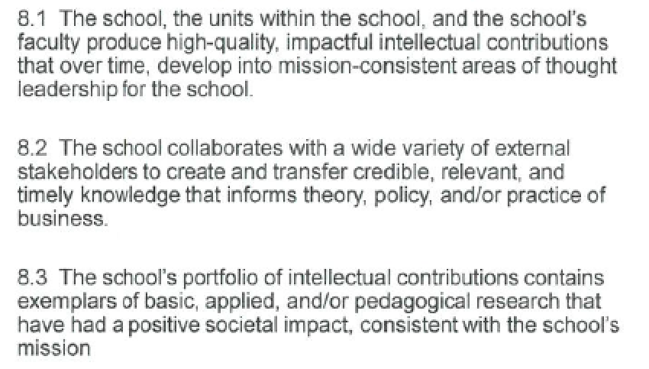
Impact of Scholarship
Standard
8
Notes:
This standard has changed since Exposure Draft #1
Key changes:
Added definitions for basic, applied and pedagogical research.
Increased recognition of a broad range of intellectual contribution types which relate to a school’s strategy, mission and thought leadership focus.
Added expectation that schools should have policies in place regarding publishing predatory journals.
Revised current Table 2-1 (now 8-1) to provide a higher view of types of intellectual contributions. Eliminated expectation that the majority of intellectual contributions are PRJs.
Added expectation that the portfolio of research produced by a school should include examples of Ics that have had a positive impact on society and have practical implications.
Rationale for changes:
Addresses a common question from the schools on the difference between applied and pedagogical research.
Greater recognition of other types of intellectual contributions a school may engage in within its mission context, beyond traditional academic publications.
Addresses current challenges related to predatory journals.

Slide 85
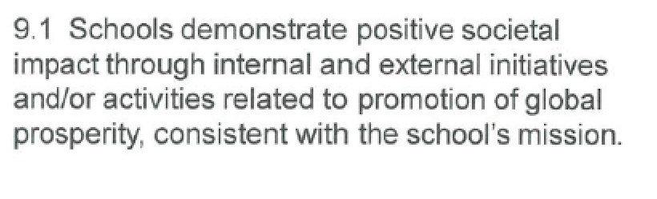
Engagement and Societal Impact
Standard
9
Notes:
This is a new standards that has been added since Exposure Draft #1.
Expects schools to provide thought leadership that supports external communities, enhances business practice and addresses real issues facing society.
We heard repeatedly from the task force as well as membership as a whole that they felt it was important to addresses the need for schools to more thoughtfully engage with business and society.
Examples in the IG:
Sustainable development goals
Consulting work that impacts society
Key is it must be promoted or sponsored by the business school.

Slide 86
BATF Key Dates/Project Milestones
Sep. 2019
Exposure draft #1 voted on by Board of Directors
Sep.–Nov. 2019
Comment period on exposure draft #1
Feb. 2020
Exposure draft #2 voted on by Board of Directors
Apr. 2020
Vote on standards
Jul 2020- Jun 2023
Transition Period – Schools with visits have an option of using 2013 or 2020 standards

Slide 87
Transition Plan
Visit Year | 2020 Standards
2020-2021 | Optional (January 2021 visits and later)
2021-2022 | Optional
2022-2023 | Optional
2023-2024 | Required (July 1, 2023 and later)
Notes:
In process schools, work with your staff liaison. All schools will be sent a letter with a recommendation and guidelines for your next visit.
First schools under the new standards are expected to be Spring 2021.

Slide 88
What’s Next
Continuing engagement of members through:
Peer-to-peer discussion
Public comment period closed 11/16 for ED 1
Ongoing BATF communications program
Volunteer Training and Process Changes will follow Standards adoption (post-ICAM)
Upcoming opportunities for member engagement:
Associate Deans Conference (November 13-15, New Orleans)
Deans Conference (February 2-4, 2020, Nashville)
Online (email feedback to BATF@aacsb.edu)
Notes:
Parallel discussions are continuing regarding process changes and volunteer training, the other 2 legs of the 3-legged stool that is “Re-imagining Accreditation.”

Slide 89
Key Dates
BATF Milestone | Date(s)
Exposure Draft #1 Feedback Period | September 16-November 16, 2019
Exposure Draft #2 Release | February 3, 2020 (in conjunction with Deans Conference)
Exposure Draft #2 Feedback Period | February 3-March 4, 2020
Vote on 2020 Standards | April 27, 2020 (in conjunction with ICAM)

Slide 90
THANK YOU!
Amy.Memon@aacsb.edu
Public comments go to
BATF@aacsb.edu
Notes:
Presenters can direct questions to me. Public comment input should go to BATF@aacsb.edu so we can adequately track comments.

