Slide 1
SEAA International Accreditation Conference
Mark Stoddard
Director of Accreditation & Business School Services
November 2018

Slide 2
SEAA Accreditation Conference
Overview
Overview
AMBA
Accreditation Overview
Accreditation Criteria & Process
AMBA Development Network

Slide 3

SEAA Accreditation Conference
AMBA

Slide 4
SEAA Accreditation Conference
AMBA
AMBA History
Formed in 1967
Head Office in London UK
Official charity
Multiple Stakeholders: Graduates, Students, Employers & Business Schools
Consumer advocate
Mission: “To Advance Postgraduate Education Globally”
Accreditation since 1990s
2017: 50th Anniversary: The Year of the MBA

Slide 5
SEAA Accreditation Conference
Accreditation Process
Future Strategy
Limit to 300 Schools
Ensure Exclusive Network
Launch BGA

Slide 6

SEAA Accreditation Conference
Accreditation Process

Slide 7
SEAA Accreditation Conference
AMBA Accreditation
Guiding Principles
International
Developmental
Quality Enhancement
Programme Specific
Stakeholder-focused
Consistency

Slide 8

SEAA Accreditation Conference
Accreditation Process

Slide 9
SEAA Accreditation Conference
AMBA Accreditation
General Management Portfolio
MBA – post-experience, postgraduate general management degrees
MBM – pre-experience, postgraduate general management degrees
DBA – post-experience doctoral applied general management degrees

Slide 10
SEAA Accreditation Conference
AMBA Accreditation
Key Quantitative Criteria
History
At least one MBA programme should have a minimum track record of three years of graduating students before the school’s portfolio can be assessed
Cohort Size
Each programme should enrol at least 20 students
Faculty with PhDs
At least 50% of the faculty (including regularly visiting faculty counted as part of the total) are expected to have a PhD degree
Student Work Experience
All admitted MBA students should have at least three years of full-time post-graduation work experience; five year average
Curriculum
An MBA should comprise 500 contact hours and 1,800 student learning hours
An MBM should comprise 300 contact hours and 1,800 student learning hours

Slide 11
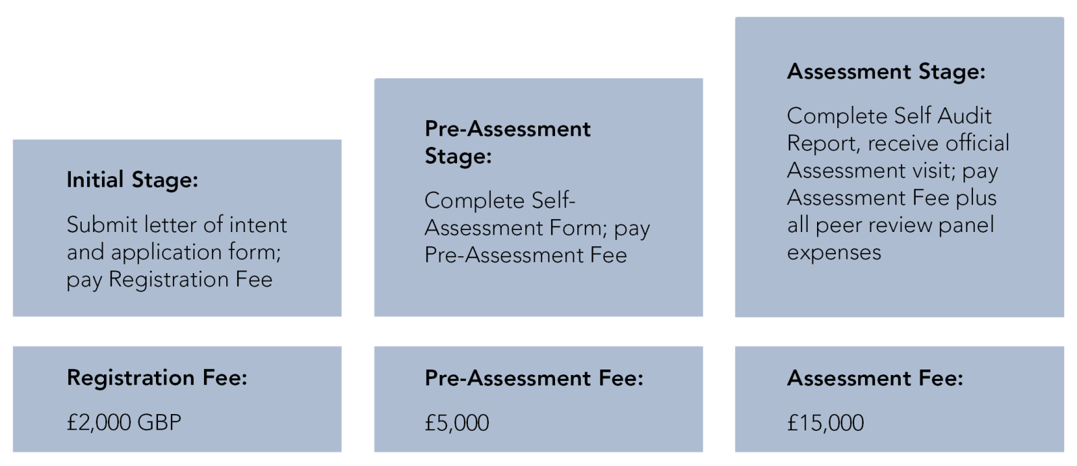
AMBA Accreditation Process / Cost

Slide 12
SEAA Accreditation Conference
Accreditation Process
Accreditation Outcomes
New schools
5 years
3 years
Deferral
Failure
Re-accreditations
2 – 5 years
1 year
Failure

Slide 13
SEAA Accreditation Conference
Accreditation Process
Faculty of Assessors
Peer review process
3 peers + 1 AMBA representative
Balanced teams
Senior staff at accredited schools
Training & development

Slide 14
SEAA Accreditation Conference
Accreditation Process
2015 Criteria Review
Published March 2016
Definition & Competencies
Impact & Output
Innovation
Flexibility
Values & Society

Slide 15
New Accreditation Criteria Launch
22 March 2016
Competencies / Attributes
MBA graduates will have built on their prior professional experience and academic background to acquire a broad base of management knowledge and skills that enables them to:
• Lead themselves and others in the achievement of organisational goals, contributing effectively to a team environment
• Think critically and make decisions based on complex information
• Maximise resources for the benefit of organisations and society
• Know and understand organisations and their stakeholders
• Integrate functional knowledge and apply strategic management skills at a senior level in changing business environments
• Operate effectively in cross-cultural settings
• Understand the complexities of business ethics in a global environment and act with integrity
• Analyse complex data, understanding the financial implications of managerial decision-making

Slide 16
New Accreditation Criteria Launch
22 March 2016
10 Guiding Principles
1: The MBA Portfolio - In order to ensure clarity and transparency in the marketplace, all programmes awarded by the institution bearing the designation MBA must be submitted for accreditation.
2: Institutional Integrity, Sustainability & Distinctiveness - The Institution offering an MBA must be sustainable, financially viable, and committed to quality and continuous improvement. It should possess a distinctive market identity which provides the basis for a high quality and successful MBA portfolio.
3: Faculty Quality and Sufficiency - The Institution must be able to provide the MBA portfolio with sufficient and balanced expertise in teaching, research and consultancy that guides the MBA learning experience in a cohesive and integrated way.
4: Programme Design & Leadership - Each MBA programme must be supported and periodically reviewed in a systematic way, with sufficient academic oversight and operational support. The MBA should be designed to represent best practice in management education, taking into account market trends and practices.
5: The Student Cohort Experience - The MBA is designed to be a postgraduate, post-experience qualification for high potential leaders; the admissions process must be rigorous in ensuring that an appropriate, sustainable and diverse cohort is recruited and maintained.

Slide 17
New Accreditation Criteria Launch
22 March 2016
10 Guiding Principles
6: Competences, Graduate Attributes & Learning Outcomes - The MBA should have clearly articulated learning outcomes which can be measured and mapped through to course learning outcomes and assessment. Outcomes should broadly reflect AMBA MBA attributes and be aligned to the mission of the Institution.
7: Curriculum Breadth & Depth - The MBA curriculum should be comprehensive and integrative, and clearly delivered at the Masters level.
8: Assessment Rigour & Relevance - The MBA assessment strategy must be robust, varied and to standards that are consistently applied at the Masters level.
9: Delivery & Interaction - In order to develop sufficient generalist management knowledge, skills and values, the MBA programme requires substantial interaction between faculty and the cohort group, in addition to providing appropriate space for private study and reflection.
10: Impact & Lifelong Learning - Graduates should be able to demonstrate significant career enhancement as a result of their MBA and should be supported in their continual development by the Institution.

Slide 18
SEAA Accreditation Conference
Accreditation Process
Current Focus (Institution)
Differentiation & USPs (school and MBA)
Continuous improvement (developments since last assessment)
Faculty integration

Slide 19
SEAA Accreditation Conference
Accreditation Process
Current Focus (Programmes)
Purpose & Outcomes
Feedback loop
Masters level – process & evidence
© - sustainability, CSR, ethics & risk
Programme integration
Formative feedback

Slide 20
SEAA Accreditation Conference
Accreditation Process
Services
Free AMBA membership for all graduates
Careers & Recruitment fairs
Benchmarking Data
Thought Leadership
Exclusive Access to AMBA Community
  Networking
  Partnerships
Detailed listing on AMBA website
Full Discount Member rates at events

Slide 21

Presentation Title
Section Title

Slide 22
SEAA Accreditation Conference
AMBA Development Network
Definition
AMBA’s membership proposition
The AMBA Development Network allows high potential and aspiring business schools who do not yet meet accreditation standards to formally become part of – and engage with – the global AMBA network.
Joining the ADN enables business schools to leverage the strength and support of this exclusive network.

Slide 23
SEAA Accreditation Conference
AMBA Development Network
Services
Eligibility for Mentorship scheme (subject to status)
Waiver of initial Accreditation Application Fee
Access to unique MBA benchmarking data
Listing / profile on AMBA’s website
Reduced rates at all AMBA events
Membership of the ADN Community – AMBA’s online networking
platform
Opportunities for structured interaction with AMBA’s accredited
network
Access to the latest AMBA thought leadership
Opportunity to post business school job opportunities via AMBA
platforms

Slide 24
SEAA Accreditation Conference
AMBA Development Network
Further Details
Annual Fees
£3,500 South Asia
£4,750 RoW
Eligibility
Be recommended by at least one currently accredited school
Provide evidence of national market credibility, financial sustainability and institutional continuity
Demonstrate commitment to continuous improvement, and to a postgraduate, post-experience MBA

Slide 25
SEAA Accreditation Conference
Conclusion
Contact
Mark Stoddard
Director of Accreditation & Business School Services
AMBA
m.stoddard@mbaworld.com
+44(0)-207-246-2697
www.mbaworld.com/accreditation
www.mbaworld.com/adn

